Slide 1

Medida I
Ordenanza sobre el cuidado infantil y la Salud de los Niños del Condado de Sonoma
Consejo Asesor Comunitario
26 de Junio 2025

Slide 2

Hoy, la Comisión de First 5 del Condado de Sonoma y el Consejo Asesor de la Medida I se complacen en reunirse en las tierras ancestrales del Pueblo Pomo del Sur. Celebramos la labor activa de sus descendientes para preservar y fomentar su cultura e identidad indígenas.
Reconocemos al Pueblo Pomo del Sur como los administradores y custodios tradicionales de esta área y honramos con gratitud la tierra misma, a todos sus antepasados: pasados, presentes y futuros.
Reconocimiento de tierras ancestrales

Slide 3
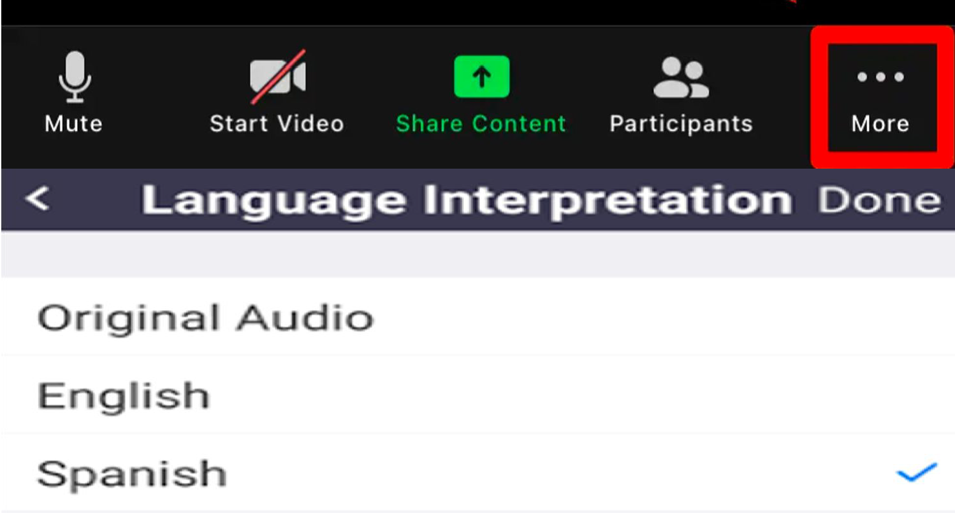
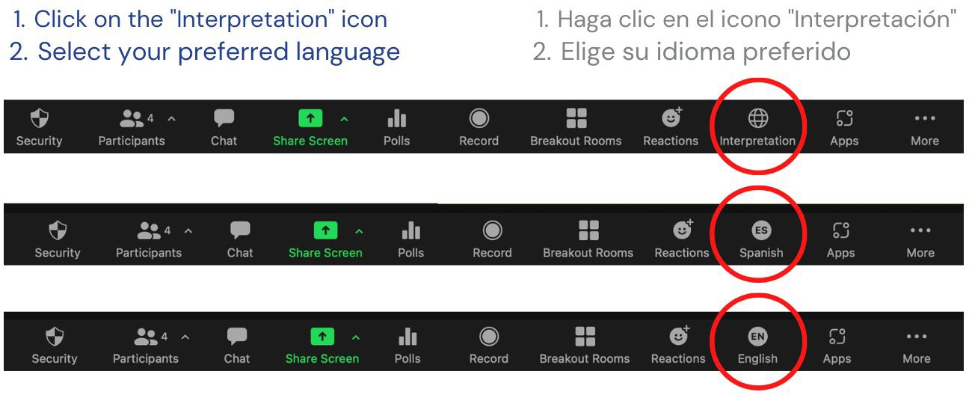
Welcome! ¡Bienvenidos!
Zoom Interpretation/Interpretación de Zoom
Computer / Computadora
Phone / Por Telefono

Slide 4
Revisión de la Agenda
y
Aprobación de las Act
Notes:
Approve May 22, 2025 CAC Meeting Minutes (3:05-3:10)
ADRIANA
Per the CAC Bylaw, there needs to be ⅔ of the attending members present to pass a vote. Today we have “ “ so we need at least “ “ to pass a vote.
Explain process for approving the minutes and then implement:
Ask members if they have edits to the minutes?
Take the edits/discussion if CAC agrees on edits
Public comment
If public comments make edits, then ask CAC members if they want to accept the edits proposed.
“Are we ready to take a vote?” (assuming yes)
“We are voting to approve the minutes (as amended)”
Ask members to Thumbs UP or Down
Summarize the vote (X = Yes; Y = No)
This passes (need 7 to pass; change number based on bylaws if needed re attending members)
ACTION ITEM
Review Agenda & Purpose/Goals for Meeting
Just to ground us in the role of the Council before we get into the purpose of today’s meeting and the agenda:
The Measure I Community Advisory Council was established by the Board of Supervisors to provide input and recommendations to First 5 staff and commission in their role as the administrator of Measure I.
You were each appointed to bring your content expertise around ECE or children’s health or perinatal mental health and/or your lived experience as a parent or provider to the table collaboratively form advisory recommendations as a Council. This is quite different from a roundtable or a focus group, which is much more informal and elevates the opinions of individuals over the consensus of the group.
As an appointed body, the CAC serves as a critical sounding board for staff and a formal, public opportunity to discuss recommendations around the goals and strategies, funding levels and evaluation of impact.
So today, after we read the community agreements, which we want to do at the beginning of every meeting, we’ll vote on the amended bylaws, then we’ll hear a report from First 5 staff about Commission actions around CAC recommendations.
After that, Christina will spend about 15 minutes to review some high level data points related to quality Early Care and Education in Sonoma County.
The main item for today will be presentation, followed by a discussion and Council action around proposed investments in the 5-year plan related to expanding access to Quality ECE.

Slide 5
Acuerdos Comunitarios

Slide 6

Public comment
on non-agendized items
Comentarios públicos sobre temas no incluidos en la agenda

Slide 7
Guidelines for Public Comment
Directrices para los comentarios públicos
Public comments are brief statements intended to inform the CAC and First 5 about the topic/Action Item
Comments from the public at public meetings do not include questions and is not intended to be a dialogue
Appointed Council members and First 5 staff and consultants are discouraged from responding or discussing topics with the public (can potentially constitute a Brown Act violation)
Time limits can (and typically will) be imposed per comment and/or for total time allotted
Los comentarios públicos son declaraciones breves destinadas a informar al CAC y a First 5 sobre el tema o punto de acción.
Los comentarios del público en reuniones públicas no incluyen preguntas y no están destinados a ser un diálogo.
Se desalienta a los miembros designados del Consejo, al personal de First 5 y a los asesores de responder o discutir temas con el público (ya que podría constituir una violación de la Ley Brown).
Se pueden imponer límites de tiempo por comentario y/o para el tiempo total asignado (y típicamente se impondrán).
Notes:
Public comments are brief statements intended to inform the CAC and First 5 about the topic/Action Item
Comments from the public at public meetings do not include questions and is not intended to be a dialogue
This means that after you make your comment, we will go to the next comment without discussion about your comment
Appointed Council members and First 5 staff and consultants are discouraged from responding or discussing topics with the public (can potentially constitute a Brown Act violation)
Time limits can (and typically will) be imposed per comment and/or for total time allotted
Approval of April 24, 2025 CAC Meeting Minutes
As a reminder, the way that CAC approves an item, is that a CAC member makes a motion. So in this case, a member would say, I make the motion to approve the April 24th Meeting Minutes. Then, somebody would 2nd the motion simply by saying “I second the motion.” Then we would see if there is any discussion or public comment, and then the group votes.
Per the CAC Bylaw, there needs to be ⅔ of the attending members present to pass a vote. Today we have “ “ so we need at least “ “ to pass a vote.
would somebody like to make a motion?
Angie - Welcome
Review Agenda
Public Comment - Items that are NOT on the agenda

Slide 8
Informe del Personal de First 5 del Condado de Sonoma
Notes:
ANGIE

Slide 9
Aprobación de los Estatutos Enmendados
Notes:
ADRIANA
Ask members if they have questions?
CAC Discussion (Q&A with F5 Staff if needed)
Public comment
If public comments make edits, then ask CAC members if they want to accept the edits proposed.
“Are we ready to take a vote?” (assuming yes)
“We are voting to approve the the CAC Bylaws (as amended)”
Ask members to Thumbs UP or Down
Summarize the vote (X = Yes; Y = No)
This passes (need 7 to pass)
ACTION ITEM

Slide 10
Informe del Personal de First 5 del Condado de Sonoma:
Hallazgos de la Participación Comunitario

Slide 11





Cronograma de la Participación Comunitaria
Grupo de Trabajo de Sistemas de Aprendizaje Temprano
Grupo de Trabajo de Sistemas de Aprendizaje Temprano
Sesión de Escucha sobre Educación y Cuidado Temprano
Abril-junio 2024
Oct-Diciembre 2024
Abril-junio 2025
Jul-Sep 2024
Enero-Mar 2025
Grupo de Trabajo de Sistemas de Aprendizaje Temprano
-Grupo de Trabajo de Sistemas de Aprendizaje Temprano
-Grupos de enfoque de Equity First
-Encuesta de Alianza FCCH
-Reunión del Consorcio de Calidad (QC)
Notes:
EL Systems Workgroup
Convened for 8 meetings between May 2024-February 2025
5/10, 6/28, 8/21, 10/15, 10/28, 11/15, 12/3, 2/5
Development of Recommendations for EL Systems Investments - “Shovel-ready” in Years 1 & 2
Categorized needs by visibility and feasibility
Alianza - Enrollment needs among licensed Family Child Care Homes - March 2025
To better understand provider capacity and enrollment needs across the region, we asked licensed family child care homes to share how many spaces they currently need to fill. In total, 22 providers responded, representing four geographic regions: Santa Rosa, Windsor, Rohnert Park, and Sebastopol.
Santa Rosa had the highest number of providers (18 in total) reporting open spaces.
Significant unfilled capacity exists across the region
Out of 22 providers, 12 (55%) reported needing to fill 4 or more spaces.
This suggests that over half of the participating providers are operating significantly below capacity, potentially impacting financial sustainability.
Most providers are operating below capacity
Only 5 providers (23%) reported needing to fill just 1 space, suggesting most are not nearing full enrollment.
The remaining 77% (17 providers) need to fill 2 or more spaces, with a majority needing 4 or more.
Santa Rosa represents the largest share of reported need
18 of the 22 providers (82%) are located in Santa Rosa.
Collectively, Santa Rosa providers reported 82 open enrollment spaces, accounting for the bulk of the regional total.
May 2025

Slide 12
Hallazgos de la participación comunitaria:
Grupo de Trabajo de Sistemas de Aprendizaje Temprano
Aceso
Fuerza laboral
Apoyo para la Alta Calidad
Instalaciones y Entorno de Aprendizaje
Infraestructura y Coordinación
Notes:
EL Systems Workgroup
Convened for 8 meetings between May 2024-February 2025
5/10, 6/28, 8/21, 10/15, 10/28, 11/15, 12/3, 2/5
Development of Recommendations for EL Systems Investments - “Shovel-ready” in Years 1 & 2
Categorized needs by visibility and feasibility
Alianza - Enrollment needs among licensed Family Child Care Homes - March 2025
To better understand provider capacity and enrollment needs across the region, we asked licensed family child care homes to share how many spaces they currently need to fill. In total, 22 providers responded, representing four geographic regions: Santa Rosa, Windsor, Rohnert Park, and Sebastopol.
Santa Rosa had the highest number of providers (18 in total) reporting open spaces.
Significant unfilled capacity exists across the region
Out of 22 providers, 12 (55%) reported needing to fill 4 or more spaces.
This suggests that over half of the participating providers are operating significantly below capacity, potentially impacting financial sustainability.
Most providers are operating below capacity
Only 5 providers (23%) reported needing to fill just 1 space, suggesting most are not nearing full enrollment.
The remaining 77% (17 providers) need to fill 2 or more spaces, with a majority needing 4 or more.
Santa Rosa represents the largest share of reported need
18 of the 22 providers (82%) are located in Santa Rosa.
Collectively, Santa Rosa providers reported 82 open enrollment spaces, accounting for the bulk of the regional total.

Slide 13

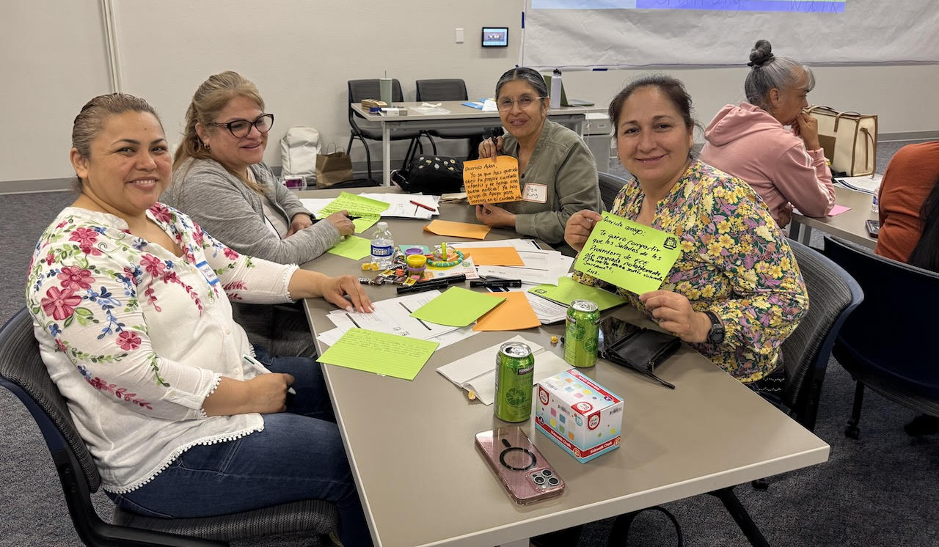
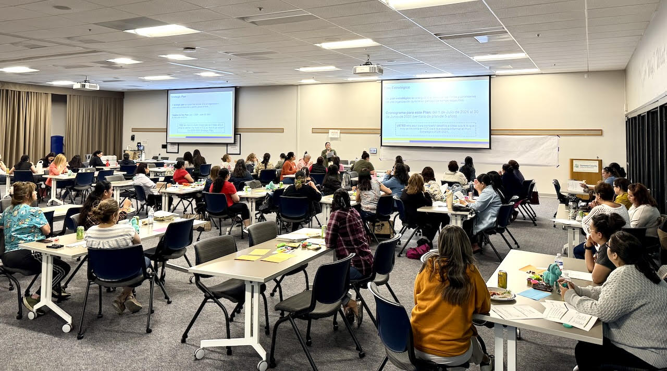
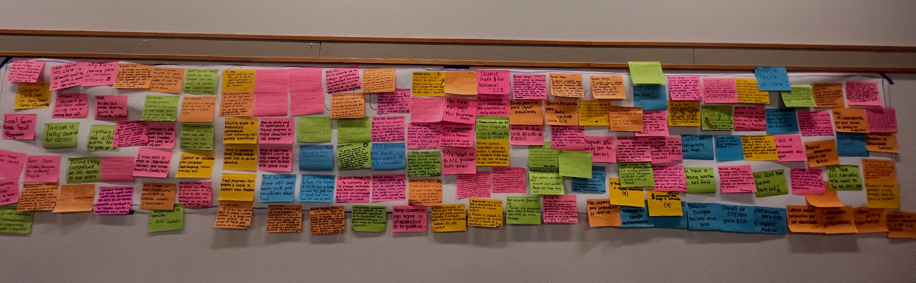
Hallazgos de la participación comunitaria:
Sesión de Escucha sobre Educación y Cuidado Temprano
Notes:
how many people, key themes, and pictures from event
~60 Participants
Center, Home-Based providers, and Alternative Setting Providers

Slide 14
Hallazgos de la participación comunitaria:
Temas de la Sesión de Escucha sobre Educación y Cuidado Temprano (ECE)
Acceso
Cuidado Universal de Alta Calidad y Becas para Familias
Fuerza Laboral
Compensación, Educación y Reclutamiento
Apoyo para la Alta Calidad
Desarrollo Profesional y Asesoramiento (Coaching)
Instalaciones y Entorno de Aprendizaje
Subvenciones
Apoyos Integrales para las Familias
Talleres de Educación para Padres, Estipendios para Familias
Notes:
Access:
Universal High-Quality Care
Family Scholarships
Workforce:
Wages - Funding the subsidy care gap to account for the true cost of care; especially for infant and toddler care; higher salaries to adjust to SoCo’s living costs.
Benefits - Retirement, sick pay, paid time off, insurance
Substitute Pool
Funding for floating staff at centers and assistants in FCCHs
Education - Free courses/paid tuition or scholarships; coursework to better prepare for serving students with disabilities;
Increase and retain the workforce -
Support for High-Quality:
Local food program
Supporting children with disabilities
Coaching and mentorship opportunities
Facilities & Learning Environments:
Grants for facility improvements
Challenges with leasing spaces
Wrap-around Family Supports:
Support with basic resources
Respect and Recognition
Feeling valued and recognized as an educator
QC Consortium - Designing an Equitable ECE Workforce Pipeline for Sonoma County

Slide 15
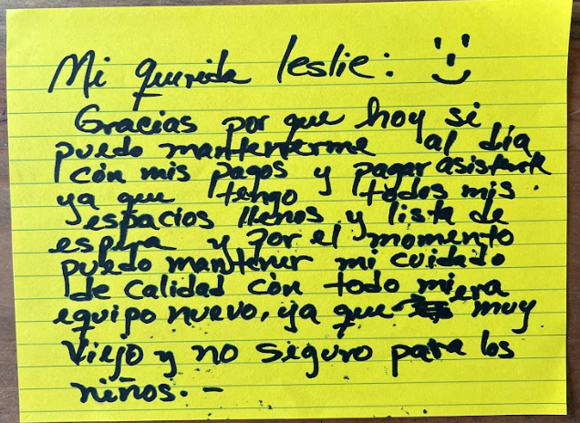




Hallazgos de la participación comunitaria:
Sesión de Escucha sobre Educación y Cuidado Temprano
Notes:
Leslie
Access:
Universal High-Quality Care
Family Scholarships
Workforce:
Wages - Funding the subsidy care gap to account for the true cost of care; especially for infant and toddler care; higher salaries to adjust to SoCo’s living costs.
Benefits - Retirement, sick pay, paid time off, insurance
Substitute Pool
Funding for floating staff at centers and assistants in FCCHs
Education - Free courses/paid tuition or scholarships; coursework to better prepare for serving students with disabilities;
Increase and retain the workforce -
Support for High-Quality:
Local food program
Supporting children with disabilities
Coaching and mentorship opportunities
Facilities & Learning Environments:
Grants for facility improvements
Challenges with leasing spaces
Wrap-around Family Supports:
Support with basic resources
Respect and Recognition
Feeling valued and recognized as an educator
QC Consortium - Designing an Equitable ECE Workforce Pipeline for Sonoma County

Slide 16
Acceso Equitativo a la Educación Infantil de Calidad
Medida I CAC
26 de Junio de 2025
Notes:
Topic Focus: Equitable Access to Quality ECE
Understanding what “Equitable Access” means in ECE
Indicators of ECE capacity, utilization, and quality
Share Back: What we have heard from Stakeholders
Recommendations from Early Learning Systems Investment workgroup and others
Action: Draft recommendations related to Equitable Access to High-Quality ECE

Slide 17
"Trabajo en el campo [y] entramos muy temprano, pero el lugar donde dejo a mis hijos para el cuidado de niños está abierto de 7:00 am a 5:00 pm y esto es muy difícil para mí porque tengo que pedir [a] llegar una hora tarde al trabajo para poder dejarlos."
Participante del Grupo de Enfoque de Padres
(Evaluación de Necesidades 2024-2025 del CCPC del Condado de Sonoma)

Slide 18
Marco para el Acceso Equitativo

Slide 19
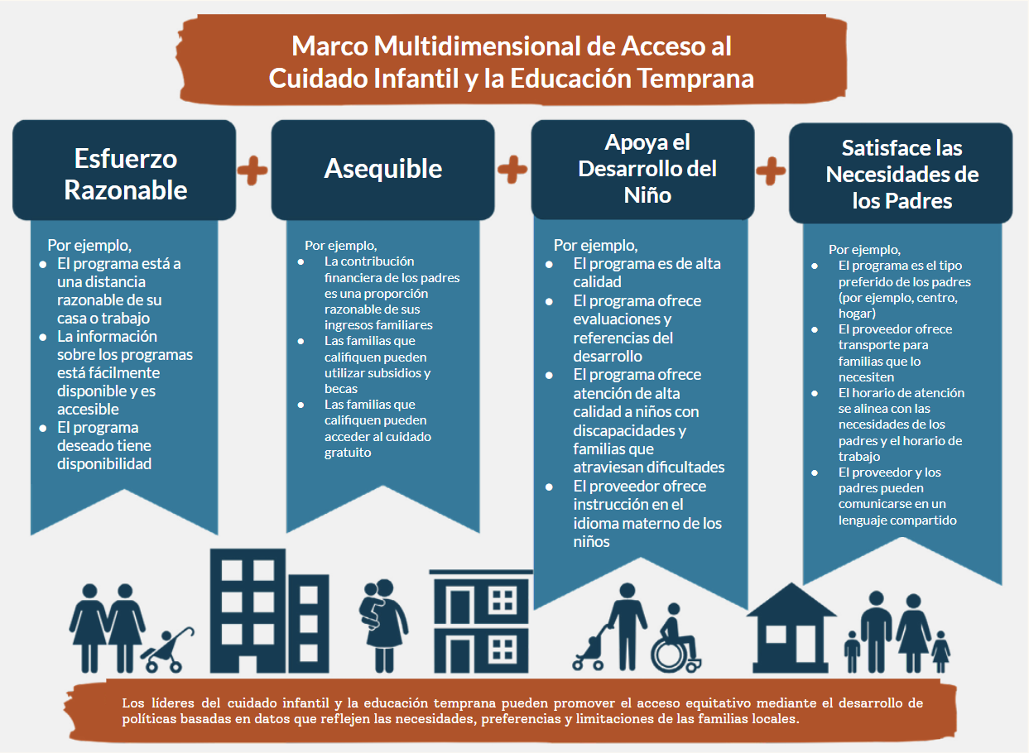
Marco para el acceso equitativo
“El acceso significa que los padres, con un esfuerzo razonable y capacidad económica, pueden inscribir a sus hijos en un programa que apoye su desarrollo y satisfaga sus necesidades.”
Pascall, K. y Maxwell, K. (2022) Definición y medición del acceso al cuidado infantil y la educación temprana, considerando a las familias. Informe. Administración para Niños y Familias.

Slide 20
Disponibilidad de Cuidado

Slide 21





Tipos de entornos de cuidado y educación temprana
Cuidado informal
(sin licencia/exento de licencia)
Guardería infantil familiar (con licencia)
Cuidado en un centro
(Con licencia)
Preescolar del Distrito
(Exento de licencia)
Jardín de Infantes de Transición
El FCCH pequeño puede atender hasta 8 niños
El FCCH grande puede atender hasta 14 niños
El número de niños atendidos depende de la edad de los niños a cargo.
Se ofrece en entornos comunitarios (no en el hogar) y puede ser en una o más aulas
Esto puede ofrecerse en un centro escolar
Ubicado en un recinto escolar y administrado por la Agencia Local de Educación (LEA)
Un "nuevo" grado que no es compensatorio.
Las escuelas deben atender a todos los alumnos que cumplan 4 años antes del 1 de Septiembre
Familia, amigo o vecino
Entornos alternativos (p. ej., grupos de juego para cuidadores, programas de enriquecimiento de ECE, visitas domiciliarias, etc.)
Notes:
2 min
18/30
Christina
This slide is background information on TYPES OF CARE that may not be known by folks in the room who are not as familiar with early care and education
You will see that we broke out district offered preK due to the lic differences - they do have guidelines and regulations of course but it is a little different than most other center based preschools
For center based care, we mean programs such as Head Start and private centers
Alternative Settings/Informal Care:
Programming that is offered to support children’s development, but that does not require a license by the caregiver. Including but not limited to:
Parent/caregiver and child play groups
Family together literacy program
ECE enrichment programs
Home visiting

Slide 22
¿Cómo se financia la educación infantil temprana en diferentes entornos?
Cuidado informal
(sin licencia/exento de licencia)
Guardería infantil familiar (con licencia)
Cuidado en un centro
(Con licencia)
Preescolar del Distrito
(Exento de licencia)
Jardín de infancia de transición
Pago privado
No pagado
Subsidio (Cupones de Pago Alternativos, también llamados Cupones AP)
Pago privado
Subsidio (Cupones AP)
Pago privado
Subsidio (AP, Head Start, CSPP, CCTR, etc.)
CCTR = Programas Generales de Cuidado y Desarrollo Infantil
CSPP = Programa Preescolar del Estado de California
Subsidio: CSPP
Gratuito (financiado a través de la Proposición 98, financiación de la educación)

Slide 23
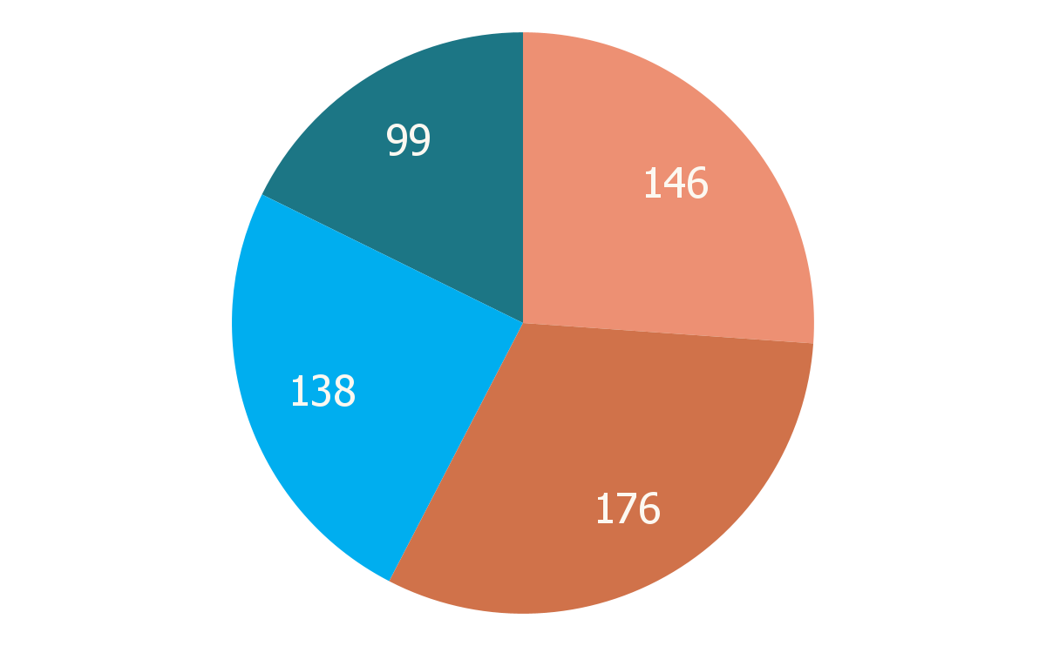
El panorama del cuidado infantil en el condado de Sonoma*
El condado de Sonoma contaba con 559 programas de cuidado y educación temprana en 2024:
Esto representa un fuerte descenso respecto a 2019:
El número de proveedores con licencia disminuyó un 10.4% (624 → 559 proveedores).
El número de plazas disminuyó un 30% (20,937 → 14,759 plazas).
* Esto no incluye a los nuevos niños atendidos por el Jardín de Infancia de Transición (TK).
Centros exentos de licencia
Centros con licencia
FCCH
Grandes
FCCH pequeños
*Fuente: Evaluación de Necesidades de Aprendizaje y Cuidado Temprano del Condado de Sonoma 2025
Notes:
Except for large family child care homes, which increased their total number of slots by 436 to 1,476 total slots in 2024, all other provider types experienced a sharp decline. As of 2024, small family child care homes declined 22% to 1,236 slots, while centers and license-exempt centers combined declined by 34% to 12,047 slots.

Slide 24
Demanda de cuidado

Slide 25
Atención subsidiada
2,895
955
Niños (de 0 a 5 años) en la Lista Centralizada de Elegibilidad, lista de espera para plazas subsidiadas de cuidado infantil temprano.*
Niños de 0 a 4 años inscritos en atención subsidiada, o el 13% de los niños.*
*Fuente: Evaluación de Necesidades de Aprendizaje y Cuidado Temprano del Condado de Sonoma 2024-2025; a enero de 2025
Notes:
As of January 2025, children ages 0-2 made up the largest proportion of children on the CEL (614 children or 42.4% of total list), followed by children ages 5-12 (493 children or 34.0% of the total list) and children ages 3-4 (341 children or 23.5% of total list); however it is important to note that the total number of children on early care and education waitlists in the county exceeds these numbers, because programs especially those who enroll private pay families typically have their own waitlists.

Slide 26
Necesidad insatisfecha de cuidado infantil - Bebés*
91.8%
86%
Necesidad insatisfecha de cuidado infantil subsidiado para niños de 0 a 2 años.
Necesidad insatisfecha de cuidado infantil, generalmente para niños de 0 a 2 años.
*Fuente: Evaluación de Necesidades de Aprendizaje y Cuidado Temprano del Condado de Sonoma 2024-2025
Notes:
Child care deserts are areas where there is an insufficient supply of licensed child care to meet community needs. Child care deserts disproportionately impact low-income households, communities of color, and non-English-speaking households. These families face additional barriers such as lack of transportation, nontraditional work hours, and a shortage of bilingual providers

Slide 27
Necesidad insatisfecha de cuidado infantil - Preescolar*
64.7%
8.8%
Necesidad insatisfecha de cuidado infantil subsidiado para niños de 3 a 4 años.
Necesidad insatisfecha de cuidado infantil, generalmente para niños de 3 a 4 años.
*Fuente: Evaluación de Necesidades de Aprendizaje y Cuidado Temprano del Condado de Sonoma 2024-2025; los datos corresponden a 2020 y no incluyen el programa de TK.
Notes:
Child care deserts are areas where there is an insufficient supply of licensed child care to meet community needs. Child care deserts disproportionately impact low-income households, communities of color, and non-English-speaking households. These families face additional barriers such as lack of transportation, nontraditional work hours, and a shortage of bilingual providers

Slide 28

Inscripción en TK
2.531
Los niños se matricularon en TK en el curso escolar 2024-25.*
*Fuente: Datos del Condado de Sonoma 2024-2025 del Departamento de Educación de California, DataQuest

Slide 29
Necesidad de cuidado infantil*
Zonas clasificadas como desiertos de cuidado infantil (una necesidad insatisfecha extremadamente alta):
Valle de Sonoma (74.1%)
Santa Rosa (73.5%)
Cotati/Rohnert Park (71.6%)
Áreas adicionales con necesidades insatisfechas significativas:
Norte del Condado (66.6%)
Sur del Condado (63.4%)
Oeste del Condado (58.1%)
*Fuente: Evaluación de Necesidades de Aprendizaje y Cuidado Temprano del Condado de Sonoma 2024-2025
Notes:
Child care deserts are areas where there is an insufficient supply of licensed child care to meet community needs. Child care deserts disproportionately impact low-income households, communities of color, and non-English-speaking households. These families face additional barriers such as lack of transportation, nontraditional work hours, and a shortage of bilingual providers

Slide 30
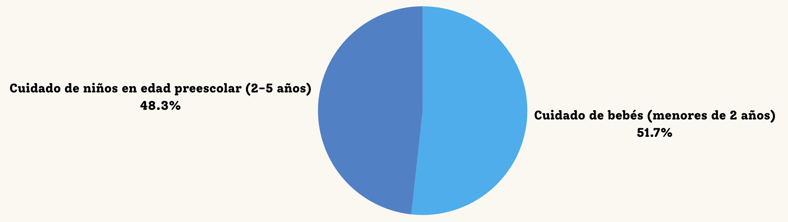
Solicitudes de familias del condado de Sonoma de R&Rs
De las 5,455 solicitudes de atención (para niños menores de 6 años), las familias especificaron el rango de edad de atención que necesitaban.
*Fuente: Evaluación de Necesidades de Aprendizaje y Cuidado Temprano del Condado de Sonoma 2024-2025
** Datos de Marzo de 2023 a Marzo de 2024
Notes:
The majority of these requests were for full-time care

Slide 31
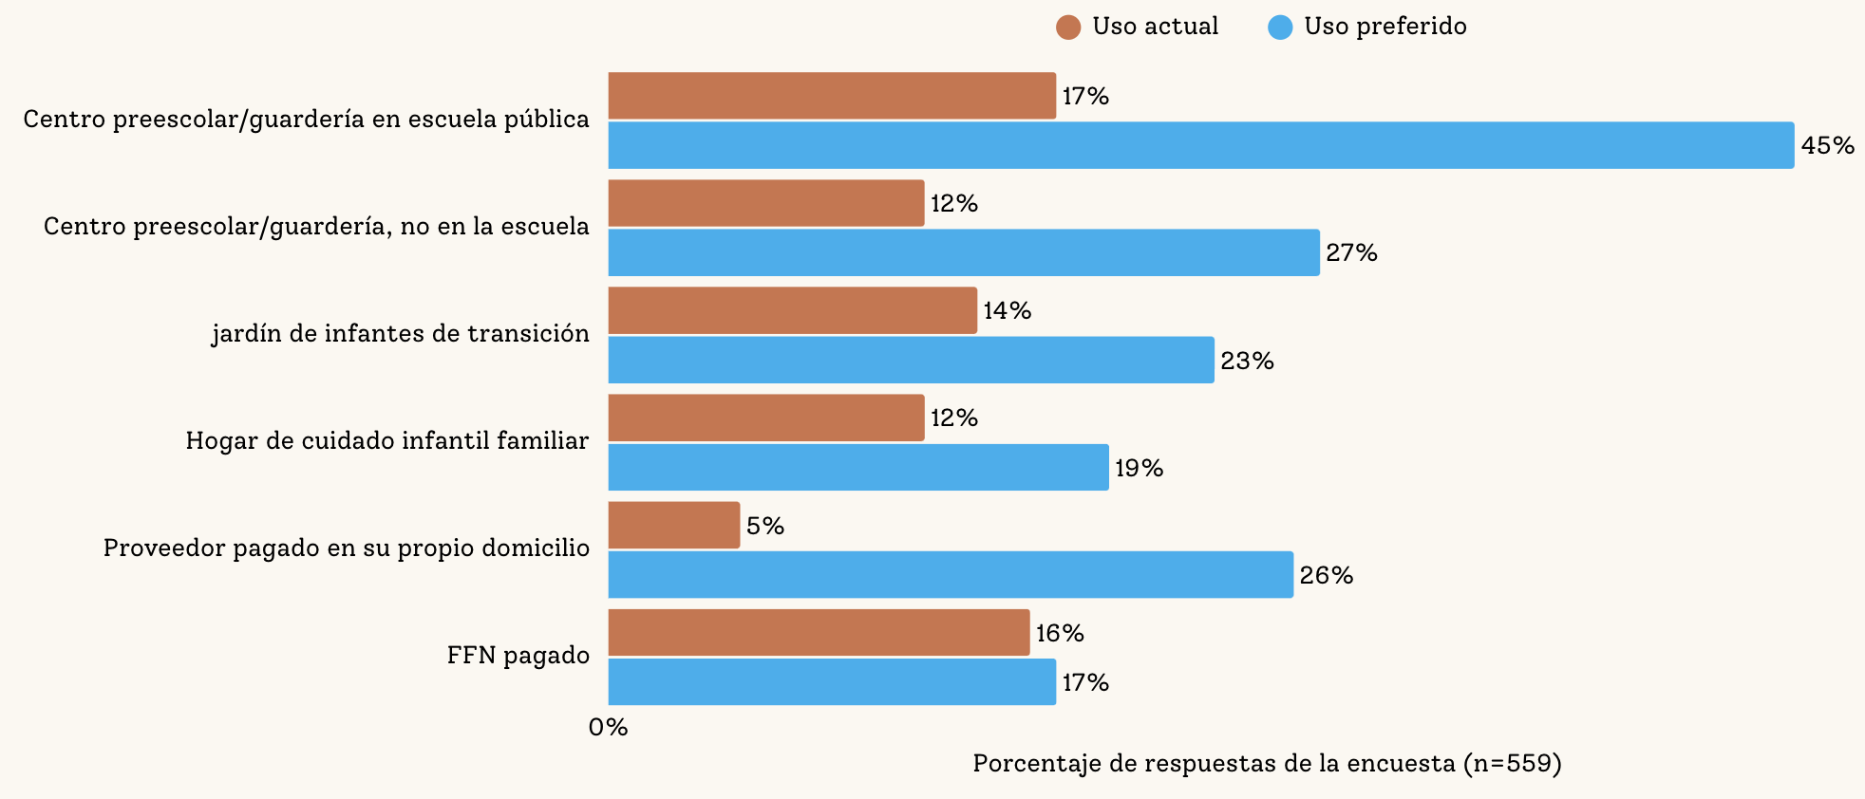
Familias: Atención actual vs. preferencia de atención
*Fuente: Evaluación de Necesidades de Aprendizaje y Cuidado Temprano del Condado de Sonoma 2024-2025; Encuesta Familiar

Slide 32
Asequibilidad

Slide 33
Costo del cuidado infantil*
Costo promedio mensual de cuidado infantil a tiempo completo en 2024:
Las familias de bajos ingresos gastan, en promedio, el 19.8% de sus ingresos en cuidado infantil a tiempo completo en centros.
El costo promedio del cuidado supera el límite de la Tarifa de Mercado Regional, lo que significa que los proveedores que ofrecen cuidado subsidiado operan con pérdidas financieras.
 | Bebé/niño pequeño | Preescolar
FCCH | $1,386 | $1,308
Centro | $1,722 | $1,230
*Fuente: Evaluación de Necesidades de Aprendizaje y Cuidado Temprano del Condado de Sonoma 2024-2025
Notes:
The discrepancy between market costs and reimbursement rates means that even providers offering subsidized care often operate at a financial loss or are unable to serve as many families, further straining access and affordability for working parents.

Slide 34
Apoyos en el desarrollo infantil (Calidad)

Slide 35

Componentes de la calidad en entornos de educación infantil temprana
Ambiente interior y exterior
Salud y seguridad
Formación y cualificación docente
Ratios de alumnos por aula
Interacciones y relaciones entre docentes y alumnos
Plan de estudios

Slide 36
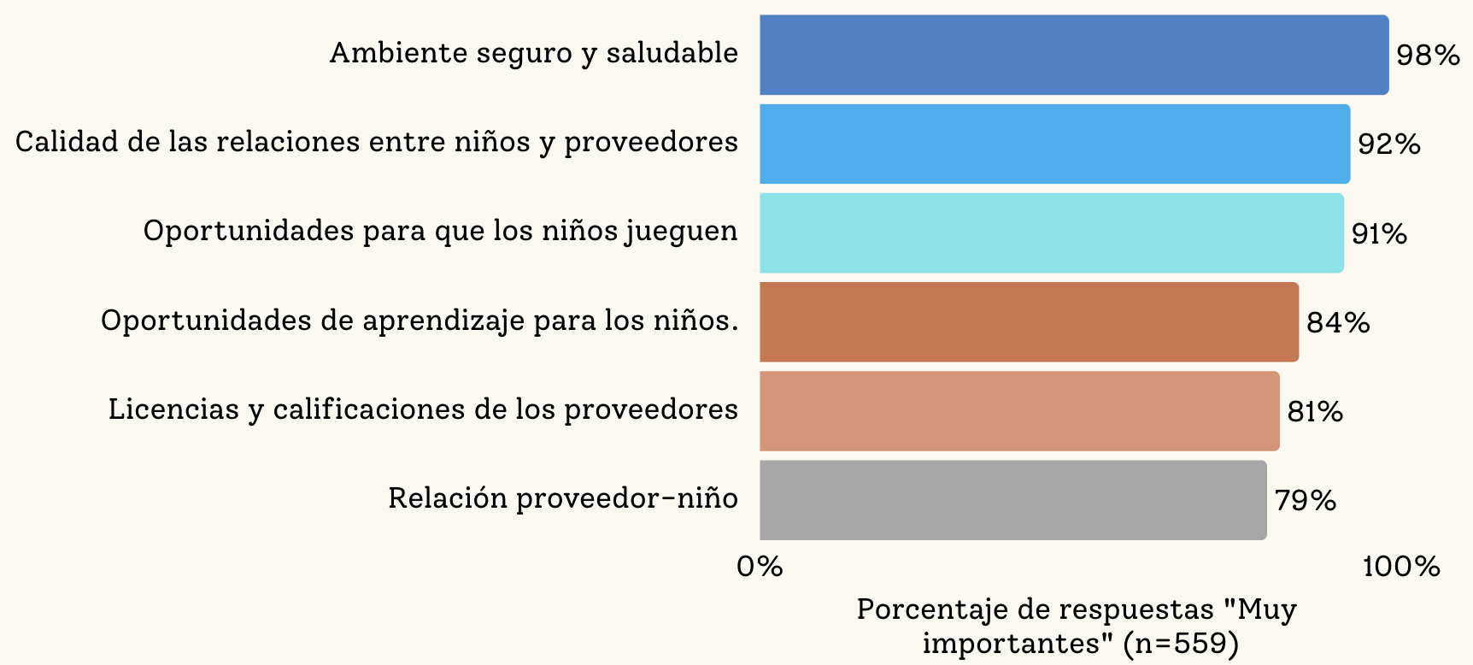
Qué buscan las familias del condado de Sonoma en los centros de cuidado
*Fuente: Evaluación de Necesidades de Aprendizaje y Cuidado Temprano del Condado de Sonoma 2024-2025; Encuesta Familiar n=559

Slide 37
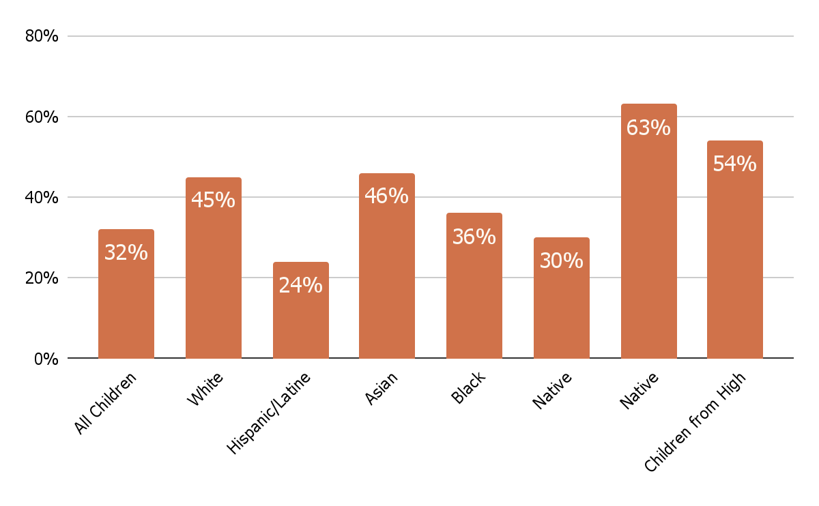
Preparación para el jardín de infancia*
Nivel promedio de preparación para el kínder en el condado de Sonoma: 32%
*Fuente: First 5 Sonoma County. Informe anual de READY 2023-2024.
Todos los niños
Blanco
Hispano/Latino
Asiático
Negro
Nativo Americano
Niños de familias de altos ingresos
PI/Hawaiano

Slide 38
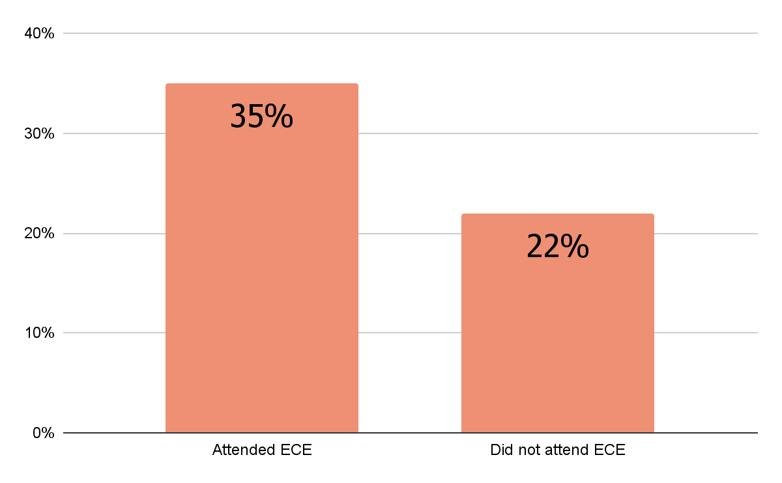
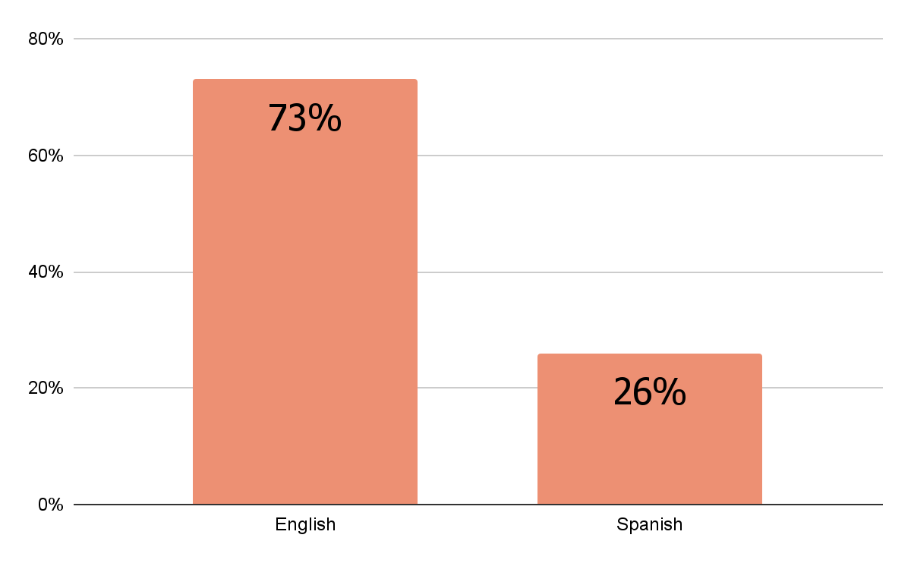
Preparación para el jardín de infancia*
Los niños que asistieron a programas de cuidado y educación temprana tenían más probabilidades de estar preparados para el jardín de infantes.
La participación en ECE fue mucho menor para las familias Hispanas.
Asistió a ECE
No asistió a ECE
Inglés
Español
*Fuente: First 5 Sonoma County. Informe Anual READY 2023-2024.
Notes:
The evaluation illuminated barriers to access and the desires of parents from Black and Latine/Hispanic communities. Common challenges were high costs, limited availability, inconvenient locations, and lack of transportation. In addition, both groups emphasized the importance of feeling safe and welcomed in educational spaces—an experience closely tied to whether staff respected and reflected their racial, cultural, and linguistic identities.

Slide 39
Medida I: Secuencia de reuniones del CAC
Abr
May
Jun
Jul
Ago
Oct
Orientación
Estableciendo el fundamento:
paisaje y recomendaciones iniciales
Acceso equitativo a la educación infantil de calidad
Recomendaciones preliminares
Compensación de la fuerza laboral de educación temprana
Recomendaciones preliminares
Salud
Recomendaciones preliminares
Recomendaciones Finales
ECE significa Cuidado y Educación Temprana y es el término utilizado profesionalmente en este campo. Otros pueden referirse a esto cómo preescolar, cuidado infantil, etc.

Slide 40
Cuidado y Educación Temprana:
Marco para las Inversiones Propuestas para la Medida I que en apoyo de un acceso equitativo a un ECE de calidad, 2026-2031
Notes:
4:15 – 4:40
Leslie

Slide 41
Recomendaciones de Inversión de la Medida I
Marco Estratégico de Cuidado y Educación Temprana 2026–2031
Inversiones Dirigidas por la Equidad
Nuestro Enfoque:
La equidad racial es la base, porque ahí es donde comienzan las brechas más profundas.
Aplicamos Universalismo con Enfoque Estratégico - establecemos una meta universal y dirigimos la mayoría de las inversiones a quienes están más lejos de alcanzarla.
Priorizamos a los niños en familias de bajos ingresos, sin vivienda o históricamente desatendidas.
La equidad significa construir un sistema que responda a las realidades de las familias y proveedores, eliminando las barreras a las oportunidades.
Nuestras estrategias buscan abordar barreras sistémicas para que las familias puedan acceder a cuidado de calidad y los proveedores cuenten con el apoyo necesario para ofrecerlo.
Notes:
4:15 – 4:40
Leslie
At the core of this investment plan is a belief that equity isn’t just about who we serve–it’s also about how we build the system. What we build must be inclusive and culturally responsive.
Racial equity is our foundation because that’s where the deepest and most persistent disparities show up.
We’re applying a Targeted Universalism approach and setting a bold goal that everyone deserves access to quality care, but prioritizing the families and providers facing the steepest barriers.
This means investing more in communities that are under-resourced, and in providers who may not have formal credentials but are doing high-quality, trusted work in their communities.
Our strategies are about fixing systems–whether that’s helping families navigate enrollment or making it easier for providers to grow their practice–not creating more hoops to jump through.
Equity here also means designing supports that are clear, culturally responsive, and structured to build capacity–not restrict access.

Slide 42
Marco Estratégico de ECE para las Inversiones Propuestas para la Medida I, 2026-2031
¿Por dónde empezamos?
Comenzamos donde la necesidad es mayor.
Invertimos en lo que hace posible la calidad: las personas, los entornos y los datos.
Centramos la voz de las familias, la equidad racial y las alianzas comunitarias.
Enfoque Estratégico de Asignación
Inversiones escalonadas durante 5 años: algunas estrategias se desarrollan gradualmente, otras se financian de forma constante.
Equilibramos necesidades urgentes con la construcción de un sistema a largo plazo.
Estabilizamos el acceso para las familias, apoyamos a los educadores y fortalecemos la infraestructura.
Notes:
4:15 – 4:40
Leslie
First, we start where the need is greatest - investing in those who’ve been excluded first, not last.
The data makes the need clear
Over 90% of the need for subsidized infant care is unmet. This is high across income lines.
Over 60%of subsidized preschool needs are unmet.
Over 40% of our youngest children rely on public assistance.
These numbers aren’t just statistics-they reflect the lived reality for thousands of families in Sonoma County.
I would also be remiss if I did not elevate the needs of our immigrant community in Sonoma County as they navigate an immeasurable amount of trauma in our current political landscape.
Second, we’re not just funding programs - we’re investing in what makes quality possible: the people who provide care, the environments children learn in, and the data and systems that connect it all.
Finally, we center family voice and community partnerships in everything we do. Sonoma County’s ECE system
Our allocation approach reflects this: some strategies scale up slowly, especially those that need time to build infrastructure. Others are funded evenly to provide consistent support.
It’s about balancing urgency–what families and providers need right now–with long-term system building that will last well beyond this five-year window.

Slide 43
Measure I Investment Recommendations
2026-2031 ECE Strategic Framework
¿Qué es una asignación?
Una asignación se refiere a una estimación general de cuánto financiamiento se planea destinar a una estrategia, meta o iniciativa específica durante un período determinado.
Las asignaciones ayudan con la planificación a largo plazo y promueven la transparencia al mostrar cómo podrían distribuirse los fondos a lo largo del tiempo.
Aunque se basan en prioridades actuales y en los fondos disponibles, las asignaciones pueden ajustarse con el tiempo para responder a cambios en las necesidades, la capacidad o los niveles de financiamiento.
Nota: Las asignaciones propuestas se basan en un ingreso anual estimado de $30 millones, con aproximadamente $18 millones (60 %) dedicados cada año a inversiones en Cuidado y Educación Temprana (ECE), para un total de $90 millones durante cinco años.
Notes:
4:15 – 4:40
Leslie

Slide 44
Cuidado y Educación Temprana:
Inversiones propuestas para la Medida I en apoyo de un
acceso equitativo a un ECE de calidad, 2026-2031

Slide 45
Acceso Equitativo a Educación y Cuidado de Calidad
Metas de Inversión Propuestas
Meta 1: Ampliar el Acceso Equitativo a Cuidado de Alta Calidad
Meta 2: Estabilizar la Fuerza Laboral y Promover Rutas Educativas
Meta 3: Apoyar la Calidad y la Equidad en el Aprendizaje Temprano
Meta 4: Invertir en Instalaciones Seguras y Sostenibles
Meta 5: Fortalecer el Aprendizaje Temprano a través de datos significativos, la voz de las familias y la participación Comunitaria
Notes:
Access:
Universal High-Quality Care
Family Scholarships
Workforce:
Wages - Funding the subsidy care gap to account for the true cost of care; especially for infant and toddler care; higher salaries to adjust to SoCo’s living costs.
Benefits - Retirement, sick pay, paid time off, insurance
Substitute Pool
Funding for floating staff at centers and assistants in FCCHs
Education - Free courses/paid tuition or scholarships; coursework to better prepare for serving students with disabilities;
Increase and retain the workforce -
Support for High-Quality:
Local food program
Supporting children with disabilities
Coaching and mentorship opportunities
Facilities & Learning Environments:
Grants for facility improvements
Challenges with leasing spaces
Wrap-around Family Supports:
Support with basic resources
Respect and Recognition
Feeling valued and recognized as an educator
QC Consortium - Designing an Equitable ECE Workforce Pipeline for Sonoma County

Slide 46
Acceso equitativo a cuidado infantil de alta calidad:Estrategias de Inversión Propuestas
Objetivo 1: Ampliar el acceso equitativo a cuidado infantil de alta calidad
Estrategia |  | Asignación Total de los Cinco Años
1. Becas familiares: Ofrecer becas con escala de pago según ingresos para familias en la lista de espera para subsidios y familias que no califican para subsidios estatales o federales, pero que aún enfrentan barreras económicas. Nota: El modelo para las becas familiares se desarrollará durante el año fiscal 2025-2026 con amplia participación comunitaria. |  | $15,861,000
2. Apoyar Modelos Alternativos de Aprendizaje Temprano: Invertir en y elevar programas alternativos de aprendizaje temprano (por ejemplo, Pasitos, Primeros Pasitos) para apoyar la alfabetización familiar y fortalecer la capacidad de los padres como primeros maestros de sus hijos. |  | $4,5000,000
3. Eliminar barreras de acceso para las familias: Financiar apoyo personalizado, orientación culturalmente relevante y estrategias de alcance para ayudar a las familias, especialmente aquellas que enfrentan inestabilidad de vivienda o barreras lingüísticas, a encontrar, entender y acceder a servicios de educación y cuidado temprano. |  | $2,250,000
Subtotal de Objetivo 1 |  | $22,611,000
Notes:
Ensure working families--especially those historically excluded or underserved--can find and afford early care and education that meets their needs.

Slide 47
Acceso equitativo a cuidado infantil de alta calidad:Estrategias de Inversión Propuestas
Objetivo 2: Estabilizar a la fuerza laboral y fortalecer trayectorias educativas
Estrategia |  | Asignación Total de los Cinco Años
1. Mejorar la compensación y beneficios de la fuerza laboral: Esta estrategia se discutirá en julio de 2025. Esta estrategia está dirigida a personal de centros con licencia y proveedores de cuidado infantil familiar con licencia |  | $25,025,000
2. Promover el acceso lingüístico y ampliar becas y apoyos para títulos y credenciales: Construir un sistema de educación y cuidado temprano más inclusivo y de alta calidad eliminando barreras financieras, lingüísticas y logísticas para obtener títulos, credenciales y permisos. Esta estrategia es fundamental para asegurar que más proveedores puedan participar en iniciativas relacionadas con la calidad en todo el sistema. |  | $5,400,000
3. Desarrollar trayectorias profesionales y apoyar el avance: Crear caminos claros y con apoyo para que educadores desarrollen su carrera, asuman roles de liderazgo y aumenten su compensación con el tiempo. Ejemplos incluyen programas de aprendices con pago, asesoría profesional, asistencia técnica y orientación académica. |  | $4,275,000
Subtotal de Objetivo 2 |  | $34,700,000
Notes:
Support a diverse early childhood workforce by expanding access to education and career advancement opportunities, while stabilizing the workforce through competitive compensation, benefits, and retention incentives.

Slide 48
Acceso equitativo a cuidado infantil de alta calidad:Estrategias de Inversión Propuestas
Objetivo 3: Apoyar la calidad y la equidad en el aprendizaje temprano
Estrategia |  | Asignación Total de los Cinco Años
1. Ofrecer mini-subvenciones para la mejora de la calidad: Mejorar la experiencia diaria de niños y familias a través de mejoras en la enseñanza, materiales de cuidado y entornos físicos. |  | $2,025,000
2. Invertir en entrenamiento para prácticas inclusivas, informadas por trauma y culturalmente relevantes: Proveer asesoría práctica y multilingüe para fortalecer el cuidado inclusivo e informado por el trauma, especialmente para aprendices de dos idiomas, con discapacidades, y quienes viven en comunidades con menos recursos, tanto en entornos de centros como en hogares |  | $5,400,000
3. Ampliar el acceso a desarrollo profesional y capacitación: Ofrecer capacitación accesible que refleje los idiomas y culturas de los proveedores. |  | $2,925,000
Notes:
Promote equitable, culturally responsive, inclusive early learning environments through continuous quality improvement strategies that support trauma-informed care.

Slide 49
Acceso equitativo a cuidado infantil de alta calidad:Estrategias de Inversión Propuestas
Goal 3: Support Quality and Equity in Early Learning (Cont’d.)
Estrategia |  | Asignación Total de los Cinco Años
4. Apoyar a cuidadores familiares, amigos y vecinos (FFN): Ofrecer recursos culturalmente pertinentes y flexibles que reconozcan el papel esencial de los cuidadores FFN en la provisión de cuidado accesible y de confianza. Nota: Los cuidadores informales son aquellos que no tienen licencia como los centros o los hogares de cuidado infantil con licencia. Estas personas pueden estar legalmente exentas de licencia, y recibir subsidios o actuar como niñeras. |  | $2,250,000
5. Fortalecer infraestructura para la mejora continua de programas: Desarrollar y mejorar la infraestructura del sistema de aprendizaje temprano. |  | $1,332,000
Subtotal de Objetivo 3 |  | $13,932,000
Notes:
Promote equitable, culturally responsive, inclusive early learning environments through continuous quality improvement strategies that support trauma-informed care.

Slide 50
Acceso equitativo a cuidado infantil de alta calidad:Estrategias de Inversión Propuestas
Objetivo 4: Invertir en instalaciones seguras y sostenibles
Estrategia |  | Asignación Total de los Cinco Años
1. Ampliar y mantener instalaciones seguras y de alta calidad: Financiar un ciclo de subvenciones para instalaciones que atienda necesidades críticas de infraestructura en todo el sistema de cuidado y educación temprana. Ejemplos incluyen construcción nueva, renovaciones y mejoras necesarias para cumplir con estándares de seguridad y requisitos de licencias, dando prioridad a proveedores en comunidades con menos recursos y a quienes atienden a bebés, niñas y niños pequeños, y niños que reciben subsidios. Nota: Se realizará una evaluación de necesidades de instalaciones en el año fiscal 25–26 que orientará esta asignación. |  | $8,500,000
2. Subvenciones de emergencia y préstamos puente: Brindar alivio financiero para que los proveedores puedan responder a necesidades urgentes relacionadas con las instalaciones y evitar cierres debido a desastres naturales, emergencias similares o retrasos en los subsidios. |  | $1,500,000
Subtotal de Objetivo 4 |  | $10,000,000
Notes:
Address critical infrastructure needs, emergency preparedness, and promote long-term sustainability of the ECE system through grants and planning supports. Facilities investments prioritize health and safety upgrades, licensing expansion, and equitable access to quality learning spaces--especially in under-resourced communities.

Slide 51
Acceso equitativo a cuidado infantil de alta calidad:Estrategias de Inversión Propuestas
Objetivo 5: Fortalecer el aprendizaje temprano mediante datos significativos, voz familiar y conciencia comunitaria
Estrategia |  | Asignación Total de los Cinco Años
1. Alcance comunitario y comunicaciones: Informar a las familias y proveedores sobre iniciativas de calidad y apoyos; crear conciencia sobre la importancia de los primeros años. |  | $1,557,000
2. Infraestructura de datos, evaluación y aprendizaje: Personal, infraestructura, suscripciones a sistemas de datos y costos de evaluaciones externas para hacer seguimiento a resultados, mejora continua y rendición de cuentas |  | $7,200,000
Subtotal de Objetivo 5 |  | $8,757,000
Notes:
Advance continuous improvement and equity by building robust data systems and evaluation practices that center family voices, while conducting targeted communications campaigns to raise awareness of quality initiatives among families, providers, and the community.

Slide 52
Comentarios del Público y Discusión del Comité Asesor Comunitario (CAC)
Proceso
Preguntas del CAC para aclaración
Comentarios del público: máximo 2 minutos por persona
  Estos serán anotados
Preguntas y comentarios del CAC
  Comentarios e ideas para considerar serán registradas en una tabla)
Discusión del CAC
  Enfoque en qué comendatorios o ideas se incorporarán en la recomendación preliminar para someter a votación
  Votación sobre las recomendaciones preliminares
RECORDATORIO – LA COMPENSACIÓN DE LA FUERZA LABORAL SERÁ EL TEMA CENTRAL DE DISCUSIÓN EN JULIO
Notes:
CHRISTINA
4:40-5:00 Public Comment (estimated 10 people @ 2 min)
● Christina charts on Public Comment chart paper
● Adriana keeps each person to 2 minutes
● F5SC staff have 2 min timer on screen
5:00 – 5:20 CAC Discussion (5:20 is the HARD STOP, NO WIGGLE if we take a vote)
● Christina charts CAC comments/direction
● If not addressed, Christina asks CAC if they want to incorporate public input
5:20 – 5:25 Christina charts what she believes the vote is based on comments, agreements, etc. Checks for agreement on language.
ADRIANA
5:25 ADRIANA STATE: It is time to vote on the DRAFT recommendations
Ask members to indicate their vote with a Thumbs UP or Down - ACTION ITEM SHOULD READ AS:
“Vote on action to advance DRAFT RECOMMENDATIONS for strategies within Equitable Access to Quality ECE to the First 5 Commission for consideration, as amended”
Summarize the vote (# = Yes; # = No)
This vote passes (need 7 to pass – 2/3)

Slide 53



Próxima Reunión del Consejo Comunitario Asesor:
31 de julio de 2025
3:00-5:30 pm
Nueva ubicación:
120 Stony Point, Suite 155, Santa Rosa

