Slide 1

Measure I
Sonoma County Child Care & Children’s Health Ordinance
Community Advisory Council
May 22, 2025
Notes:
Welcome group
Introduce self
Mention ECE Listening Session following this meeting - need to end on time

Slide 2

Today, the First 5 Sonoma County Commission and the Measure I Advisory Council is humbled to bring us together on the ancestral lands of the Southern Pomo People. We celebrate the active work of their descendants to preserve & nourish their indigenous culture and identity.
We acknowledge the Southern Pomo People as the traditional stewards and custodians of this area and honor with gratitude the land itself, all of its ancestors - past, present and future.
Ancestral Land Acknowledgement
Notes:
Today, First 5 Sonoma County is humbled to bring the Measure I Community Advisory Council together on the ancestral lands of the Southern Pomo People. We celebrate the active work of their descendants to preserve & nourish their indigenous culture and identity. We acknowledge the Southern Pomo People as the traditional stewards and custodians of this area and honor with gratitude the land itself, all of its ancestors - past, present and future.

Slide 3
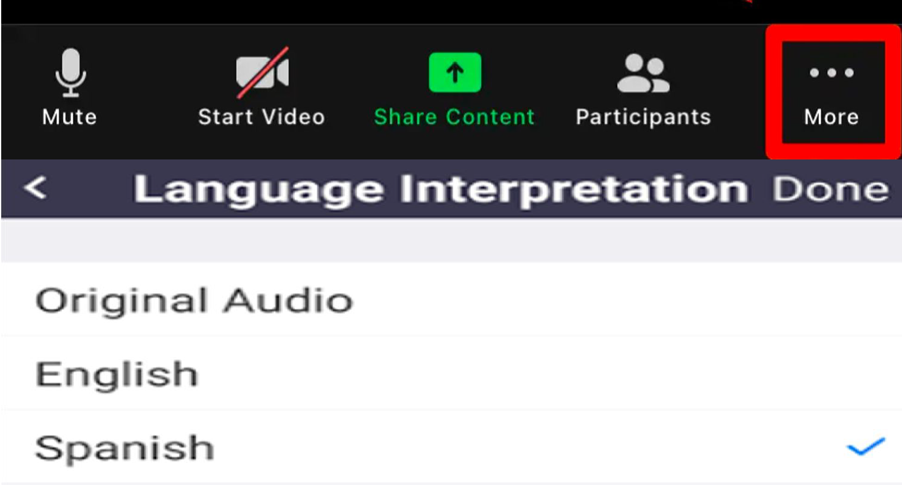
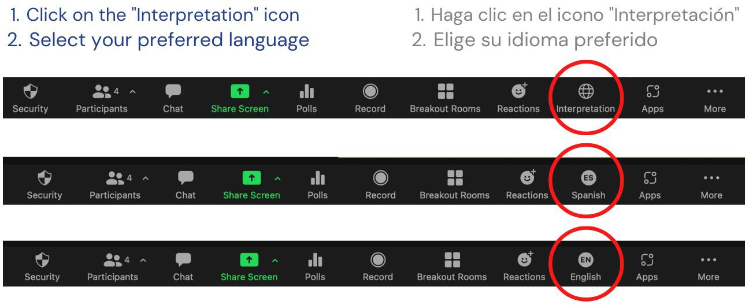
Welcome! ¡Bienvenidos!
Zoom Interpretation/Interpretación de Zoom
Computer / Computadora
Phone / Por Telefono
Notes:
CAC Member Brittany Lobo is attending remotely on Zoom - as per AB 2449 exception
A few words about public participation in CAC meetings. The CAC meetings are held in person and the public is welcome to join us. We have a virtual option for members of the public and the Zoom link can be found at the top of the agenda that will always be posted on the First 5 website at least 3 days prior to each meeting.
For those members of the public on Zoom, please click on the globe icon to select your language preference, either English or Spanish.
(Sandra) In person - if need Spanish interpretation, headsets are available…
I will do my best to speak slowly enough to make interpretation as seamless as possible
Everybody can help by avoiding cross talk while people facilitating, presenting or making public comment
Seated next to Isabel is my colleague Joseline who is bilingual and here to provide contextual support if it would be helpful beyond interpretation.
Joseline, please let me know if anybody presenting needs to slow down

Slide 4

Public comment
on non-agendized items
Comentarios públicos sobre temas no incluidos en la agenda
Notes:
There are different opportunities for public comment:
Items NOT on the agenda, which will do in just a moment
Items on the agenda for ACTION. For example, on today’s agenda there is an action item to approve recommendations for early funding with Measure I. Public comments for the recommendations item will be taken after the presentation is over and there is a motion and a second to approve the recommendations. Public comment will be taken before the vote.
If a member of the public attending in person would like to make a public comment, please come to the podium, form a line if necessary and when it is your turn, state your name first and then you will have 2 minutes to offer your comments.
If a member of the public attending virtually would like to comment on any agenda item, please use the “raise hand” feature in the webinar when I call for public comment on the item you wish to comment on. When your name is called, you will be unmuted and you will have 2 minutes to offer your comments to the Council.

Slide 5
Guidelines for Public Comment
Directrices para los comentarios públicos
Public comments are brief statements intended to inform the CAC and First 5 about the topic/Action Item
Comments from the public at public meetings do not include questions and is not intended to be a dialogue
Appointed Council members and First 5 staff and consultants are discouraged from responding or discussing topics with the public (can potentially constitute a Brown Act violation)
Time limits can (and typically will) be imposed per comment and/or for total time allotted
Los comentarios públicos son declaraciones breves destinadas a informar al CAC y a First 5 sobre el tema o punto de acción.
Los comentarios del público en reuniones públicas no incluyen preguntas y no están destinados a ser un diálogo.
Se desalienta a los miembros designados del Consejo, al personal de First 5 y a los asesores de responder o discutir temas con el público (ya que podría constituir una violación de la Ley Brown).
Se pueden imponer límites de tiempo por comentario y/o para el tiempo total asignado (y típicamente se impondrán).
Notes:
Public comments are brief statements intended to inform the CAC and First 5 about the topic/Action Item
Comments from the public at public meetings do not include questions and is not intended to be a dialogue
This means that after you make your comment, we will go to the next comment without discussion about your comment
Appointed Council members and First 5 staff and consultants are discouraged from responding or discussing topics with the public (can potentially constitute a Brown Act violation)
Time limits can (and typically will) be imposed per comment and/or for total time allotted
Approval of April 24, 2025 CAC Meeting Minutes
As a reminder, the way that CAC approves an item, is that a CAC member makes a motion. So in this case, a member would say, I make the motion to approve the April 24th Meeting Minutes. Then, somebody would 2nd the motion simply by saying “I second the motion.” Then we would see if there is any discussion or public comment, and then the group votes.
Per the CAC Bylaw, there needs to be ⅔ of the attending members present to pass a vote. Today we have “ “ so we need at least “ “ to pass a vote.
would somebody like to make a motion?
Angie - Welcome
Review Agenda
Public Comment - Items that are NOT on the agenda

Slide 6
Community Agreements
Notes:
(each member read one agreement, start with Isabel who will be seated at one of the ends next to Joseline)
Adriana Arrizón proposed the Community Agreements that are in your packet
We are going to go around the table and have each CAC member read off one agreement
Let’s start with Isabel
If you have suggestions to add/modify please send an email to Yvette

Slide 7
Election of CAC Chair & Vice Chair
Notes:
Now we will move to electing the chair and vice chair of the CAC

Slide 8

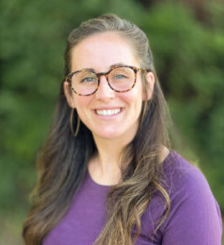
CAC Officer Slate
Adriana Arrizón
Health Sector Representative
Chair
Helen Myers
Parent Representative
Vice Chair
Notes:
These were only nominations we received
Would somebody like to make a motion to approve the officer slate, which means both the chair and vice chair?

Slide 9
Sonoma County Data Landscape
Notes:
This part of the presentation shares some key data related to Measure I
For CAC members, this data comes from the Data Landscape Report you received as part of your packet
It is not intended to be all relevant data
We have members that are more health focused, some that are ECE focused, and some parent representatives. This is intended to provide some leveling of information so that all CAC members have at least a big picture overview of the data related to Measure I
Next month and for each focused discussion, there will be a section of the meeting where data is shared that is relevant to each meeting topic
My plan is to go through these fairy quickly so that we have sufficient time for the recommendations.
If you have a question, please feel free to jump in at any point, or you can wait until the end where I will pause for questions/comments

Slide 10
Measure I
Data Landscape
Measure I CAC Meeting
May 22, 2025

Slide 11

Sonoma County’s Children
Demographic Profile

Slide 12
Understanding the characteristics of Sonoma County’s youngest residents and their families is essential for designing equitable, responsive early childhood systems.

Slide 13



Demographics of Children in Sonoma County*
25,217 children ages 0-5*
27.5% English Language Learners. Of these, 91.5% speak Spanish.**
12.5% are identified as having special needs in kindergarten. 7.9% of 0-4 years olds have IFSPs supporting special needs.**
Sources: *2023 American Community Survey 1 Year Estimates
**2025 Sonoma County Early Learning and Care Needs Assessment (Children 0-12)
Notes:
https://data.census.gov/table/ACSDT1Y2023.B05009?q=sonoma+county+demograhics+children+under+age+6
2023 1 Year estimates
2023 5 year estimates = 26,663 https://data.census.gov/table/ACSDT5Y2023.B05009?q=sonoma+county+demograhics+children+under+age+6

Slide 14
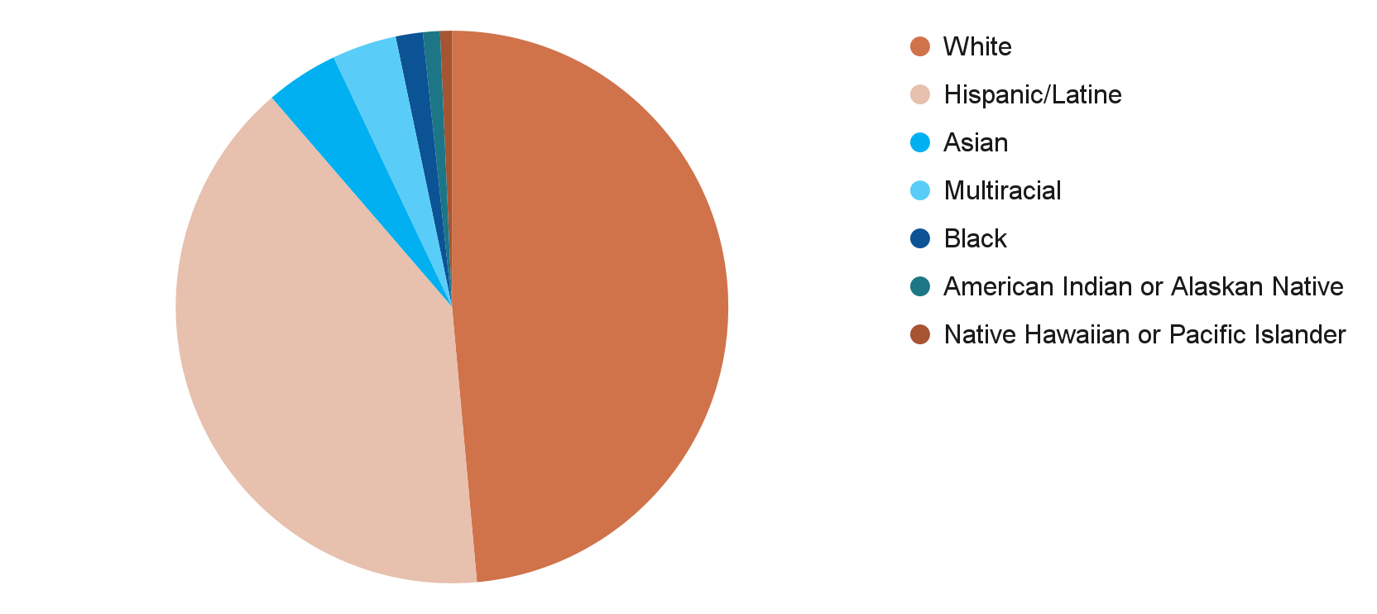
Demographics of Children in Sonoma County (2023)*
48.9% White
40.4% Hispanic/Latine
4.3% Asian
3.8% Multiracial
1.6% Black
1.0% American Indian/Alaskan Native
0.7% Native Hawaiian/Pacific Islander
*Ages 0-12. Source: Sonoma County 2024-25 Early Learning and Care Needs Assessment

Slide 15
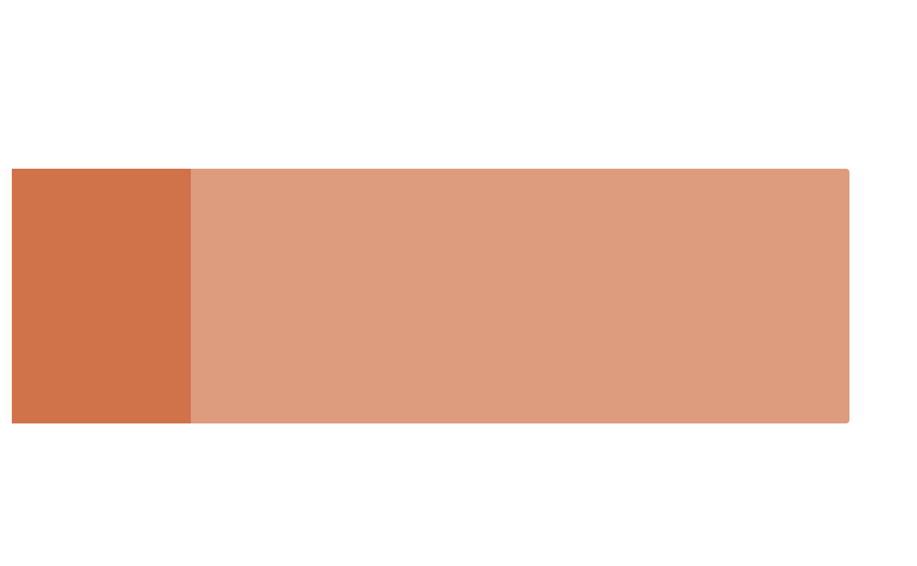
Basic Needs and Income
Minimum Wage
Living Wage
2,588
A living wage in Sonoma County is
Yet the minimum wage in Sonoma County is
$60.14 / hour**
Children 0-5 lived below the federal poverty line in 2023. That’s a 44% increase from 2021.*
$16.50 / hour**
*Source: 2023 California Child Care Portfolio
**Source: Glasmeier, A. K., & Massachusetts Institute of Technology. (2025). Living wage calculator: Sonoma County, California. https://livingwage.mit.edu/counties/06097. Note: This is the living wage for 1 adult with 2 children.

Slide 16
Basic Needs and Income*
Families with young children are especially vulnerable to the effects of a high cost of living in Sonoma County.
2x
60%
50%
more likely to be severely cost-burdened (spending more than half of income on housing).
live in overcrowded homes – 5x more than households without young children.
report difficulty affording food, a rate twice as high as other households.
*Source: Generation Housing. (2023). Making the Rent: The Human Price of Housing Cost Burden. Retrieved from https://generationhousing.org/wp-content/uploads/2023/03/2023_0322-Making-the-Rent-The-Human-Price-of-Housing-Cost-Burden.pdf
Notes:
As of October 2023, nearly 46.4% of children ages 0–12 in Sonoma County were enrolled in at least one public assistance program—CalFresh, Medi-Cal, or CalWORKs.

Slide 17
Vulnerable Populations in Sonoma County
Children 0-5 involved in Child Protective Services*
161
Children of migrant/seasonal workers, ages 0-5*
169
Families with children under age 18 experiencing homelessness**
57
children ages 0-5 live with at least one parent who is undocumented ***
5,000
*Source: 2022-2025 Sonoma County Early Learning and Care Needs Assessment
**Source: 2024 Sonoma County Homelessness Point in Time Count and Report
*** Estimation based on 20% of all CA minors live with at least one undocumented parent (CA Immigrant Data Portal, 2021)

Slide 18
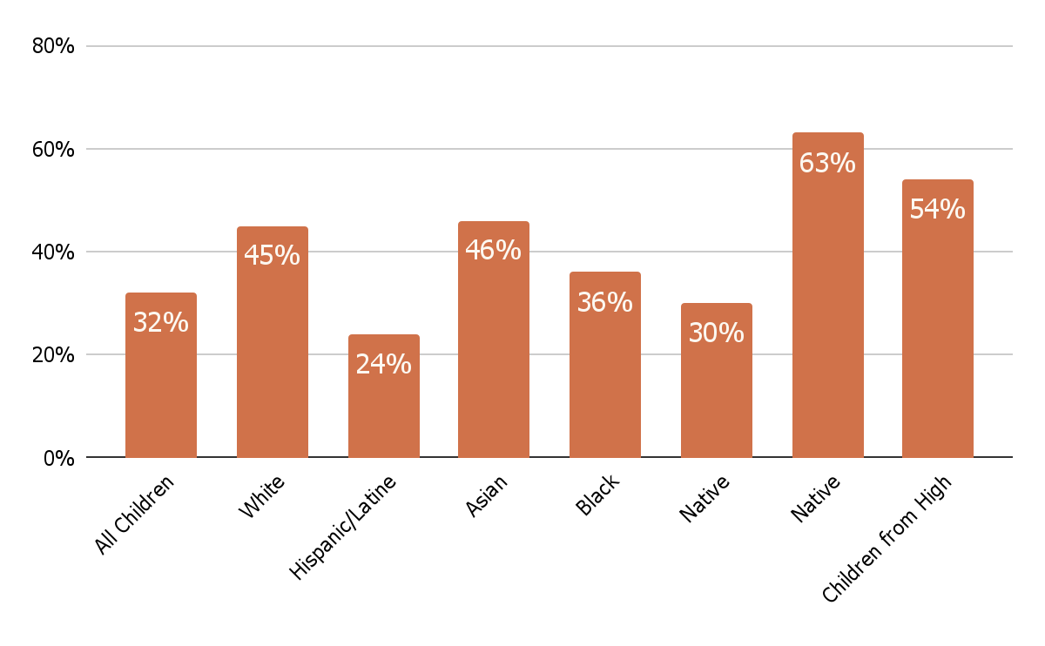
Kindergarten Readiness*
Average kindergarten readiness of all children in Sonoma County: 32%
*Source: First 5 Sonoma County. READY Annual Report 2023–2024.
All children
White
Hispanic/ Latine
Asian
Black
Native American
Children from High Income Families
PI/Hawaiian

Slide 19
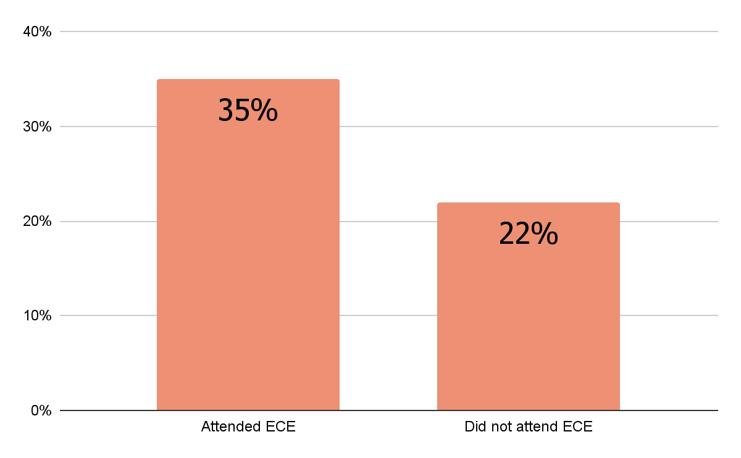
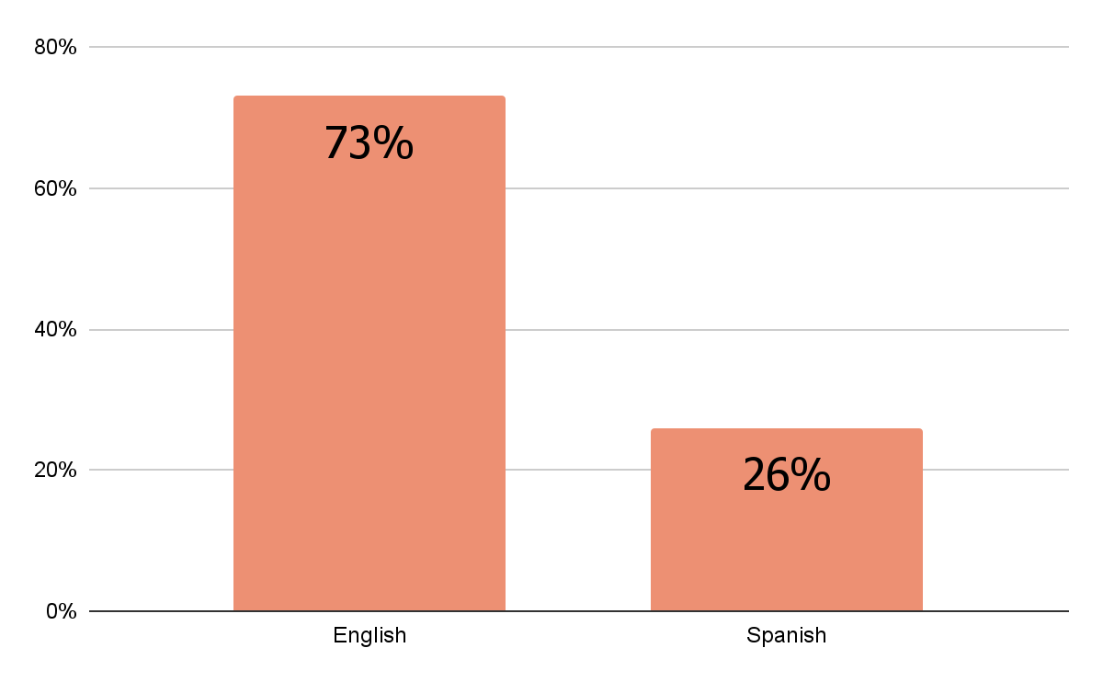
Kindergarten Readiness*
Children who attended early care and education programs were more likely to be ready for kindergarten.
ECE participation was much lower for Spanish-speaking families.
Attended ECE
Did not attend ECE
English
Spanish
*Source: First 5 Sonoma County. READY Annual Report 2023–2024.
Notes:
The evaluation illuminated barriers to access and the desires of parents from Black and Latine/Hispanic communities. Common challenges were high costs, limited availability, inconvenient locations, and lack of transportation. In addition, both groups emphasized the importance of feeling safe and welcomed in educational spaces—an experience closely tied to whether staff respected and reflected their racial, cultural, and linguistic identities.

Slide 20

Early Care & Education
Landscape Review

Slide 21
Access to affordable, high-quality child care remains one of the most pressing challenges, with significant gaps between the demand for care and the supply of licensed early learning spaces.

Slide 22
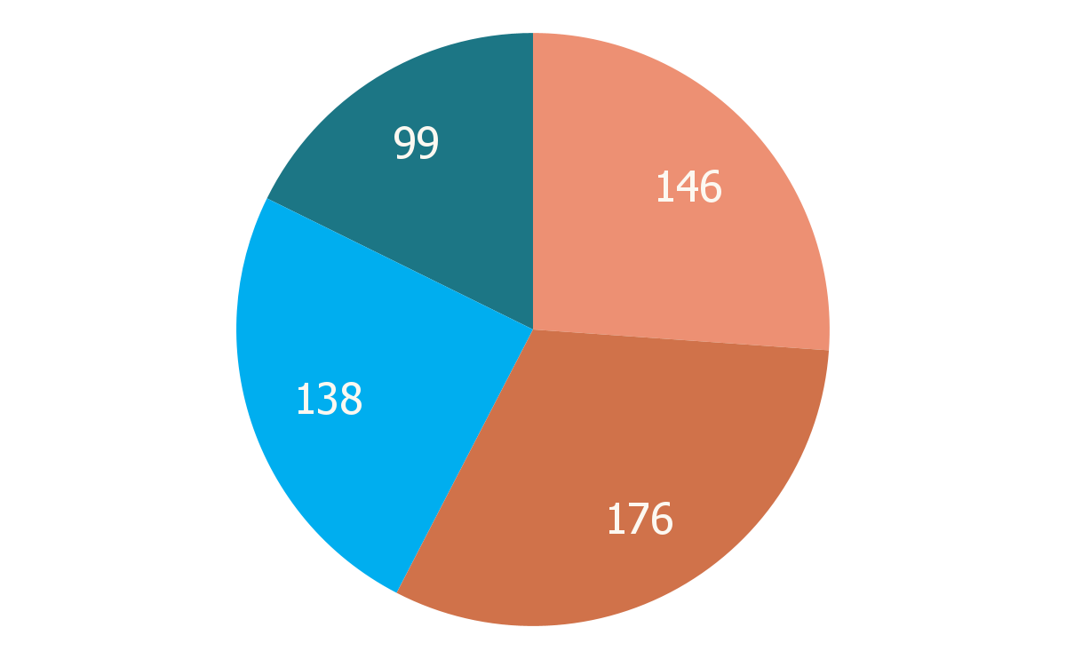
Child Care Landscape in Sonoma County*
Sonoma County had 559 early care and education programs in 2024:
This represents a sharp decline from 2019:
License- Exempt Centers
The number of licensed providers declined by 10.4% (624 → 559 providers)
The number of slots declined 30% (20,937 → 14,759 slots)
Licensed Centers
Large FCCHs
Small FCCHs
*Source: 2025 Sonoma County Early Learning and Care Needs Assessment
Notes:
Except for large family child care homes, which increased their total number of slots by 436 to 1,476 total slots in 2024, all other provider types experienced a sharp decline. As of 2024, small family child care homes declined 22% to 1,236 slots, while centers and license-exempt centers combined declined by 34% to 12,047 slots.

Slide 23
Child Care Need*
Areas classified as child care deserts (extremely high unmet need):
Sonoma Valley (74.1%)
Santa Rosa (73.5%)
Cotati/Rohnert Park (71.6%)
69.6%
Additional areas with significant unmet need:
North County (66.6%)
South County (63.4%)
West County (58.1%)
Unmet need for child care in Sonoma County. Need is highest for children ages 0-2, at 86%.
*Source: 2024-2025 Sonoma County Early Learning and Care Needs Assessment
Notes:
Child care deserts are areas where there is an insufficient supply of licensed child care to meet community needs. Child care deserts disproportionately impact low-income households, communities of color, and non-English-speaking households. These families face additional barriers such as lack of transportation, nontraditional work hours, and a shortage of bilingual providers

Slide 24


Subsidized Care
2,895
Children 0-4 enrolled in subsidized care, or 13% of children.*
1,448
91.8% unmet need for subsidized child care for eligible children 0-2.**
The unmet need for children 3-5 years is 73.6%.**
Children on the waitlist for subsidized early care slots.*
*Source: 2024-2025 Sonoma County Early Learning and Care Needs Assessment
**Source: 2020 Early Learning Needs Assessment Tool
Notes:
As of January 2025, children ages 0-2 made up the largest proportion of children on the CEL (614 children or 42.4% of total list), followed by children ages 5-12 (493 children or 34.0% of the total list) and children ages 3-4 (341 children or 23.5% of total list); however it is important to note that the total number of children on early care and education waitlists in the county exceeds these numbers, because programs especially those who enroll private pay families typically have their own waitlists.

Slide 25
Cost of Child Care*
Average Monthly Full-time Child Care Costs in 2024:
Low-income families spend, on average, 19.8% of their income for full-time infant center-based care.
The average cost of care exceeds the Regional Market Rate ceiling, meaning that providers offering subsidized care operate at a financial loss.
 | Infant/Toddler | Preschool
FCCH | $1,386 | $1,308
Center | $1,722 | $1,230
*Source: 2024-2025 Sonoma County Early Learning and Care Needs Assessment
Notes:
The discrepancy between market costs and reimbursement rates means that even providers offering subsidized care often operate at a financial loss or are unable to serve as many families, further straining access and affordability for working parents.

Slide 26



Early Care and Education Workforce*
Diversity
Latina educators are nearly half of the workforce, however White educators are 74% of center directors.
Education
58% of center directors, 37% of teachers, and 20% of FCC providers hold a bachelor’s degree or higher.
Experience
79% of center directors and 53% of FCC providers have over 15 years in the field.
*Source: Powell, A., Muruvi, W., Austin, L., & Petig, A. (2024). The Early Care and Education Workforce of Sonoma County. Center for the Study of Child Care Employment, University of California, Berkeley.

Slide 27
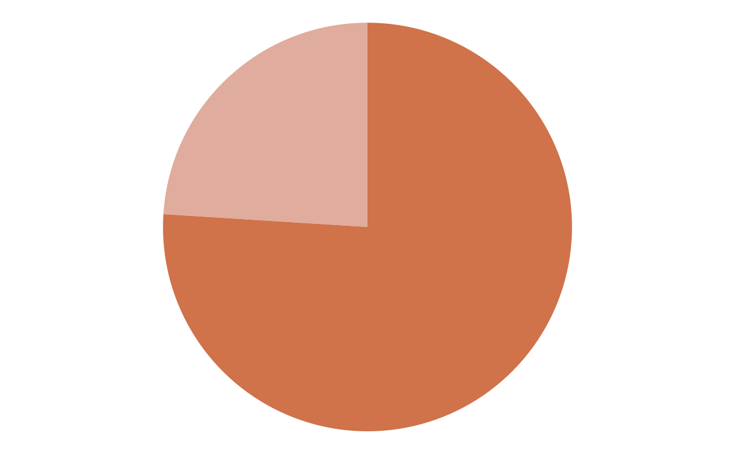
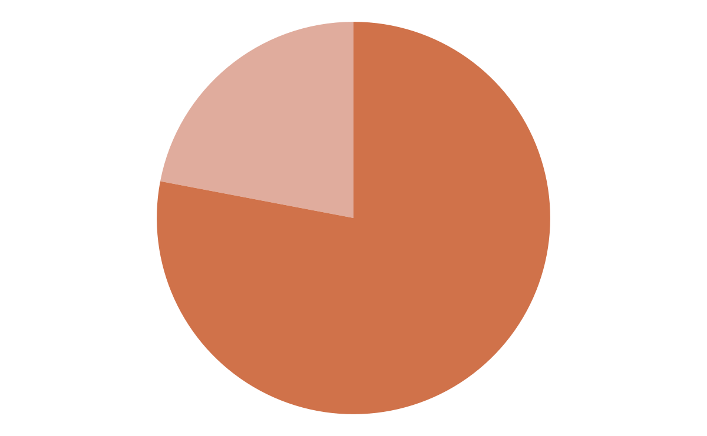
Early Care and Education Workforce*
Compensation
Turnover
$34,000 - $44,600
Average annual income for FCCH providers
$19.75 - $22.38
Average hourly wage for lead teachers
76% of all centers experienced staff turnover
78% of centers reported challenges recruiting qualified staff
*Source: Powell, A., Muruvi, W., Austin, L., & Petig, A. (2024). The Early Care and Education Workforce of Sonoma County. Center for the Study of Child Care Employment, University of California, Berkeley.
Notes:
due to low compensation, 45 percent of FCC providers and 50 percent of center teachers and assistants used at least one form of public support.

Slide 28
Early Care and Education Workforce*
Mental Health
Physical Health
67%
of Center Directors report high levels of perceived stress
33%
of Center Directors report significant depressive symptoms
71%
of Family Child Care providers report a chronic health condition
52%
of Family Child Care providers report being moderately to very concerned about exposure to infections at work
*Source: Powell, A., Muruvi, W., Austin, L., & Petig, A. (2024). The Early Care and Education Workforce of Sonoma County. Center for the Study of Child Care Employment, University of California, Berkeley.

Slide 29

Child and Perinatal Health and Mental Health
Landscape Review

Slide 30
Sonoma County’s child health system is characterized by committed providers, community-driven initiatives, and strong public health infrastructure.

Slide 31
Provider Landscape
Perinatal and Child Health Services in Sonoma County
2 managed care plans*
Multiple Federally Qualified Health Centers (FQHCs) and hospitals*
2 birthing centers (both located in Santa Rosa)*
10+ home visiting programs serve a range of parent populations; however, they lack centralized coordination and referrals
Doula care is available, including a training programs for Black doulas. The utilization rate through managed care is 6.9 per 1,000 birthing members.**
*Source: Partnership Healthplan of California. (2024, April). Annual Partnership County Data Report 2024: Sonoma County.
**Source: California Department of Health Care Services. (2025, April 11). Doula implementation stakeholder meeting [PDF].

Slide 32
Perinatal and Birth Outcomes
Despite similar prenatal care rates, birth outcomes vary by race in Sonoma County.
American Indian & Alaska Native (AIAN) and Black mothers have the highest rates of pregnancy hypertensive disorder***
Asian/PI mothers have the highest severe maternal morbidity rates (unexpected and serious complications during L&D)***
Black mothers’ preterm birth rates are nearly double that of White mothers***
91%
Begin prenatal care in the first trimester, with rates comparable across racial groups*
*Source: 2025 Children Now: California Scorecard of Children's Well-being: Sonoma County.
***Source: 2025 California Department of Public Health, Center for Family Health, Maternal, Child and Adolescent Health Division, Severe Maternal Morbidity Dashboard; Preterm Birth Dashboard; Maternal Health Conditions Dashboard
Notes:
*Source: Children Now. (2025). 2025 California Scorecard of Children's Well-being: Sonoma County. Retrieved from https://www.childrennow.org/portfolio-posts/2025-california-county-scorecard-of-childrens-well-being/
**Source:California Department of Public Health, Center for Family Health, Maternal, Child and Adolescent Health Division, Maternal Health Conditions Dashboard, Last Modified March 2025. go.cdph.ca.gov/Maternal-Health-Conditions-at-Delivery-Dashboard
***Source: California Department of Public Health, Center for Family Health, Maternal, Child and Adolescent Health Division, Severe Maternal Morbidity Dashboard, Last Modified February 2025. go.cdph.ca.gov/Severe-Maternal-Morbidity-Dashboard
****Source: California Department of Public Health, Center for Family Health, Maternal, Child and Adolescent Health Division, Preterm Birth Dashboard, Last Modified April 2025. go.cdph.ca.gov/Preterm-Birth-Dashboard

Slide 33
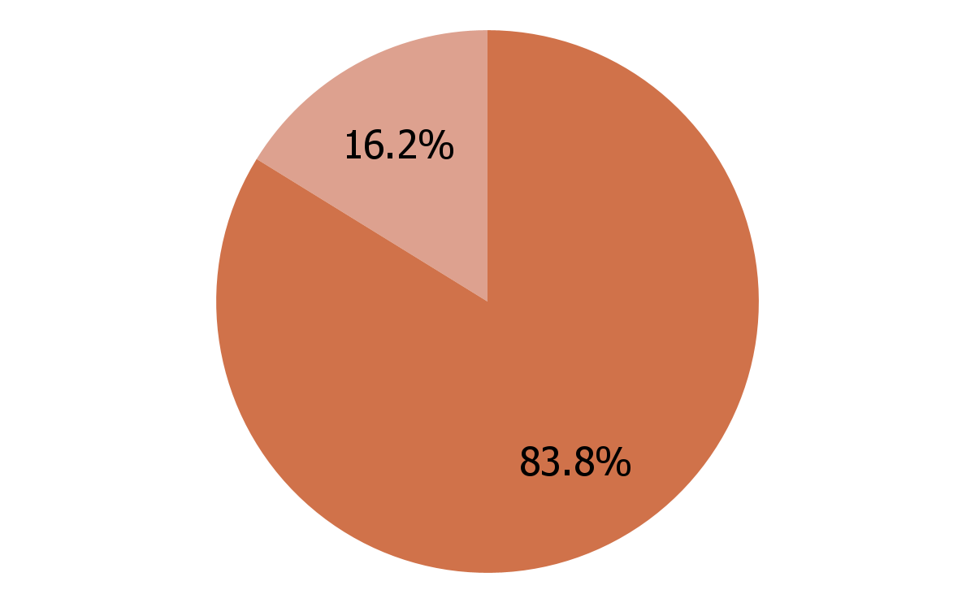
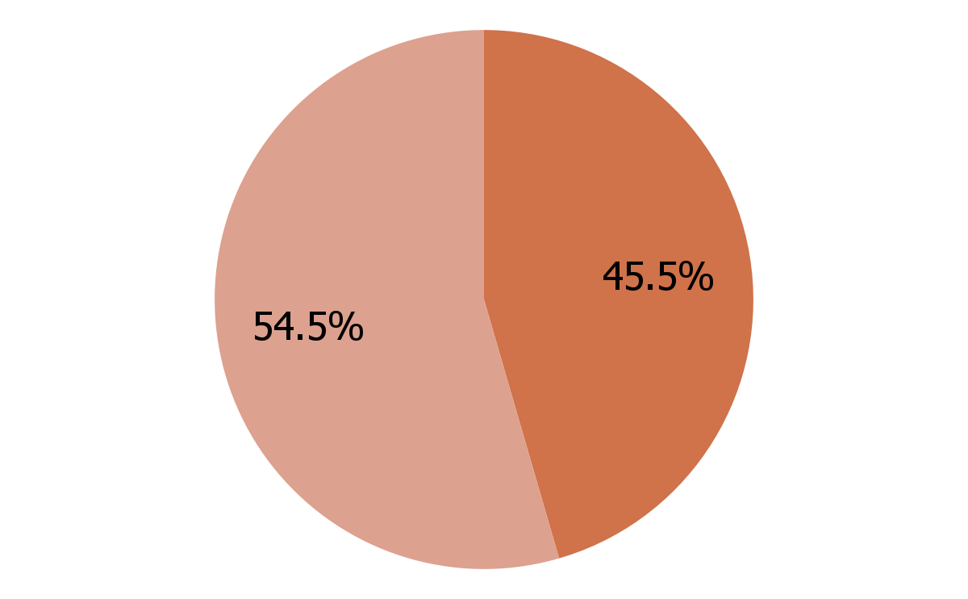
Breastfeeding Rates*
83.8% of newborns were exclusively breastfed as of hospital discharge, with even more receiving some breastfeeding
That drops to 45.5% of infants who are exclusively breastfed at 3 months postpartum
*Source: California Department of Public Health, Center for Family Health, Maternal, Child and Adolescent Health Division, Breastfeeding Intention and Duration Dashboard, Last Modified November 2023. go.cdph.ca.gov/Breastfeeding-Intention-and-Duration-Dashboard

Slide 34
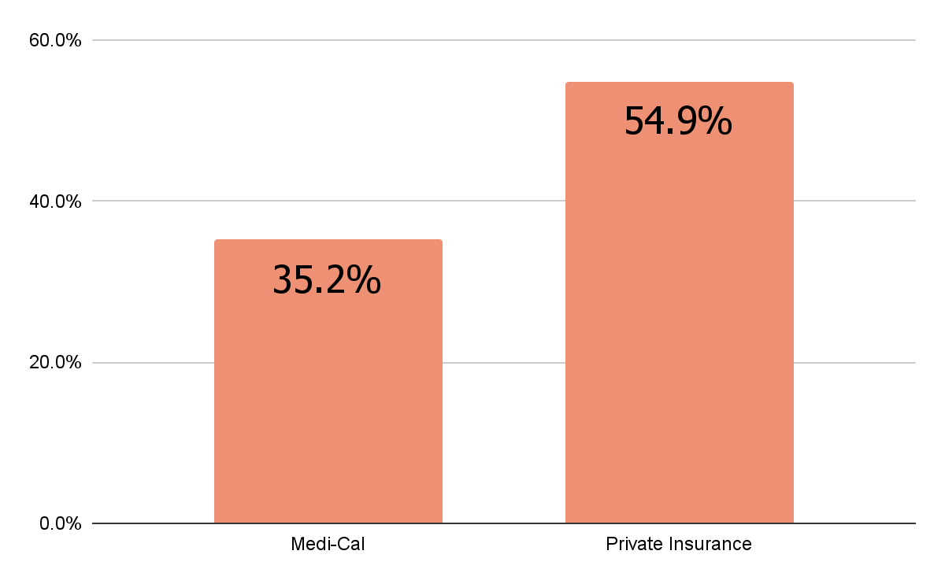
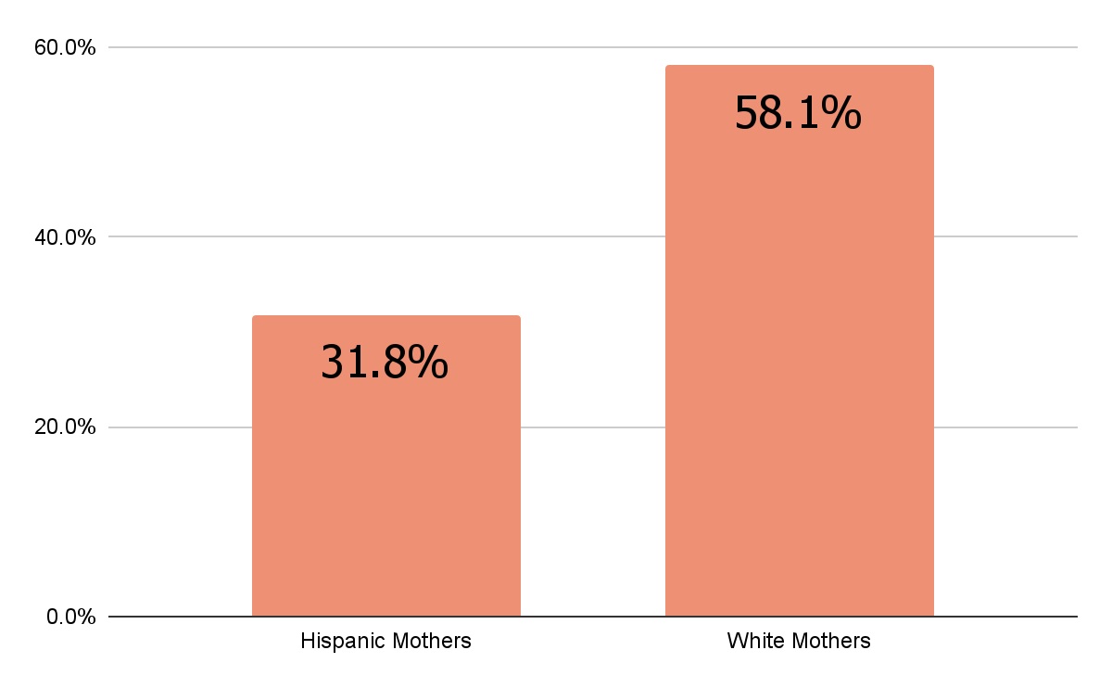
Breastfeeding Rates by Demographic*
Rates of exclusive breastfeeding at 3 months postpartum vary greatly by insurance type and race.
Medi-Cal
Private Insurance
Hispanic Mothers
White Mothers
*Source: California Department of Public Health, Center for Family Health, Maternal, Child and Adolescent Health Division, Breastfeeding Intention and Duration Dashboard, Last Modified November 2023. go.cdph.ca.gov/Breastfeeding-Intention-and-Duration-Dashboard

Slide 35
Perinatal Mental Health
Compared to 8.3% statewide*
Increase of nearly 8% from 2016-2018*
Much lower than self- reported survey data from mothers, in which 86% reported perinatal emotional or mental health issues**
20.7%
Birthing mothers presented with a perinatal mental health condition at delivery, 2020-2022*
*Source: California Department of Public Health’s Maternal, Child & Adolescent Health Division data dashboards, from 2020 to 2022
**Source: First 5 Sonoma County. 2024 Perinatal Feeding and Mental Health Survey
Notes:
Statewide average increased only 2% over same time periods.

Slide 36
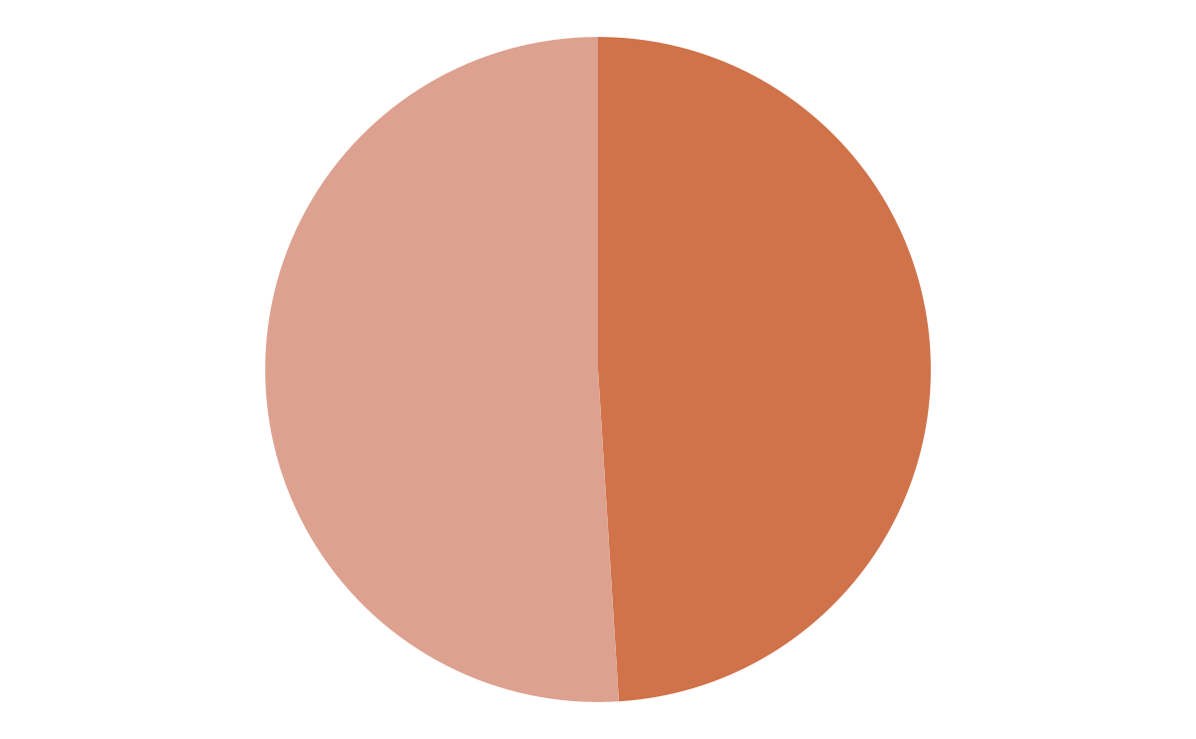
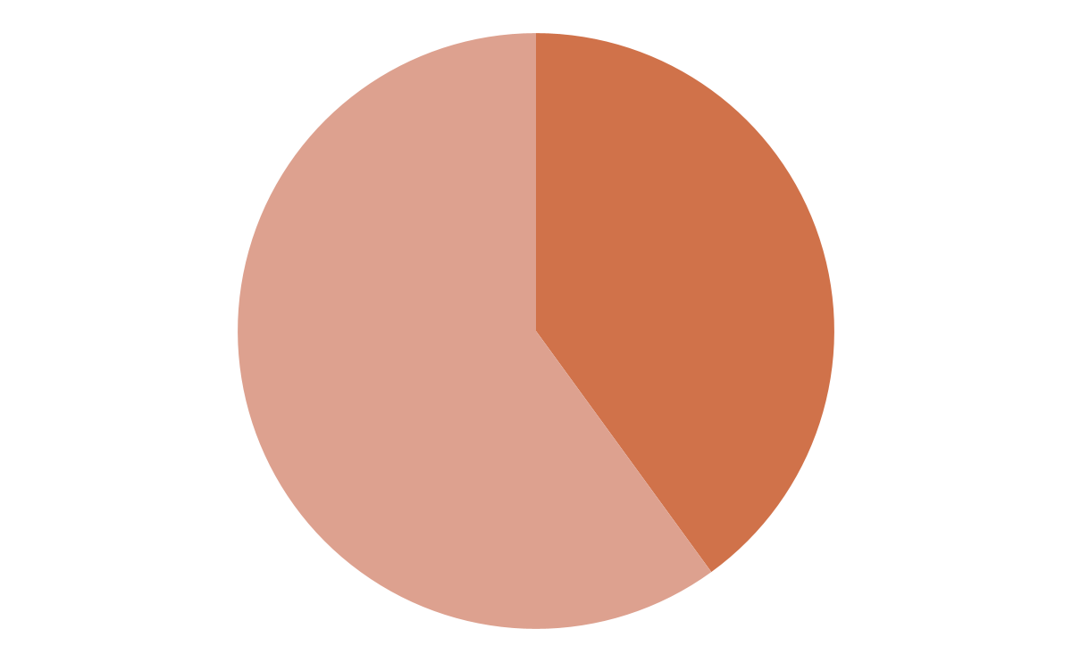
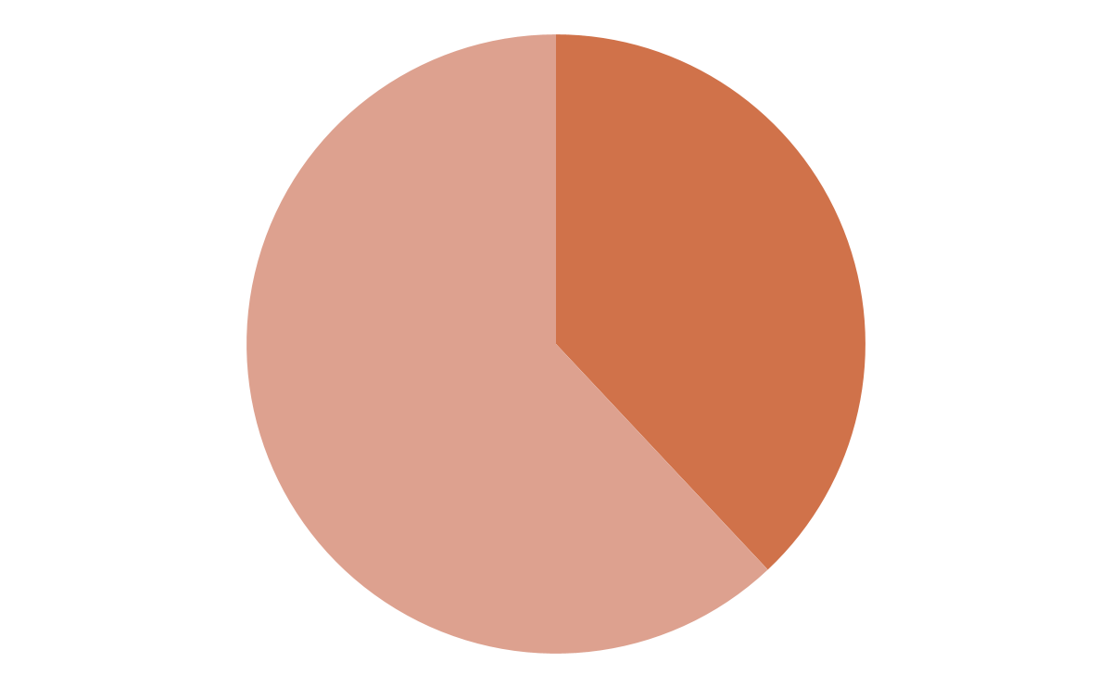
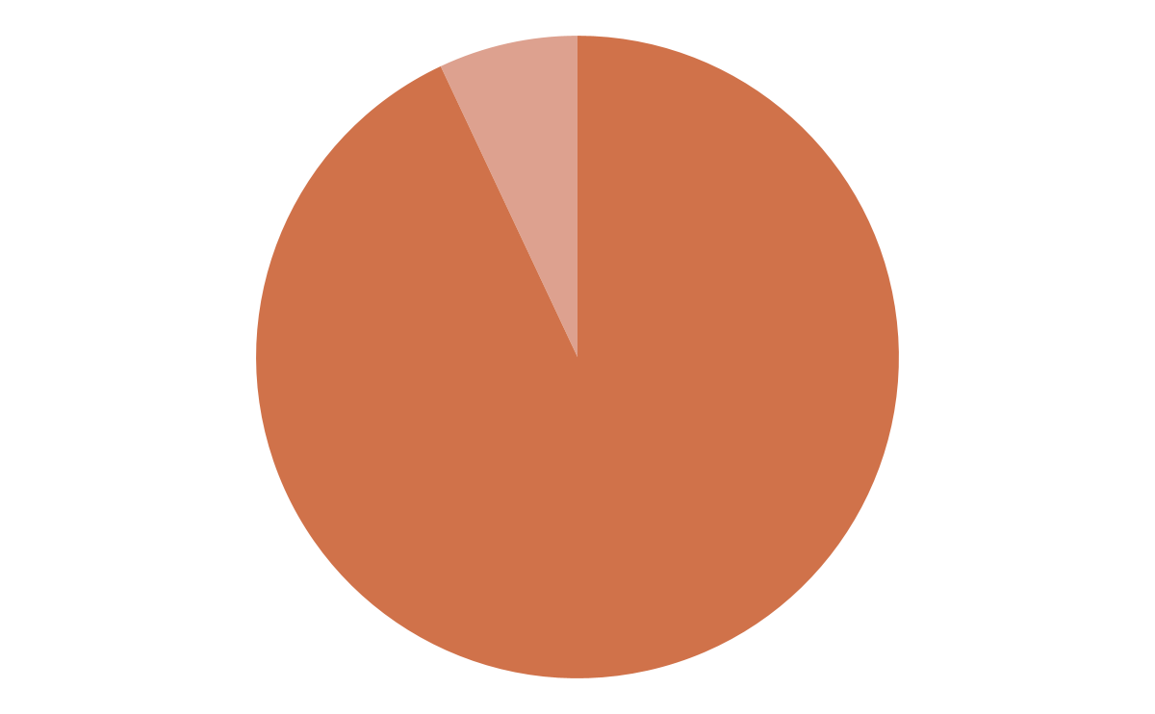
Preventive Health and Early Identification
49% of children enrolled in Medi-Cal received six or more well-child visits by 15 months*
40% of children in low-income families had a dental visit in the past year**
38% of children received a developmental screening, with Black children screened at the lowest rate*
93% of kindergarteners had up-to-date immunizations***
*Source: Children Now. 2025 Scorecard.
**Source: Children Now. 2025 California Children’s Report Card Scorecard: Low-income children (ages 0-5) who visited a dentist in the last year: Sonoma County.
***Children Now. 2025 Kindergartners with up-to-date immunizations: Sonoma County.

Slide 37
Thank you!

Slide 38
Measure I:
Existing Initiatives & Supports
Notes:
You received a snapshot of existing ECE and Child/Perinatal Health Investments and Initiatives in Sonoma County that are relevant to Measure I
Please note that for some, due to lack of certainty of the state/federal budget, some of these will be impacted
This is not intended to be comprehensive
It is just a snapshot so that all members have an idea of some of the work that is already underway
Natalie Wright & Leslie Corral Cisneros, First 5 Sonoma County Program Directors, are here if you have any questions about these efforts

Slide 39
Proposed FY 25-26
Early Investment Strategies
Sonoma County Measure I
Notes:
Reference to the F5SC Strategic Plan
reminder of balance 60/40
We will try to stay in the balance in this meeting, however, if it comes down to not being able to reach the exact number, we will need to move on and we can provide your comments to the Commission when they review your recommendations
these are recommendations to go to Commission for approval
Process: Will be public comment after the motions, introduce Natalie and Leslie to provide overview (this is a separate doc, not in slides)
Health recommendations (soft agreement)
ECE recommendations (soft agreement)
Now we will look at why there are early recommendations, meaning prior to the completion of the strategic plan

Slide 40
Early Investments: Rationale
Respecting Community Ownership
Demonstrate to Sonoma County taxpayers that their contributions are being put to work right away.
Partnering with the Community
Early investments will strengthen partnerships with local organizations and raise awareness, building community capacity to support child/maternal health and early education.
Responsive and Strategic Approach
Balancing immediate action with long-term planning ensures we are both proactive and thoughtful.
Pilot projects and targeted early investments offer impact AND gather insight for the broader strategic plan.
Responsive to Urgent Needs & Planning Needs
Sonoma County families and workforce face urgent challenges NOW. Target investments when the need and paths to support are clear.
Leverage the opportunity to resource needs for deeper analysis to support strategic planning
Notes:
Christina
refer to slide and then add
Between May and October 2025, the CAC will discuss and propose recommendations on the use of tax revenue for Early Care and Education and Health, as outlined in the measure.
These recommendations will be submitted to the First 5 Sonoma Commission for consideration and integration into the unified First 5 Sonoma Strategic Plan (July 1, 2026 - June 30, 2031), which will include funds from Proposition 10 and Measure I.
The 5-year Measure I allocation for the strategic plan term is estimated at approximately $162 million.
The first community investments under the new Strategic Plan are scheduled to begin on July 1,2026.
Early recommendations will bridge the gap between this summer and next summer by allowing some funding to flow into the community between September 1, 2025, to June 30, 2026.
As soon as the early recommendations term (June 30, 2026) the funds will be available under the new strategic plan.
On the next slide we will look at the process

Slide 41
Early Investments: Process
CAC: Vote on support of recommendations of early investments for FY 25-26
First 5 Sonoma County Commission: Review, discuss, and vote to approve recommendations for early investments and allocations of associated Measure I funding at June 23 Commission meeting
First 5 Sonoma County staff: Develop and implement procurement processes to support the Commission-approved early investments. Contracts to start September 1 - June 30, 2026.
County Treasurer: As per executed Interagency Agreement with Sonoma County Board of Supervisors, first quarter of revenue will be transferred on August 15th and quarterly thereafter.

Slide 42
Early Childhood Health/Mental Health & Perinatal Mental Health:
Proposed FY 25-26
Proposed Early Investment Strategies for Sonoma County Measure I
Notes:
We will start with Natalie Wright and Health
She is going to go through all of the recommendations and then take any questions or comments
If you have a question of comment while she is speaking, it would be greatly appreciated if you could write it down and then she will have time to address your question or comment after she finishes

Slide 43
Health:
Proposed Early Investment Strategies
GOAL: Expand Access to Perinatal Mental Health Screening & Community-based & Clinical Interventions
Strategy | Allocation
1. Build the clinical and community-based workforce to support Perinatal and Early Childhood Mental Health. Examples may include tuition reimbursement, scholarships, training, and similar workforce-building supports. | $1,100,000
2. Expand comprehensive and clinical community-based lactation support. Examples may include family and partner-centered initiative design, public awareness campaign, workplace supports, and workforce development. | $1,200,000
3. Pilot and scale holistic perinatal health and wellness supports. | $400,000

Slide 44
Health:
Proposed Early Investment Strategies
GOAL: Expand Access to Mental Health/Behavioral Health Support for Children 0-5 and Their Families within Homeless Services and in ECE Settings
Strategy | Allocation
1. Support health and mental health needs of young children, pregnant women, and/or families with children 0-5 who are experiencing homelessness and currently engaged in homeless services | $600,000
2. Increase access to behavioral and early intervention consultation services for ECE providers | $200,000

Slide 45
Health:
Proposed Early Investment Strategies
GOAL: Address Inequitable Geographic Access to Birthing Supports
Strategy | Allocation
1. Support planning, including a feasibility study regarding the needs and options for a Sonoma County birth center and/or postpartum center. | $100,000
GOAL: Increase Integration & Coordination across Systems and Organizations
Strategy | Allocation
1. Build on existing efforts to develop a countywide Early Relational Health Consortium and collaboratively develop an Early Relational Health Roadmap. | $300,000

Slide 46
Health:
Proposed Early Investment Strategies
GOAL: Increase Awareness, Reduce Stigma, and Direct Residents to Existing Resources Related to Perinatal Mental Health
Strategy | Allocation
1. Plan and implement a series of mixed media multilingual outreach and education communication campaigns that provide perinatal awareness, education, and resource connections for Sonoma County families. | $500,000

Slide 47
Health:
Proposed Early Investment Strategies
GOAL: Create the Measure I “Program Plan Evaluation” and develop a data collection strategy.
Strategy | Allocation
1. Hire an external evaluation firm. Please note, this is a shared cost of $300,000 with Health funding 40% and ECE funding 60%. | $120,000
TOTAL Proposed Health Early Investments | $4,520,000
Notes:
Christina to explain this slide
Natalie takes questions/comments
Christina to support if needed
Christina to get “soft vote” not official and then we will move onto ECE
Public comment will come after ECE is done and before the “official vote” is taken

Slide 48
Early Care & Education:
Proposed FY 25-26
Early Investment Strategies
for Sonoma County Measure I
Notes:
Turn over Leslie Corral Cisneros
We will use the same process
Leslie will go through all recommendations, then take questions and comments
Then a soft vote
Then motions, then public comment
Then final CAC discussion and official vote - this will be managed by Chair

Slide 49
ECE:
Proposed Early Investment Strategies
GOAL: Expand Access to Quality Early Learning Opportunities
Strategy | Allocation
1. Fund Facilities Grants Cycle to address existing and emerging facility needs. May include grants and/or forgivable loans. Examples include: support to address health and safety repairs, promote quality physical environments, expand licensing capacity, and related efforts. | $3,500,000
2. Provide mini-grants to ECE providers for quality early learning supplies and materials. | $450,000
Notes:
Facilities: High-quality early learning spaces are key to healthy child development but many child care providers in Sonoma County simply can’t afford the cost of keeping their facilities safe and up to standard. Repairs like fixing HVAC systems, removing mold, upgrading flooring, or adapting spaces for infants and toddlers can cost tens of thousands of dollars, and most providers don’t have that kind of money. Some end up using credit cards, personal loans, or dipping into their savings just to get by. When First 5 Sonoma County administered two rounds of facilities grants in Santa Rosa with ARPA funds, we received more requests than we could fund, even with a $2.7 million budget. That shows how great the need is. This investment would support a new round of facilities grants, ranging from $25,000 to $300,000, to help both centers and family child care providers make urgent repairs, improve safety, and expand their ability to serve more children, especially infants and toddlers. This is one of the most direct ways we can support providers and increase access to safe, quality care, just as Measure I promises.
Mini-grants: We know that the relationships between young children and their caregivers are what matter most but many early care providers don’t have the money to replace worn-out furniture, buy new learning toys, or invest in safety and outdoor equipment. They do this work out of love, but the costs add up fast, and their budgets are tight. This mini-grants investment would give providers small but meaningful funds to buy what they need whether that’s educational toys, culturally relevant books, safety supplies, or even basic technology to help run their business. These types of grants make a big difference in helping providers create safe, engaging spaces where children can grow and thrive. Past mini-grant cycles have had more requests than we could fund, so this is a chance to expand what’s working and help meet the growing demand, directly supporting Measure I’s goal to increase access to high-quality early learning.
Why now: The demand is there
Leslie - if somebody asks why fund this now as an early recommendation, I think you can say demand is there, you already have experience and you dont think there is any reason to delay getting this funds out.
I did not make any wording changes; as an FYI Natalie is linking the strategies to the goal. I am not saying you need to, but if you want to be consistent then you can say having a high quality learning environment is one part of quality ECE

Slide 50
ECE:
Proposed Early Investment Strategies
GOAL: Understand Facility Needs and Promote Sustainable ECE Development
Strategy | Allocation
1. Gain an understanding of ECE facilities needs and opportunities. Examples include: assessing countywide ECE facilities needs (all care types), assessing current county/city planning policies and providing recommendations to include ECE facilities in new development; related data collection to guide future ECE facilities investments. | $500,000
Notes:
Christina Proposed:
A previous strategy “Fund Facilities Grants” focuses on existing sites/homes. This strategy has two core parts. First is having an accurate assessment of countywide facilitates needs based on where children live and where existing facilitates are located.This is called a Facilities Needs Assessment.
We need a Facilitates Needs Assessment because before we can invest in expanding early care and education facilities, we need to fully understand what the current landscape looks like across the county. We know there are places, like Sonoma Valley and Cotati/Rohnert Park, that are designated child care deserts, and we know the number of licensed providers has gone down over the years.
We don’t have a full picture of where the gaps are, what facilities are outdated or underused, or which communities need the most support, especially when it comes to care for infants and toddlers, which is the hardest to find.
The second part of this strategy is reviewing County and City Planning and Building Policies and identifying where to propose changes. These changes could be things such as when a certain type of building is going through the permitting process, ECE needs must be considered. These needs would be specified in the updated policies. There are experts who have done this in other places in CA and had success in getting county and city planning and building approvals amended to consider ECE. Santa Barbara County and the City of Goleta (in Santa Barbara) is an example of a place that has done this. Having city and county policies consider ECE is a way to build facilitates in a sustainable way.
As a whole, this planning investment would help us collect that data and build a roadmap for the future. It would look at things like land use policies, facility conditions, and where we might be able to co-locate child care in housing developments. It would also help us act quickly when programs are at risk of closing, like when state or federal funding shifts, so we can try to keep those slots available for families. This investment helps us plan for growth, respond to community needs, and build a stronger system that works for families and providers across Sonoma County. This kind of work would involve collaboration with cities, county departments, and key community partners, and would require bringing in consultant support to guide the technical pieces.

Slide 51
ECE:
Proposed Early Investment Strategies
GOAL: Develop ECE Workforce Compensation and Family Scholarship Models
Strategy | Allocation
1. Support planning costs such as ECE key partner time, facilitation, listening sessions and other community engagement activities to develop Sonoma County's Workforce Compensation and Family Scholarship models. | $500,000
Notes:
Christina Proposed:
To create long-term solutions that help both families and early educators, we need time to plan together, especially with the people most impacted. This investment would cover the cost of planning activities like partner meetings, listening sessions, and community input to co-design two key pieces of Sonoma County’s early care system: a compensation model to better support and retain early educators, and a scholarship model to make child care more affordable for families.
The build a workforce compensation and a family scholarship programs, we need to build financial models showing how much we are able to invest for the current and projected size of the workforce. For families above existing income thresholds to receive child care subsidies, we need to understand the impact of different sliding scale options.This will require specialty skills.
This investment will helps us build an equitable and informed foundation, so future funding goes where it’s most needed and truly supports the Measure I goals of equity, access, and stability for children, families, and the workforce.This effort could be led by multiple consultants who can inform the design, lead community engagement, and develop an evaluation framework to lay the foundation for these models.

Slide 52
ECE:
Proposed Early Investment Strategies
GOAL: ECE Workforce Development and Stabilization
Strategy | Allocation
1. Offer financial incentives to family child care providers who are providing care that is in critical need throughout Sonoma County. Examples include: Infant/Toddler care, weekend care, shift work care, early morning or evening care, or care for young children with significant health or other special needs. In future years, this will be updated under the broader umbrella of workforce compensation supports. | $1,000,000
2. Support the Sonoma County ECE Apprenticeship program needs, including cost of paid apprenticeships and staffing. | $250,000
Notes:
Incentives for FCCH:
Family child care providers are the backbone of our early care system, especially for families who work nontraditional hours or need specialized care. Yet they are among the most under-resourced in the field.
This investment would provide financial incentives to family child care providers offering care that’s in critically short supply, like infant and toddler care, evening or weekend hours, or care for children with special needs. These types of care are often harder to find and more demanding to provide, yet they are essential for working families across Sonoma County. Sadly, large percentages of FCC and their families are on public benefits because their wages are so low (added).
Offering incentives not only acknowledges the value of this work, it helps stabilize and retain a segment of the workforce that is essential to expanding access in line with Measure I’s goals. These incentives may change after the work of the done in the previous strategy done to create a comprehensive ECE Workforce Compensation Plan. However, due to the critical shortage of infant and toddler care which is often provided by FCC and due to the extremely low wages earned by most FCC, I am recommending this as an intermediate step so that FCC are not waiting nearly 1.5 years for relief under the main strategic plan. (added) - (Leslie I will go over the timeline in previous slides.)
Apprenticeship Program:
The early care and education field is facing a workforce crisis, and without new strategies to recruit and retain educators, we can't expand access for families. The Sonoma County ECE Apprenticeship Program is a critical pipeline for developing a local, skilled workforce. It offers a paid pathway that combines hands-on experience with mentorship and college coursework while embedding individualized supports at the junior college through services such as tutoring and technical assistance.
This investment would help cover apprentice salaries at participating early learning programs. It would also support staffing at Santa Rosa Junior College to implement the program and begin building the capacity needed to sustain and scale it over time. This program was piloted with time-limited grant funding, and now needs local investment to continue and to grow into the long-term solution Sonoma County needs to address its early educator shortage.
Changes made in red

Slide 53
ECE:
Proposed Early Investment Strategies
GOAL: Increase Awareness, Provide Critical Information to Parents, Direct Residents to Existing Resources
Strategy | Allocation
1. Plan and implement a series of mixed media multilingual outreach and education communication campaigns regarding importance of early brain development, early care and education, and providing ECE resource connections for Sonoma County families. | $500,000
Notes:
Families can’t access resources they don't know exist. A multilingual, mixed-media communication campaign would raise public awareness about the importance of early brain development, the value of quality early care and education, and how to connect to trusted local ECE resources. This is especially critical for families who are new to parenting, new to the county, or navigating language or access barriers. The campaign would center equity by reaching families in culturally relevant ways, on social media, radio, print, and in community spaces with clear, consistent messages in the languages they speak. It's an essential strategy to ensure public investments actually reach the families they're intended to support, while reinforcing the long-term value of early learning.
No changes from Christina

Slide 54
ECE:
Proposed Early Investment Strategies
GOAL: Create the Measure I “Program Plan Evaluation” and develop a data collection strategy.
Strategy | Allocation
1. Hire an external evaluation firm. Please note, this is a shared cost of $300,000 with Health funding 40% and ECE funding 60%. | $180,000
TOTAL Proposed ECE Early Investments | $6,880,000
Notes:
Christina comment - I will cover this when I do it for health, which will be before you.
Leslie talking point:
This is cost sharing for the same external evaluation consultant that you heard about in the health section

Slide 55
Guidelines for Public Comment
Directrices para los comentarios públicos
Public comments are brief statements intended to inform the CAC and First 5 about the topic/Action Item
Comments from the public at public meetings do not include questions and is not intended to be a dialogue
Appointed Council members and First 5 staff and consultants are discouraged from responding or discussing topics with the public (can potentially constitute a Brown Act violation)
Time limits can (and typically will) be imposed per comment and/or for total time allotted
Los comentarios públicos son declaraciones breves destinadas a informar al CAC y a First 5 sobre el tema o punto de acción.
Los comentarios del público en reuniones públicas no incluyen preguntas y no están destinados a ser un diálogo.
Se desalienta a los miembros designados del Consejo, al personal de First 5 y a los asesores de responder o discutir temas con el público (ya que podría constituir una violación de la Ley Brown).
Se pueden imponer límites de tiempo por comentario y/o para el tiempo total asignado (y típicamente se impondrán).

Slide 56
Action Item:
Recommendations for Early Investments
ECE
Total Measure I Allocation
$6,880,000
60%
Health
Total Measure I Allocation
$4,520,000
40%

Slide 57
Next Steps
June 26 CAC Meeting:
Vote to adopt amended Bylaws
Discuss and vote on draft recommendations for 2026-2031 Measure I Goals & Strategies: Equitable Access to Quality ECE Focus Area
Notes:
This will include all ECE items other than Workforce Compensation

Slide 58



Next Community Advisory Council Meeting:
June 26, 2025
3:00-5:30 pm
NOTE NEW LOCATION:
120 Stony Point, Suite 155, Santa Rosa

