Slide 1

Measure I
Sonoma County Child Care & Children’s Health Ordinance
Community Advisory Council
June 26, 2025
Notes:
(3:00 – 3:05)
Welcome group and open meeting – Adriana

Slide 2

Today, the First 5 Sonoma County Commission and the Measure I Advisory Council is humbled to bring us together on the ancestral lands of the Southern Pomo People. We celebrate the active work of their descendants to preserve & nourish their indigenous culture and identity.
We acknowledge the Southern Pomo People as the traditional stewards and custodians of this area and honor with gratitude the land itself, all of its ancestors - past, present and future.
Ancestral Land Acknowledgement
Notes:
(3:00 – 3:05)
Adriana
Today, First 5 Sonoma County is humbled to bring the Measure I Community Advisory Council together on the ancestral lands of the Southern Pomo People. We celebrate the active work of their descendants to preserve & nourish their indigenous culture and identity. We acknowledge the Southern Pomo People as the traditional stewards and custodians of this area and honor with gratitude the land itself, all of its ancestors - past, present and future.

Slide 3
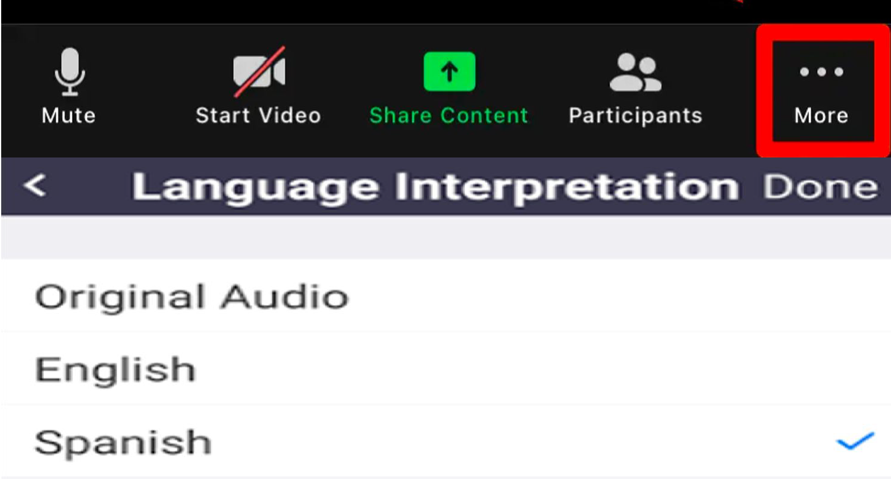
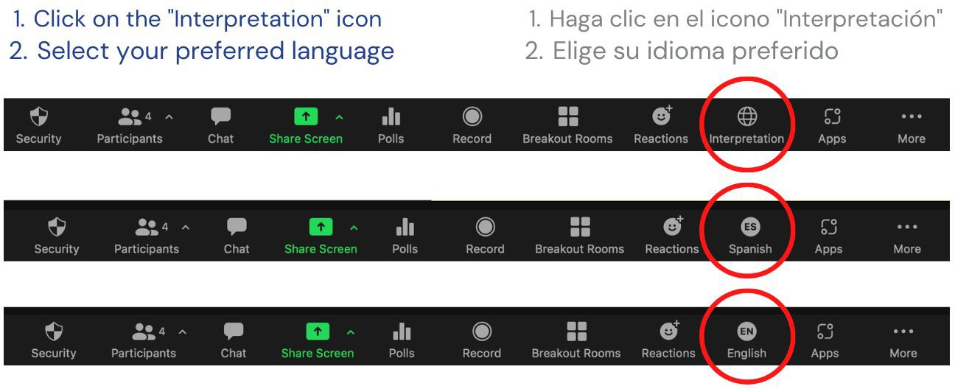
Welcome! ¡Bienvenidos!
Zoom Interpretation/Interpretación de Zoom
Computer / Computadora
Phone / Por Telefono
Notes:
(3:00 – 3:05)
CHRISTINA
A few words about public participation in CAC meetings. The CAC meetings are held in person and the public is welcome to join us. We have a virtual option for members of the public and the Zoom link can be found at the top of the agenda that will always be posted on the First 5 website at least 3 days prior to each meeting.
For those members of the public on Zoom, please click on the globe icon to select your language preference, either English or Spanish.
(Sandra) In person - if needed, Spanish interpretation, headsets are available…
I will do my best to speak slowly enough to make interpretation as seamless as possible
Everybody can help by avoiding cross-talk while people are facilitating, presenting or making public comments.

Slide 4
Agenda Review
&
Minutes Approval
Notes:
(3:05-3:10)
ADRIANA
Review Agenda & Purpose/Goals for Meeting
Just to ground us in the role of the Council before we get into the purpose of today’s meeting and the agenda:
The Measure I Community Advisory Council was established by the Board of Supervisors to provide input and recommendations to First 5 staff and commission in their role as the administrator of Measure I.
You were each appointed to bring your content expertise around ECE or children’s health or perinatal mental health and/or your lived experience as a parent or provider to the table collaboratively form advisory recommendations as a Council. This is quite different from a roundtable or a focus group, which is much more informal and elevates the opinions of individuals over the consensus of the group.
As an appointed body, the CAC serves as a critical sounding board for staff and a formal, public opportunity to discuss recommendations around the goals and strategies, funding levels and evaluation of impact.
So today, after we read the community agreements, which we want to do at the beginning of every meeting, we’ll vote on the amended bylaws, then we’ll hear a report from First 5 staff about Commission actions around CAC recommendations.
After that, Leslie will share some insights from Community Engagement related to ECE. Then, Christina will spend about 15 minutes to review some high level data points related to quality Early Care and Education in Sonoma County.
The main item for today will be presentation by Leslie, followed by a discussion and Council action around proposed investments in the 5-year plan related to expanding access to Quality ECE.
ACTION ITEM Approve May 22, 2025 CAC Meeting Minutes
Per the CAC Bylaw, there needs to be ⅔ of the attending members present to pass a vote. Today we have “ “ so we need at least “ “ to pass a vote.
Explain process for approving the minutes and then implement:
Ask members if they have edits to the minutes?
Take the edits/discussion if CAC agrees on edits
Public comment
If public comments make edits, then ask CAC members if they want to accept the edits proposed.
“Are we ready to take a vote?” (assuming yes)
“We are voting to approve the minutes (as amended)”
Ask members to Thumbs UP or Down
Summarize the vote (X = Yes; Y = No)
This passes (need 7 to pass; change number based on bylaws if needed re attending members)

Slide 5
Community Agreements
Notes:
3:10-3:15
ADRIANA
Each member read one agreement, start with Isabel who will be seated at one of the ends next to Joseline

Slide 6

Public comment
on non-agendized items
Comentarios públicos sobre temas no incluidos en la agenda
Notes:
3:15-3:3:25)
CHRISTINA
There are different opportunities for public comment:
Items NOT on the agenda, which will do in just a moment
Items on the agenda for ACTION. For example, on today’s agenda there is an action item to approve recommendations for early funding with Measure I. Public comments for the recommendations item will be taken after the presentation is over and there is a motion and a second to approve the recommendations. Public comment will be taken before the vote.
If a member of the public attending in person would like to make a public comment, please come to the podium, form a line if necessary and when it is your turn, state your name first and then you will have 2 minutes to offer your comments.
If a member of the public attending virtually would like to comment on any agenda item, please use the “raise hand” feature in the webinar when I call for public comment on the item you wish to comment on. When your name is called, you will be unmuted and you will have 2 minutes to offer your comments to the Council.

Slide 7
Guidelines for Public Comment
Directrices para los comentarios públicos
Public comments are brief statements intended to inform the CAC and First 5 about the topic/Action Item
Comments from the public at public meetings do not include questions and is not intended to be a dialogue
Appointed Council members and First 5 staff and consultants are discouraged from responding or discussing topics with the public (can potentially constitute a Brown Act violation)
Time limits can (and typically will) be imposed per comment and/or for total time allotted
Los comentarios públicos son declaraciones breves destinadas a informar al CAC y a First 5 sobre el tema o punto de acción.
Los comentarios del público en reuniones públicas no incluyen preguntas y no están destinados a ser un diálogo.
Se desalienta a los miembros designados del Consejo, al personal de First 5 y a los asesores de responder o discutir temas con el público (ya que podría constituir una violación de la Ley Brown).
Se pueden imponer límites de tiempo por comentario y/o para el tiempo total asignado (y típicamente se impondrán).
Notes:
3:15-3:3:25)
CHRISTINA
Public Comment - Items that are NOT on the agenda – F5 Staff use TIMER and Project on Screen
Public comments are brief statements intended to inform the CAC and First 5 about the topic/Action Item
Comments from the public at public meetings do not include questions and is not intended to be a dialogue
This means that after you make your comment, we will go to the next comment without discussion about your comment
Appointed Council members and First 5 staff and consultants are discouraged from responding or discussing topics with the public (can potentially constitute a Brown Act violation)
Time limits can (and typically will) be imposed per comment and/or for total time allotted

Slide 8
First 5 Sonoma County Staff Report
Notes:
3:25-3:30
ANGIE

Slide 9
Approve Amended Bylaws
Notes:
3:30-3:35
ADRIANA
As a reminder, when the Bylaws were first discussed and approved in the first CAC meeting so that we could conduct business as a publicly appointed body. However, there were members with suggested edits. Those edits were taken and, as appropriate to belong in bylaws, incorporated. These needed to be posted again prior to a new amendment vote. That is why we are taking this vote today.
Ask members if they have questions?
CAC Discussion (Q&A with F5 Staff if needed)
Public comment
If public comments make edits, then ask CAC members if they want to accept the edits proposed.
“Are we ready to take a vote?” (assuming yes)
“We are voting to approve the the CAC Bylaws (as amended)”
Ask members to Thumbs UP or Down
Summarize the vote (X = Yes; Y = No)
This passes (need 7 to pass)
ACTION ITEM

Slide 10
First 5 Sonoma County
Staff Report:
ECE Community Engagement Findings
Notes:
3:35-3:55
Leslie

Slide 11





Community Engagement Timeline
Early Learning Systems Workgroup
Early Learning Systems Workgroup
ECE Listening Session
Health Listening Session
Apr-Jun 2024
Oct-Dec 2024
Apr-Jun 2025
Jul-Sep 2024
Jan-Mar 2025
Early Learning Systems Workgroup
- Early Learning Systems Workgroup
- Equity First Focus Groups
- Alianza FCCH Survey
- QC Sonoma Consortium Meeting
Notes:
3:35-3:55
Leslie
EL Systems Workgroup
Convened for 8 meetings between May 2024-February 2025
5/10, 6/28, 8/21, 10/15, 10/28, 11/15, 12/3, 2/5
Development of Recommendations for EL Systems Investments - “Shovel-ready” in Years 1 & 2
Categorized needs by visibility and feasibility
In the next slide I will highlight the themes
In 2025 we’ve had a variety of community engagement efforts:
Our Strategic Planning consultants, Equity First, facilitated Focus Groups in March 2024 with families by age group and racial affinity, as well as health care and CBO providers. For ECE:
1 Group consisted of Home-based Family Child Care providers
Spanish
Another consisted of Center-based Site Directors and Supervisors
Private and CSPP sites
The FG elevated needs for wrap-around services that are culturally and linguistically responsive, supports for children with disabilities, and families facing financial instability
Also in March, we surveyed participants in our Alianza - Small Business Admistration FCC Comprehensive Network to get a snapshot of their enrollment needs among licensed
To better understand provider capacity and enrollment needs across the region, we asked licensed family child care homes to share how many spaces they currently need to fill. In total, 22 providers responded, representing four geographic regions: Santa Rosa, Windsor, Rohnert Park, and Sebastopol.
Santa Rosa had the highest number of providers (18 in total) reporting open spaces.
We found that the majority of licensed Family Child Care Homes surveyed are operating below capacity, with over half needing to fill four or more spaces–raising concerns about financial sustainability. Most of the unfilled slots are concentrated in Santa Rosa, which accounts for the largest share of reported need. Providers reported that some families they want to serve are on the waitlist.
In May, we partnered with VIVA Social Impact Partners to host an ECE Listening Session. I will share highlights of that session in subsequent slide as well.
Also in May the QC Sonoma Consortium met to brainstorm workforce pipeline supports.
In June F5SC partnered with VIVA Social Impact Partners to host an Health Listening Session consisting of…
Additional notes for reference only:
Significant unfilled capacity exists across the region
Out of 22 providers, 12 (55%) reported needing to fill 4 or more spaces.
This suggests that over half of the participating providers are operating significantly below capacity, potentially impacting financial sustainability.
Most providers are operating below capacity
Only 5 providers (23%) reported needing to fill just 1 space, suggesting most are not nearing full enrollment.
The remaining 77% (17 providers) need to fill 2 or more spaces, with a majority needing 4 or more.
Santa Rosa represents the largest share of reported need
18 of the 22 providers (82%) are located in Santa Rosa.
Collectively, Santa Rosa providers reported 82 open enrollment spaces, accounting for the bulk of the regional total.

Slide 12
Community Engagement Findings:
EL Systems Workgroup & Focus Group Themes
Access
Workforce
Support for High-Quality Care
Facilities & Learning Environment
Infrastructure & Coordination
Notes:
3:35-3:55
Leslie
EL Systems Workgroup
Themes that emerged from the development of Recommendations for EL Systems Investments - “Shovel-ready” in Years 1 & 2

Slide 13
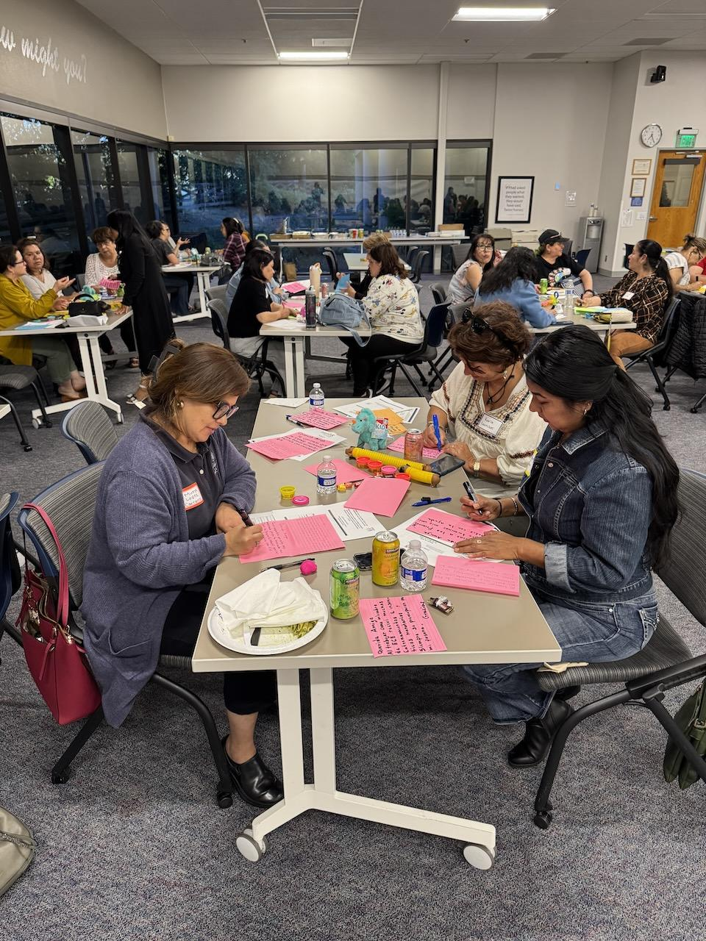
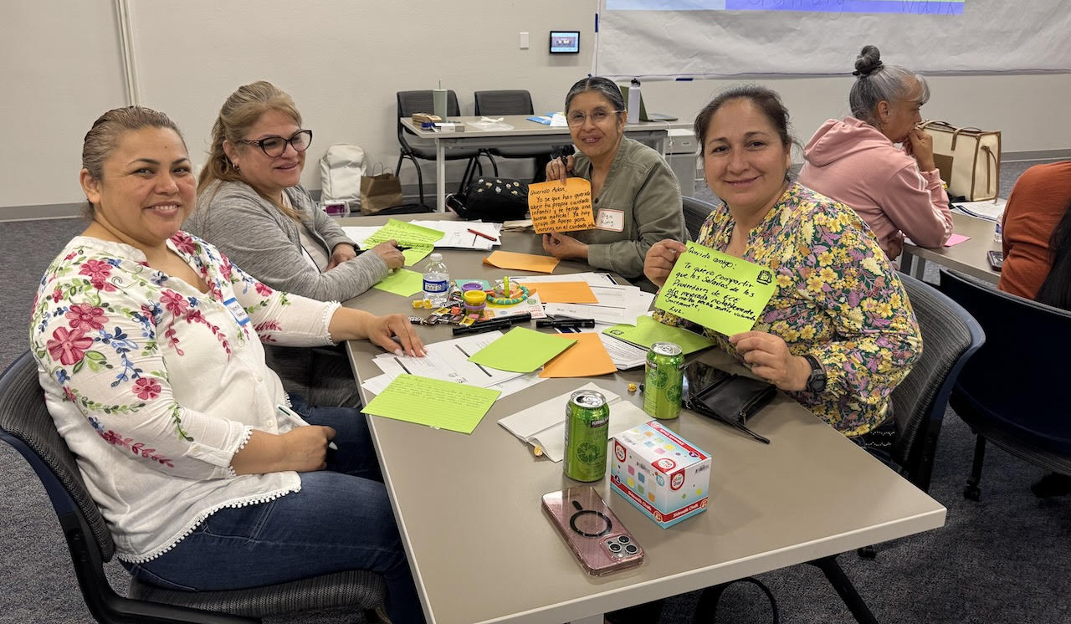
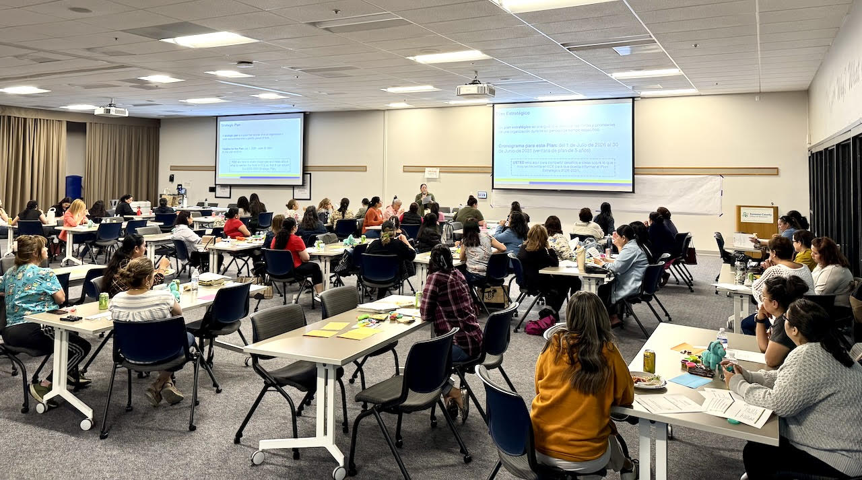
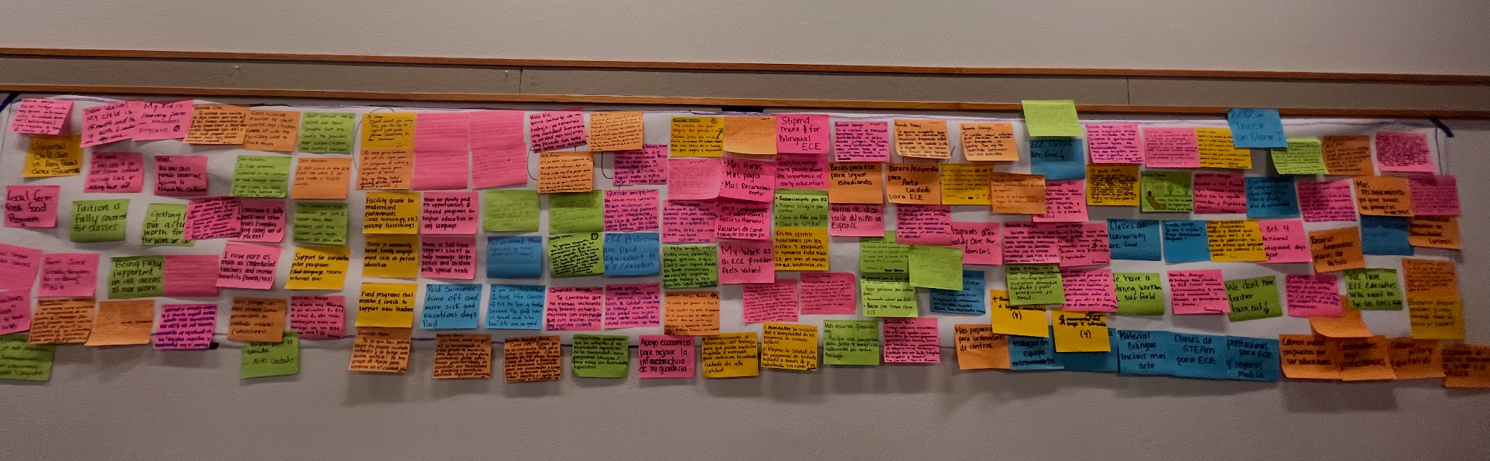
Community Engagement:
ECE Listening Session
50 ECE professionals attended
Representation from Licensed FCCH, Licensed Center, and Alternative care settings
Notes:
3:35-3:55
50 Participants
Center, Home-Based providers, and Alternative Setting Providers

Slide 14
Community Engagement Findings:
ECE Listening Session Themes
Access
Universal High-Quality Care and Family Scholarships
Workforce
Compensation, Education, & Recruitment
High-Quality Care
Professional Development & Coaching
Facilities & Learning Environment
Grants
Wrap-around Family Supports
Parent Education Workshops, Stipends for Families
Notes:
3:35-3:55
Leslie
Expanding Access to High-Quality Care
Universal High-Quality Care
Family Scholarships
Strengthening and Sustaining the Workforce
Wages - Funding the subsidy care gap to account for the true cost of care; especially for infant and toddler care; higher salaries to adjust to SoCo’s living costs.
Benefits - Retirement, sick pay, paid time off, insurance
Substitute Pool
Funding for floating staff at centers and assistants in FCCHs
Education - Free courses/paid tuition or scholarships; coursework to better prepare for serving students with disabilities;
Increase and retain the workforce -
Advancing High-Quality Care
Local food program
Supporting children with disabilities
Coaching and mentorship opportunities
Funding to improve Facilities & Learning Environments:
Grants for facility improvements
Challenges with leasing spaces
Wrap-around Family Supports:
Support with basic resources
Respect and Recognition
Feeling valued and recognized as an educator

Slide 15
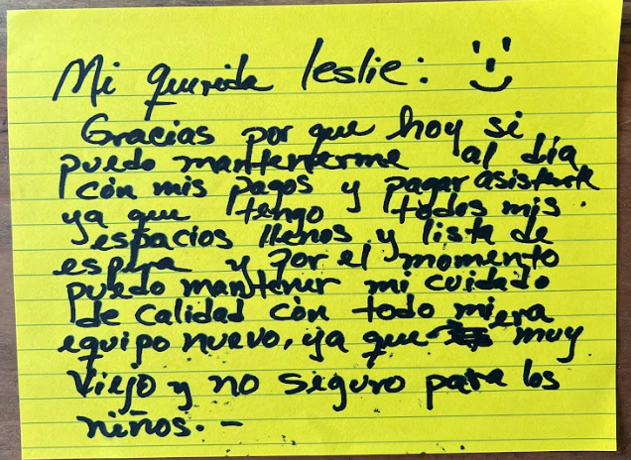




Community Engagement:
ECE Listening Session
Notes:
3:35-3:55
Leslie
Children with disabilities
Lack of access for families with disabilities - funding is being cut and specialized and places
Identified student with disabilities and no way of offering services due to bottle neck
Certificate for special education
Children left in

Slide 16
Equitable Access to Quality ECE
Measure I CAC
June 26, 2025
Notes:
(3:55 – 4:15
CHRISTINA
Topic Focus: Equitable Access to Quality ECE
Understanding what “Equitable Access” means in ECE
Indicators of ECE capacity, utilization, and quality
Share Back: What we have heard from Stakeholders
Recommendations from Early Learning Systems Investment workgroup and others
Action: Draft recommendations related to Equitable Access to High-Quality ECE

Slide 17
“I work in the fields [and] we go in very early, but the place where I take my children for child care is open from 7:00 am until 5:00 pm and this is very difficult for me because I have to ask to come in an hour late for work in the morning to be able to drop off my children.”
Parent Focus Group Participant
(Sonoma County CCPC’s 2024-2025 Needs Assessment)
Notes:
(3:55 – 4:15

Slide 18
Framework for Equitable Access
Notes:
(3:55 – 4:15

Slide 19
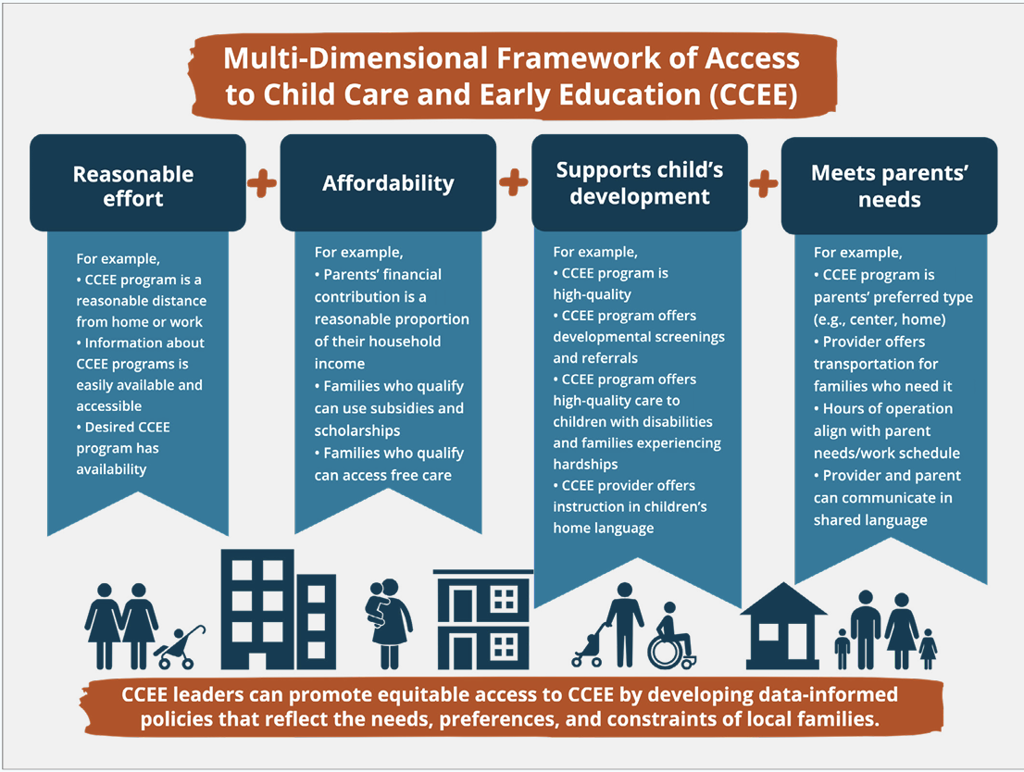
Framework for Equitable Access
“Access means that parents, with reasonable effort and affordability, can enroll their child in an arrangement that supports their child’s development and meets the parent’s needs.”
Pascall, K, & Maxwell, K. (2022) Defining and Measuring Access to Child Care and Early Education with Families in Mind. Report. Administration for Children and Families
Notes:
(3:55 – 4:15

Slide 20
Availability of Care (Supply)
Notes:
(3:55 – 4:15

Slide 21





Types of Early Care and Education Settings
Informal Care
(unlicensed/ license-exempt)
Family Child Care Home
(Licensed)
Center-Based Care
(Licensed)
District Preschool
(License-exempt)
Transitional
Kindergarten
Family, Friend, or Neighbor
Alternative settings (e.g., caregiver play groups, ECE enrichment programs, home visiting, etc.)
Small FCCH can serve up to 8 children
Large FCCH can serve up to 14 children
The “up to” served # depends on ages of children in care.
Offered in community settings (not a home) and may be one or more classrooms
This can be offered on a school site
Located on a school site, and administered by Local Education Agency (LEA)
A “new” grade which is not competensary
Schools are required to serve all who are 4 years old by Sept 1st
Notes:
(3:55 – 4:15
2 min
18/30
Christina
This slide is background information on TYPES OF CARE that may not be known by folks in the room who are not as familiar with early care and education
You will see that we broke out district offered preK due to the lic differences - they do have guidelines and regulations of course but it is a little different than most other center based preschools
For center based care, we mean programs such as Head Start and private centers
Alternative Settings/Informal Care:
Programming that is offered to support children’s development, but that does not require a license by the caregiver. Including but not limited to:
Parent/caregiver and child play groups
Family together literacy program
ECE enrichment programs
Home visiting

Slide 22
How is ECE Paid for in Different ECE Settings?
Informal Care
(unlicensed/ license-exempt)
Family Child Care Home
(Licensed)
Center-Based Care
(Licensed)
District Preschool
(License-exempt)
Transitional
Kindergarten
Privately paid
Unpaid
Subsidy (Alternative Payment Vouchers - also called AP Vouchers)
Privately paid
Subsidy (AP Vouchers)
Privately paid
Subsidy (AP, Head Start, CSPP, CCTR, Etc.)
CCTR = General Child Care & Development Programs
CSPP = California State Preschool Program
Subsidy: CSPP
Free (funded through Prop 98, education funding)
Notes:
(3:55 – 4:15

Slide 23
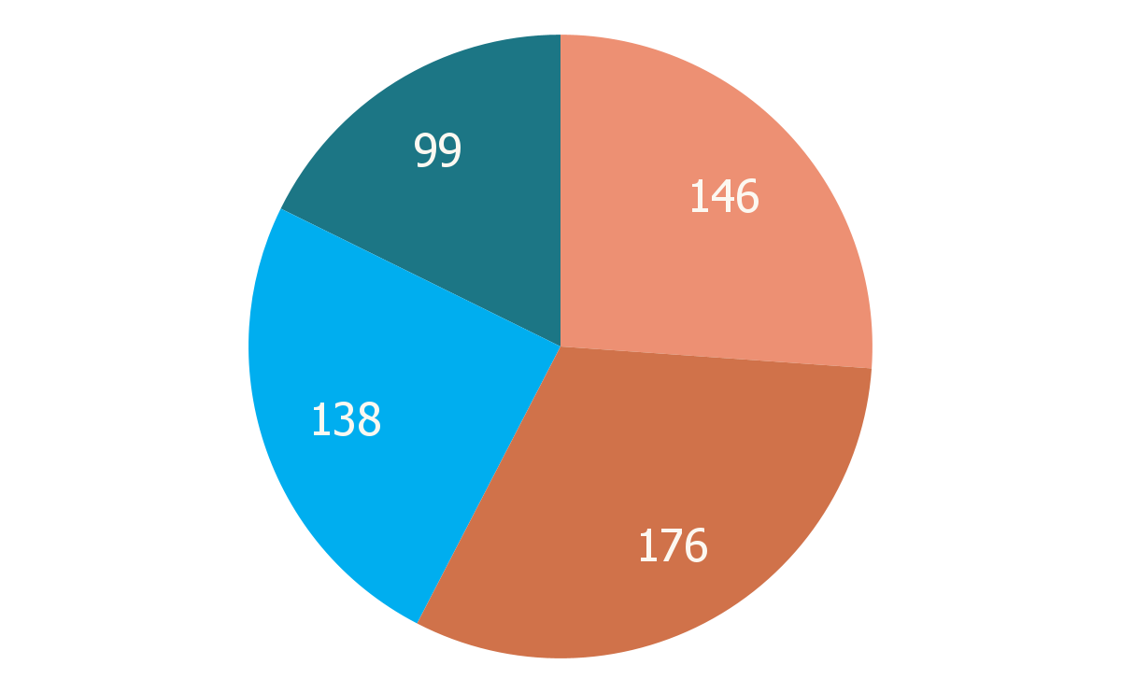
Child Care Landscape in Sonoma County*
Sonoma County had 559 early care and education programs in 2024:
This represents a sharp decline from 2019:
License- Exempt Centers
The number of licensed providers declined by 10.4% (624 → 559 providers)
The number of slots declined 30% (20,937 → 14,759 slots)
* This does not take into account new children served by Transitional Kindergarten (TK)
Licensed Centers
Large FCCHs
Small FCCHs
*Source: 2025 Sonoma County Early Learning and Care Needs Assessment
Notes:
(3:55 – 4:15
Except for large family child care homes, which increased their total number of slots by 436 to 1,476 total slots in 2024, all other provider types experienced a sharp decline. As of 2024, small family child care homes declined 22% to 1,236 slots, while centers and license-exempt centers combined declined by 34% to 12,047 slots.

Slide 24
Demand of Care
Notes:
(3:55 – 4:15

Slide 25
Subsidized Care
2,895
955
Children (ages 0-5) on the Centralized Eligibility List waitlist for subsidized early care slots.*
Children ages 0-4 enrolled in subsidized care, or 13% of children.*
*Source: 2024-2025 Sonoma County Early Learning and Care Needs Assessment; as of January 2025
Notes:
(3:55 – 4:15
As of January 2025, children ages 0-2 made up the largest proportion of children on the CEL (614 children or 42.4% of total list), followed by children ages 5-12 (493 children or 34.0%
of the total list) and children ages 3-4 (341 children or 23.5% of total list); however it is important to note that the total number of children on early care and education waitlists in the county exceeds these numbers, because programs especially those who enroll private pay families typically have their own waitlists.

Slide 26
Unmet Child Care Need - Infants*
91.8%
86%
Unmet need for subsidized child care for children ages 0-2.
Unmet need for child care, generally, for children ages 0-2.
*Source: 2024-2025 Sonoma County Early Learning and Care Needs Assessment
Notes:
(3:55 – 4:15
Child care deserts are areas where there is an insufficient supply of licensed child care to meet community needs. Child care deserts disproportionately impact low-income households, communities of color, and non-English-speaking households. These families face additional barriers such as lack of transportation, nontraditional work hours, and a shortage of bilingual providers

Slide 27
Unmet Child Care Need - Preschool*
64.7%
8.8%
Unmet need for subsidized child care for children ages 3-4.
Unmet need for child care, generally, for children ages 3-4.
*Source: 2024-2025 Sonoma County Early Learning and Care Needs Assessment;
Data is from 2020 and does not account for TK.
Notes:
(3:55 – 4:15
Child care deserts are areas where there is an insufficient supply of licensed child care to meet community needs. Child care deserts disproportionately impact low-income households, communities of color, and non-English-speaking households. These families face additional barriers such as lack of transportation, nontraditional work hours, and a shortage of bilingual providers

Slide 28

TK Enrollment
2,531
children were enrolled in TK in the 2024-25 school year.*
*Source: 2024-2025 Sonoma County Data from California Department of Education, DataQuest
Notes:
(3:55 – 4:15

Slide 29
Child Care Need*
Areas classified as child care deserts (extremely high unmet need):
Sonoma Valley (74.1%)
Santa Rosa (73.5%)
Cotati/Rohnert Park (71.6%)
Additional areas with significant unmet need:
North County (66.6%)
South County (63.4%)
West County (58.1%)
*Source: 2024-2025 Sonoma County Early Learning and Care Needs Assessment
Notes:
(3:55 – 4:15
Child care deserts are areas where there is an insufficient supply of licensed child care to meet community needs. Child care deserts disproportionately impact low-income households,
communities of color, and non-English-speaking households. These families face additional barriers such as lack of transportation, nontraditional work hours, and a shortage of bilingual providers

Slide 30
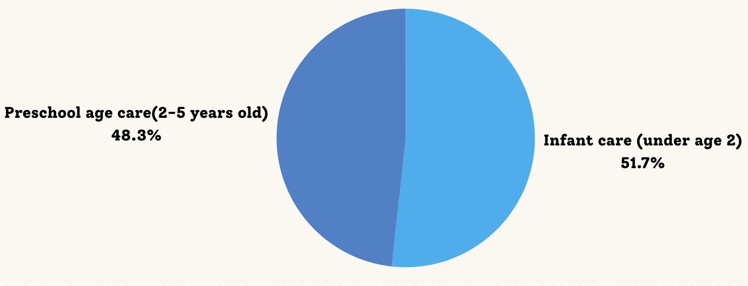
Sonoma County Family Requests from R&Rs
Of the 5,455 requests for care (for children under the age of 6), families specified which age range(s) of care they needed.
*Source: 2024-2025 Sonoma County Early Learning and Care Needs Assessment
** Data from March 2023 - March 2024
Notes:
(3:55 – 4:15
The majority of these requests were for full-time care

Slide 31
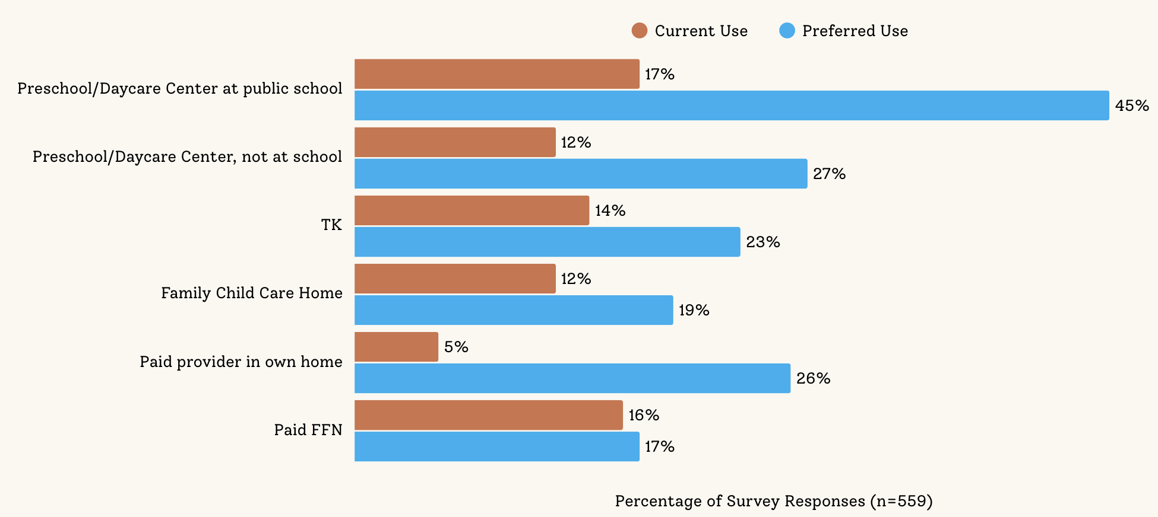
Families: Current Care vs. Preference for Care
*Source: 2024-2025 Sonoma County Early Learning and Care Needs Assessment; Family Survey
Notes:
(3:55 – 4:15

Slide 32
Affordability
Notes:
(3:55 – 4:15

Slide 33
Cost of Child Care*
Average Monthly Full-time Child Care Costs in 2024:
Low-income families spend, on average, 19.8% of their income for full-time infant center-based care.
The average cost of care exceeds the Regional Market Rate ceiling, meaning that providers offering subsidized care operate at a financial loss.
 | Infant/Toddler | Preschool
FCCH | $1,386 | $1,308
Center | $1,722 | $1,230
*Source: 2024-2025 Sonoma County Early Learning and Care Needs Assessment
Notes:
(3:55 – 4:15
The discrepancy between market costs and reimbursement rates means that even providers offering subsidized care often operate at a financial loss or are unable to serve as many families, further straining access and affordability for working parents.
This will be discussed more in depth in the next CAC Meeting

Slide 34
Supports Child Development (Quality)
Notes:
(3:55 – 4:15

Slide 35

Components of Quality in ECE Settings
Indoor and Outdoor Environment
Health and Safety
Teacher Training and Qualifications
Classroom Ratios
Teacher and Child Interactions/Relationships
Curriculum
Notes:
(3:55 – 4:15

Slide 36
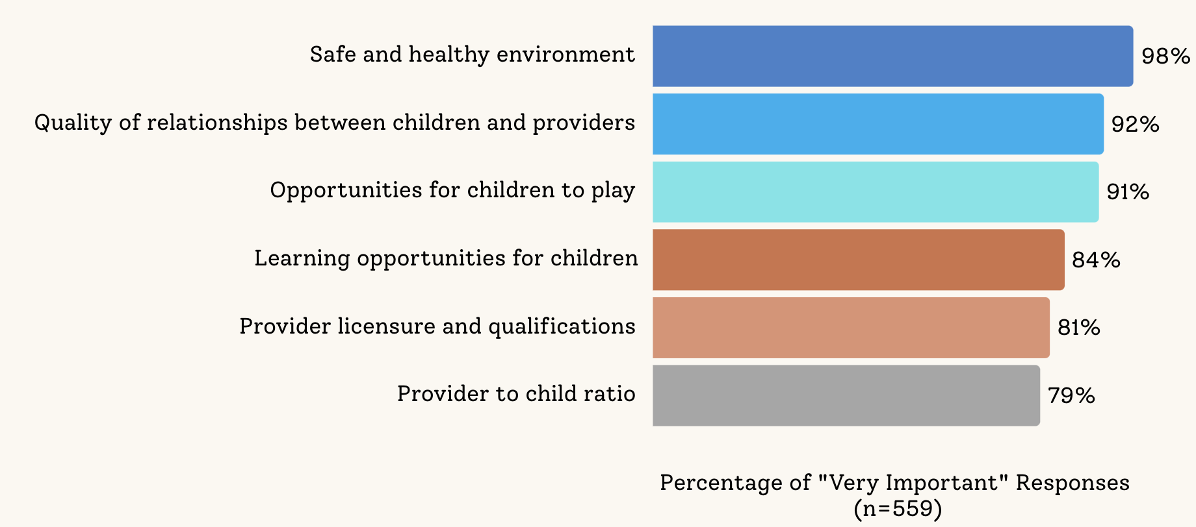
What Sonoma County Families Look For in Care Settings
*Source: 2024-2025 Sonoma County Early Learning and Care Needs Assessment; Family Survey n=559
Notes:
(3:55 – 4:15

Slide 37
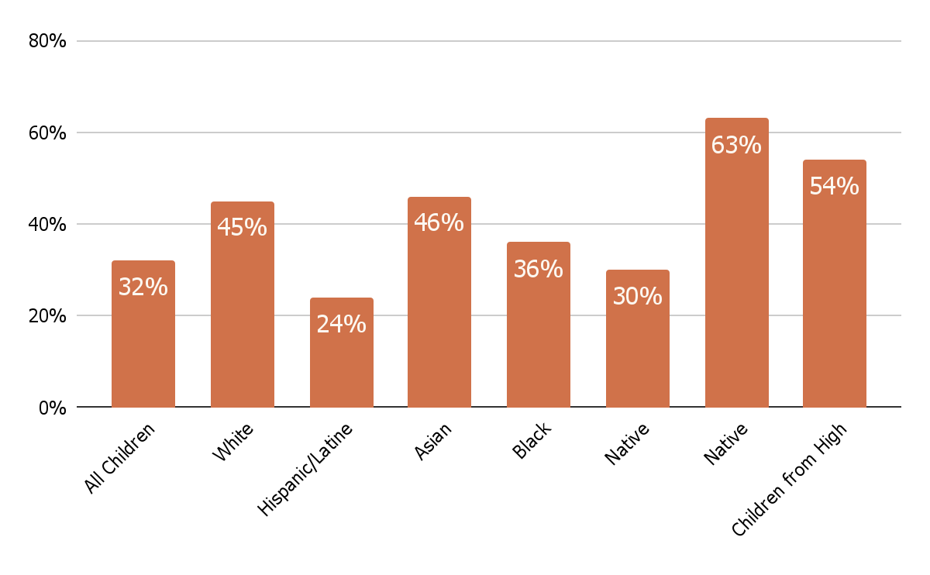
Kindergarten Readiness*
Average kindergarten readiness of all children in Sonoma County: 32%
*Source: First 5 Sonoma County. READY Annual Report 2023–2024.
All children
White
Hispanic/ Latine
Asian
Black
Native American
Children from High Income Families
PI/Hawaiian
Notes:
(3:55 – 4:15

Slide 38
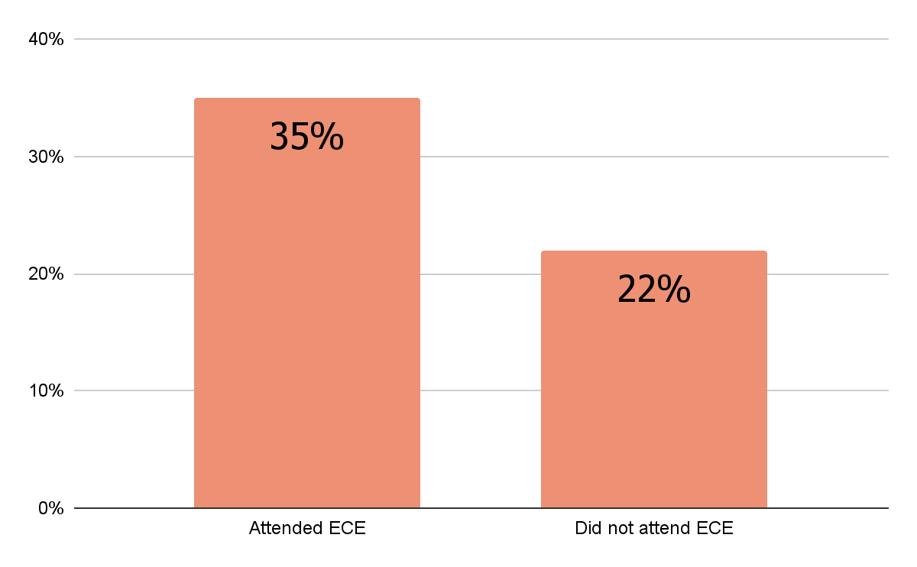
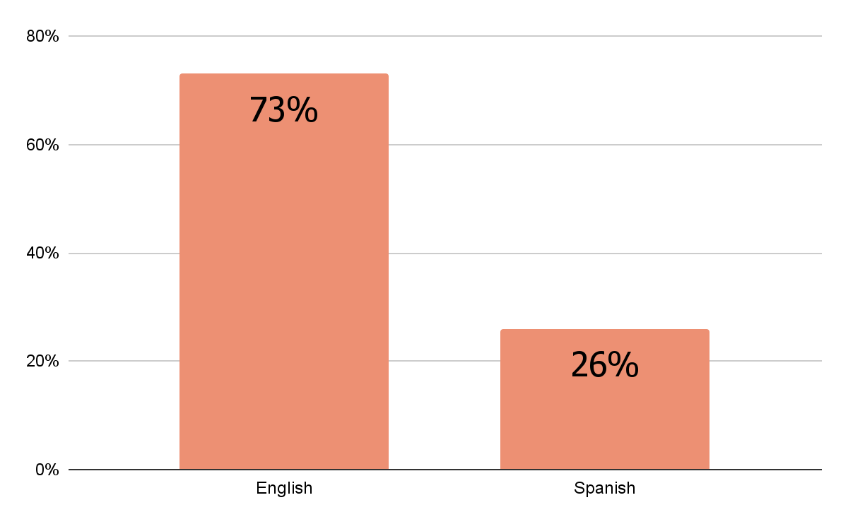
Kindergarten Readiness*
Children who attended early care and education programs were more likely to be ready for kindergarten.
ECE participation was much lower for Spanish-speaking families.
Attended ECE
Did not attend ECE
English
Spanish
*Source: First 5 Sonoma County. READY Annual Report 2023–2024.
Notes:
(3:55 – 4:15
The evaluation illuminated barriers to access and the desires of parents from Black and Latine/Hispanic communities. Common challenges were high costs, limited availability, inconvenient locations, and lack of transportation. In addition, both groups emphasized the importance of feeling safe and welcomed in educational spaces—an experience closely tied to whether staff respected and reflected their racial, cultural, and linguistic identities.

Slide 39
Measure I: CAC Meeting Sequence
Apr
May
Jun
Jul
Aug
Oct
Orientation
Laying the
Foundation
Landscape &
Early Recommendations
Equitable Access to Quality ECE
Draft Recommendations
ECE Workforce Compensation Draft Recommendations
Health
Draft Recommendations
Final Recommendations
ECE means Early Care and Education and is the term used professionally in the field. Others may refer to this as preschool, child care, etc.
Notes:
4:15
CHRISTINA
Ad-hoc in September

Slide 40
Early Care & Education:
Framework for Proposed Measure I Investments Supporting Equitable Access to Quality ECE, 2026-2031
Notes:
4:15 – 4:40
Leslie

Slide 41
Measure I Investment Recommendations
2026-2031 ECE Strategic Framework
Equity-Driven Investments
Our Approach:
Racial equity is the foundation because that’s where the deepest gaps begin
We apply a Targeted Universalism lens - we set a universal goal, and invest most in those furthest from it
We prioritize children in families who are low-income, unhoused, or historically underserved
Equity means building a system that meets providers and families where they are and removes barriers to opportunity
Our strategies aim to address systemic barriers, so families can access high quality care, and providers are supported to offer it
Notes:
4:15 – 4:40
Leslie
At the core of this investment plan is a belief that equity isn’t just about who we serve–it’s also about how we build the system. What we build must be inclusive and culturally responsive.
Racial equity is our foundation because that’s where the deepest and most persistent disparities show up.
We’re applying a Targeted Universalism approach and setting a bold goal that everyone deserves access to quality care, but prioritizing the families and providers facing the steepest barriers.
This means investing more in communities that are under-resourced, and in providers who may not have formal credentials but are doing high-quality, trusted work in their communities.
Our strategies are about fixing systems–whether that’s helping families navigate enrollment or making it easier for providers to grow their practice–not creating more hoops to jump through.
Equity here also means designing supports that are clear, culturally responsive, and structured to build capacity–not restrict access.

Slide 42
Measure I Investment Recommendations
2026-2031 ECE Strategic Framework
Where do we start?
Start where the need is greatest
Invest in what makes quality possible - people, environments, and data
Center family voice, racial equity, and community partnerships
Strategic Allocation Approach
Phased investments over 5 years - some strategies scale slowly, others are funded at a steady scale
Balance urgent needs with long-term system building
Stabilize access for families, support educators, and strengthen infrastructure
Notes:
4:15 – 4:40
Leslie
First, we start where the need is greatest - investing in those who’ve been excluded first, not last.
The data makes the need clear
Over 90% of the need for subsidized infant care is unmet. This is high across income lines.
Over 60%of subsidized preschool needs are unmet.
Over 40% of our youngest children rely on public assistance.
These numbers aren’t just statistics-they reflect the lived reality for thousands of families in Sonoma County.
I would also be remiss if I did not elevate the needs of our immigrant community in Sonoma County as they navigate an immeasurable amount of trauma in our current political landscape.
Second, we’re not just funding programs - we’re investing in what makes quality possible: the people who provide care, the environments children learn in, and the data and systems that connect it all.
Finally, we center family voice and community partnerships in everything we do. Sonoma County’s ECE system
Our allocation approach reflects this: some strategies scale up slowly, especially those that need time to build infrastructure. Others are funded evenly to provide consistent support.
It’s about balancing urgency–what families and providers need right now–with long-term system building that will last well beyond this five-year window.

Slide 43
Measure I Investment Recommendations
2026-2031 ECE Strategic Framework
What is an allocation?
An allocation refers to a high-level estimate of how much funding is planned for a particular strategy, goal, or initiative during a specific period.
Allocations help with long-term planning and transparency by showing how funds may be distributed over time.
While allocations are based on current priorities and available funds, they may be adjusted over time to respond to changes in needs, capacity, or funding levels.
Please note: The proposed allocations are based on an estimated $30 million in annual revenue, with approximately $18 million (60%) dedicated to ECE investments each year, totaling $90 million over five years.
Notes:
4:15 – 4:40
Leslie

Slide 44
Early Care & Education:
Proposed Measure I Investments Supporting Equitable Access to Quality ECE, 2026-2031
Notes:
4:15 – 4:40
Leslie
I’m going to walk us through the proposed investment goals and strategies for early care and education.
As we move through each one, I invite your thought partnership. Are there any gaps or areas we’ve missed?
I’ll also share examples of the types of programs that could be funded under each strategy. These are just illustrative, not exhaustive.
If you have a specific program in mind, consider whether it aligns with one of the strategies outlined today. If it doesn’t, let’s discuss whether there’s a case to add a new strategy, keeping in mind that doing so would mean reallocating funding from an existing one.
We are thinking at a higher altitude - what areas do we want to see invested in our system and to help meet which goals? Where do we want to see a change in the next five years for families, children, and our early care and education professionals?

Slide 45
Equitable Access to Quality ECE
Proposed Investment Goals
Goal 1: Expand Equitable Access to High-Quality Care
Goal 2: Stabilize Workforce and Advance Education Pathways
Goal 3: Support Quality and Equity in Early Learning
Goal 4: Invest in Safe and Sustainable Facilities
Goal 5: Strengthen Early Learning through Meaningful Data, Family Voice, and Community Awareness
Notes:
4:15 – 4:40
Leslie
Descriptions - don’t read
Goal 1: Ensure working families--especially those historically excluded or underserved--can find and afford early care and education that meets their needs.
Goal 2: Support a diverse early childhood workforce by expanding access to education and career advancement opportunities, while stabilizing the workforce through competitive compensation, benefits, and retention incentives. - NOTE THIS WILL BE JULY
Goal 3: Promote equitable, culturally responsive, inclusive early learning environments through continuous quality improvement strategies that support trauma-informed care.
Goal 4: Address critical infrastructure needs, emergency preparedness, and promote long-term sustainability of the ECE system through grants and planning supports. Facilities investments prioritize health and safety upgrades, licensing expansion, and equitable access to quality learning spaces--especially in under-resourced communities.
Goal 5: Advance continuous improvement and equity by building robust data systems and evaluation practices that center family voices, while conducting targeted communications campaigns to raise awareness of quality initiatives among families, providers, and the community.

Slide 46
Equitable Access to Quality ECE
Proposed Investment Strategies
Goal 1: Expand Equitable Access to High-Quality Care
Strategy |  | Five-Year Total Allocation
1. Family Scholarships: Provide sliding-scale scholarships for families on the waitlist for subsidized care and families who do not qualify for state or federal child care subsidies but still face affordability barriers. Please note: The model that will be used for family scholarships will be developed in FY 25-26 with extensive community engagement. |  | $15,861,000
2. Support Non-Traditional Early Learning Models: Invest in and elevate non-traditional early learning programs to support family literacy and build the capacity of parents as their child’s first teacher. Examples include Primeros Pasitos and Pasitos. |  | $4,5000,000
3. Remove Barriers to Access for Families: Fund culturally responsive navigation, outreach, and tailored supports that help families--especially those experiencing housing instability and language barriers--find, understand, and access early care and education. |  | $2,250,000
Goal 1 Subtotal |  | $22,611,000
Notes:
4:15 – 4:40
Leslie
Ensure working families--especially those historically excluded or underserved--can find and afford early care and education that meets their needs.

Slide 47
Equitable Access to Quality ECE
Proposed Investment Strategies
Goal 2: Stabilize Workforce and Advance Education Pathways
Strategy |  | Five-Year Total Allocation
1. Improve Workforce Compensation and Benefits: This will be discussed in July 2025. This strategy is for licensed center-based staff and licensed family child care homes. |  | $25,025,000
2. Promote Language Access and Expand Scholarships and Supports for Degrees and Credentials: Build a more inclusive, high-quality early care and education system by removing financial, linguistic, and logistical barriers to obtaining degrees, credentials, and permits. This strategy is foundational to ensuring more providers can participate in quality-linked initiatives across the system. |  | $5,400,000
3. Build Career Pathways and Support Advancement: Create clear, supported pathways for educators to grow their careers, take on leadership roles, and increase their compensation over time. Examples include paid apprenticeships, career coaching, technical assistance, and student advising. |  | $4,275,000
Goal 2 Subtotal |  | $34,700,000
Notes:
4:15 – 4:40
Leslie
Support a diverse early childhood workforce by expanding access to education and career advancement opportunities, while stabilizing the workforce through competitive compensation, benefits, and retention incentives.

Slide 48
Equitable Access to Quality ECE
Proposed Investment Strategies
Goal 3: Support Quality and Equity in Early Learning
Strategy |  | Five-Year Total Allocation
1. Offer Quality Improvement Mini-Grants: Enhance the daily experience of children and families by improving the quality of teaching and care materials and physical environments. |  | $2,025,000
2. Invest in Coaching to Support Inclusive, Trauma-Informed, and Culturally Responsive Practice: Provide multilingual, practice-based coaching to strengthen trauma-informed and inclusive care for dual language learners, children with disabilities, and those in under-resourced communities in center and home-based settings. |  | $5,400,000
3. Expand Access to Professional Development and Training: Offer accessible professional development that reflects providers’ languages and cultures. |  | $2,925,000
Notes:
4:15 – 4:40
Leslie
Promote equitable, culturally responsive, inclusive early learning environments through continuous quality improvement strategies that support trauma-informed care.

Slide 49
Equitable Access to Quality ECE
Proposed Investment Strategies
Goal 3: Support Quality and Equity in Early Learning (Cont’d.)
Strategy |  | Five-Year Total Allocation
4. Support Family, Friend, and Neighbor (FFN) Caregivers: Provide culturally relevant, flexible resources that honor FFN caregivers’ vital role in delivering trusted, accessible care. Please note: Informal caregivers are those who do not have a license to provide care, like center-based or family child care homes. These individuals may be legally licensed exempt, and receiving subsidies or nannies, “babysitters”, etc. |  | $2,250,000
5. Strengthen Infrastructure for Continuous Program Improvement: Build and strengthen infrastructure across the early learning system. |  | $1,332,000
Goal 3 Subtotal |  | $13,932,000
Notes:
4:15 – 4:40
Leslie
Promote equitable, culturally responsive, inclusive early learning environments through continuous quality improvement strategies that support trauma-informed care.

Slide 50
Equitable Access to Quality ECE
Proposed Investment Strategies
Goal 4: Invest in Safe and Sustainable Facilities
Strategy |  | Five-Year Total Allocation
1. Expand and Sustain Safe, High-Quality Facilities: Fund a Facilities Grant Cycle to address critical infrastructure needs across the early care and education system. Examples include new construction, renovations and upgrades, and improvements necessary to meet safety and licensing compliance standards, prioritizing providers in under-resourced communities and those serving infants and toddlers, and children receiving subsidies. Please note: A facilities needs assessment will be done in FY 25-26 that will inform this allocation. |  | $8,500,000
2. Emergency Responsive Grants and Bridge Loans: Provide financial relief to help early care and education providers address urgent facility-related needs and prevent closures due to natural disasters, similar emergencies, and subsidy funding delays. |  | $1,500,000
Goal 4 Subtotal |  | $10,000,000
Notes:
4:15 – 4:40
Leslie
Address critical infrastructure needs, emergency preparedness, and promote long-term sustainability of the ECE system through grants and planning supports. Facilities investments prioritize health and safety upgrades, licensing expansion, and equitable access to quality learning spaces--especially in under-resourced communities.

Slide 51
Equitable Access to Quality ECE
Proposed Investment Strategies
Goal 5: Strengthen Early Learning through Meaningful Data, Family Voice, and Community Awareness
Strategy |  | Five-Year Total Allocation
1. Outreach and Communications: Inform families and providers of quality initiatives and supports; raise awareness of the importance of the early years |  | $1,557,000
2. Data Infrastructure, Evaluation, and Learning: Staffing, infrastructure, data system subscriptions, and external evaluation costs to track outcomes, continuous improvement, and accountability. |  | $7,200,000
Goal 5 Subtotal |  | $8,757,000
Notes:
4:15 – 4:40
Leslie
Advance continuous improvement and equity by building robust data systems and evaluation practices that center family voices, while conducting targeted communications campaigns to raise awareness of quality initiatives among families, providers, and the community.

Slide 52
Measure I Investment Recommendations
2026-2031 ECE Strategic Framework
Core Design Principles
Link access and quality through supportive pathways, not exclusion
Meet providers where they are and recognize diverse strengths and settings
Co-define quality with families and providers
Prioritize equity by expanding access for children on subsidies or scholarships
Build layered supports with transparency and predictability
Notes:
4:15 – 4:40
SKIP IF NO TIME
Leslie
Overall this framework is grounded in the belief that access and quality must move together and that we can’t talk about quality if families can’t get in the door.
The system we’re building will provide multiple entry points for providers at different stages.
A licensed provider who’s trusted by families, actively learning, and implementing strong practices–but doesn’t yet have a degree or a center that does not have a QRIS rating–should still be able to access key supports.
At the same time, we want to prioritize families who rely on public assistance or scholarships. So deeper supports, like scholarships or facilities grants, may include a requirement to serve subsidized or scholarship-supported children.
For more intensive investments, like facilities grants, we may link those to consistent participation in professional development or coaching, with those expectations shared well ahead of time.
And we will continue engaging and partnering with families and providers next year to co-define what quality looks like across different setting types in our mixed-delivery system.
I’m looking forward to your thought partnership in mapping how these supports can reinforce each other in ways that are clear, equitable, and responsive.

Slide 53
Public Member Comment & CAC Discussion
Process
CAC Questions for clarification
Public Member Comments - 2 minutes maximum per member
  These will be charted
CAC Questions and Comments
  Feedback/Ideas for consideration will be charted
CAC Discussion
  Focused on what feedback to incorporate into the draft recommendation for a vote
  Vote on draft recommendations
REMINDER - WORKFORCE COMPENSATION IS THE FOCUS FOR DISCUSSION IN JULY
Notes:
CHRISTINA
4:40-5:00 Public Comment (estimated 10 people @ 2 min)
● Christina charts on Public Comment chart paper
● Adriana keeps each person to 2 minutes
● F5SC staff have 2 min timer on screen
5:00 – 5:20 CAC Discussion (5:20 is the HARD STOP, NO WIGGLE if we take a vote)
● Christina charts CAC comments/direction
● If not addressed, Christina asks CAC if they want to incorporate public input
5:20 – 5:25 Christina charts what she believes the vote is based on comments, agreements, etc. Checks for agreement on language.
ADRIANA
5:25 ADRIANA STATE: It is time to vote on the DRAFT recommendations
Ask members to indicate their vote with a Thumbs UP or Down - ACTION ITEM SHOULD READ AS:
“Vote on action to advance DRAFT RECOMMENDATIONS for strategies within Equitable Access to Quality ECE to the First 5 Commission for consideration, as amended”
Summarize the vote (# = Yes; # = No)
This vote passes (need 7 to pass – 2/3)

Slide 54



Next Community Advisory Council Meeting:
July 31, 2025
3:00-5:30 pm
NOTE NEW LOCATION:
120 Stony Point, Suite 155, Santa Rosa

