Slide 1

Measure I
Sonoma County Child Care & Children’s Health Ordinance
Community Advisory Council
Orientation Retreat
April 24, 2025

Slide 2

Today, the First 5 Sonoma County Commission and the Measure I Advisory Council is humbled to bring us together on the ancestral lands of the Southern Pomo People. We celebrate the active work of their descendants to preserve & nourish their indigenous culture and identity.
We acknowledge the Southern Pomo People as the traditional stewards and custodians of this area and honor with gratitude the land itself, all of its ancestors - past, present and future.
Ancestral Land Acknowledgement

Slide 3
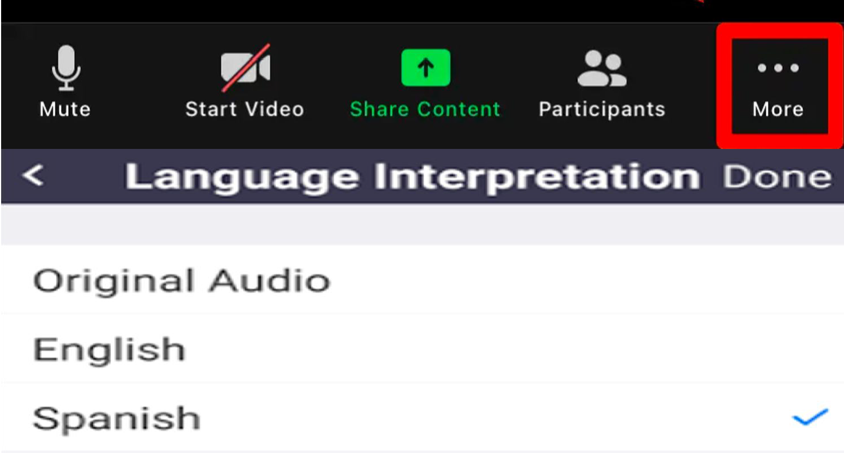
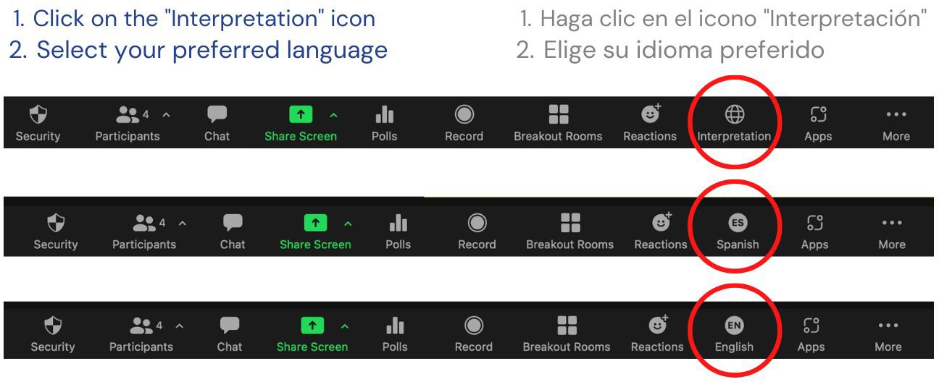
Welcome! ¡Bienvenidos!
Zoom Interpretation/Interpretación de Zoom
Computer / Computadora
Phone / Por Telefono

Slide 4



Welcome & Thank You for serving on the
Measure I Community Advisory Council

Slide 5

Public comment
on non-agendized items
Comentarios públicos sobre temas no incluidos en la agenda

Slide 6

Council Member Introductions

Slide 7
Measure I Community Advisory Committee
Kristel England | Parent Voices | Parent representative
Helen Myers | Parent | Parent representative
Adriana Arrizón | Health Action Together | Pediatric/Perinatal Health Systems
Jose Morales, MD | Retired Pediatrician | Pediatric/Perinatal Health Systems
Allison Murphy | Mother’s Care | Perinatal Health and Mental Health Care Systems
Brittany Lobo | Sonoma County Health Services | Pediatric/Perinatal Health Systems
Rachel Marcus | Aliados Health | Pediatric/Perinatal Health and Mental Health Care Systems
Norma (Milagros) Ott | Multi-Cultural Child Dev.Center | Subsidized Child Care Program representative
Melanie Dodson | 4Cs | Administrator Child Care Resource and Referral Agency
Zoe Teeter | Little Monarchs Preschool | Child Care Provider representative
Maria Isabel Menjivar | Menjivar Family Child Care | Child Care Provider representative

Slide 8

Measure I Orientation
April 24, 2025
Ben Gevercer

Slide 9
OVERVIEW
Measure I
  Sonoma County Child Care and Children’s Health Program Plan
  First 5 Sonoma County
  Community Advisory Council (CAC)
Conflicts of Interest
  Political Reform Act
  Government Code § 1090
The Brown Act
Draft Community Advisory Council Bylaws

Slide 10
Measure I
Imposes a ¼ cent sales tax.
The tax revenue must be used exclusively to:
  (1) increase access to high-quality child care, preschool, and early education services to benefit low- and middle-income children and families in Sonoma County;
  (2) improve wages and compensation for child care providers and early educators
  (3) maintain and protect the availability and accessibility of local health and mental health care services that are specific to the unique needs of infants, toddlers and pediatric patients;
  (4) support the efficient administration of tax proceeds.

Slide 11
Measure I Revenue
After covering administrative costs, Measure I revenue must be allocated as follows:
60% for expanding access to early learning and child care
40% to support health and wellness for children, including perinatal mental health

Slide 12
Purpose of the Child Care and Children’s Health Plan
Increasing, improving and maintaining access to quality early care and education for families and children
Improving workforce compensation of family child care providers and early educator employees
3. Improving children’s access to health and mental health care

Slide 13
Non-Supplementation Requirement
Measure I prohibits revenue from being used to “replace or otherwise supplant the tax revenue funding and other county or state funding and payments currently provided or otherwise available in support of health care providers and/or child care and early education providers.”
  In short, Measure I revenue must be used to expand programs.
  It cannot replace existing county or state funding for health care, child care, or early education providers.

Slide 14
Administering Agency
First 5 Sonoma County is responsible for developing and administering the Child Care and Children’s Health Plan, including:
(1) Developing the Child Care and Children’s Health Plan and Annual Expenditure Plan
(2) Allocating funds pursuant to the Annual Expenditure Plan;
(3) Developing, administering, overseeing implementation and evaluation of impact of all programs and services paid for by Measure I;
(4)Providing staff support for the Advisory Council;
(5) Developing the Program Plan Evaluation
(6) Operating with the intention to promote transparency and public accountability, and maintain good fiscal stewardship of public resources;
(7) Awarding funds pursuant to the contracting requirements applicable to First 5 and the requirements of Measure I

Slide 15
Community Advisory Council
(1/2)
Measure I establishes the Community Advisory Council (CAC) to provide recommendations to First 5 regarding:
(1) The Child Care and Children’s Health Program Plan and Budget;
(2) Initiatives to improve the quality and capacity-building of service providers;
(3) Initiatives to evaluate and improve access to programs, particularly including through the use of technology to streamline referral, navigation and linkage and better integration of services; and
(4) Strategies to enhance community engagement in the planning and implementation of services.

Slide 16
Community Advisory Council
(2/2)
The CAC consists of an 11 members appointed by the Board of Supervisors:
The first class of members will serve a combination of 2- and 4-year terms:
  5 members will serve a 2-year term
  6 members serving a 4-year term.
New members will serve staggered 4-year terms
Members are prohibited from serving on the council for more than 12 consecutive years
Members are appointed based on their experience and expertise, but as CAC members, represent the citizens of Sonoma County, not their employers
Members may draw upon their experience to inform their guidance to First 5 but should refrain from explaining how a First 5 decision would affect their employer

Slide 17
Child Care and Children’s Health Program Plan and Budget and Annual Expenditure Plan
First 5 will develop the Program Plan and Budget, including an annual budget, on a 5-year cycle for the use of Measure I funds, and will seek input from CAC
The Program Plan and Budget must be designed to meet the respective needs of regions throughout the County with respect to increasing, improving and maintaining access to quality early care and education for families and children, improving workforce compensation of family child care providers and early educator employees, and improving children’s access to health and mental health care
First 5 Commission and the Board of Supervisors must approve the Program Plan and Budget
The Board of Supervisors appropriates funds necessary to carry out the Program Plan and Budget

Slide 18
CAC is an Advisory Body, not a Decision-Making Body
CAC’s role is to provide strategic guidance and advice regarding the 5-year Child Care and Children’s Health Program Plan and annual expenditure plan, capacity building, improvements in administration of the Program, and community engagement
Measure I designates the CAC as an advisory body, not a decision-making body
This designation has important implications for conflict-of-interest purposes

Slide 19
Conflicts of Interest : Political Reform Act
Members of the CAC are not currently subject to Political Reform Act conflict of interest rules, which prohibit public officials from participating in a governmental decision in which they have a financial interest (e.g., if public official’s employer is likely to benefit from a decision, then public official must recuse from decision)
Under the Political Reform Act (PRA), advisory council members may become public officials subject to the Act if, over time, their recommendations are regularly approved without significant amendment or modification by another public official or governmental agency
First 5 will work with CAC to evaluate potential conflict issues as the CAC progresses with its work

Slide 20
Government Code § 1090
Prohibits public officials from being financially interested in any contract made by them in their official capacity, or made by a body or board of which they are members
Making a contract includes participating in or attempting to influence it at any stage of the process
Applies to advisory body members if they act as “trusted advisors” to public agency regarding contracts or qualify as public officials under PRA

Slide 21
Government Code § 1090
CAC’s role is to serve as an advisor to First 5 on the strategic 5-year plan, capacity building, improvements in administration, and community engagement
CAC members are not “trusted advisors” under 1090 because CAC’s role is to provide strategic guidance, not to provide input regarding RFPs, contract processes, or contract awards
CAC members must refrain from advocating for funding on behalf of their employers and from intervening with First 5 on contract matters
Compliance with conflict rules is a personal obligation of public officials, but First 5 will assist CAC to support compliance

Slide 22
The Brown Act
The Ralph M. Brown Act (also known as the Brown Act) is a California law that guarantees the public's right to attend and participate in local government meetings
The Brown Act applies to all legislative bodies of local agencies, including the CAC
All CAC meetings must be open and public except when the Brown Act authorizes otherwise

Slide 23
Brown Act Requirements
Notice for agenda posted in publicly accessible location 72 hours before a regular meeting; 24 hours before special meetings and one hour before emergency meetings
All persons must be permitted to attend
Public has the right to address the CAC via public comment with reasonable time limitations; cannot prohibit criticism but do not need to allow personal attacks or disruptive comment
Prohibits serial meetings, i.e. a majority of members of a legislative body outside of a lawful meeting may not directly or indirectly use a series of meetings to discuss, deliberate or take action on any item of business within the subject matter jurisdiction of the body

Slide 24
Brown Act: Use of Social Media
May use social media platforms such as Facebook and Twitter to engage in communications with the public regarding matters within CAC’s jurisdiction:
    Answer questions
    Provide information
    Solicit information
Prohibited from using social media platforms to engage in communications with a majority of your colleagues regarding matters within CAC’s jurisdiction, including through the use of emojis
Members are prohibited from using social media platforms to:
  Respond to a colleague’s post about matters within CAC’s jurisdiction (e.g., education, child care, etc.)
  Share a communication posted by another CAC member about a matter within the CAC’s jurisdiction

Slide 25
Brown Act: Remote Participation
Members may participate from a remote location provided that their location is identified on the agenda and is accessible to the public
A member may participate remotely without identifying their location if they have “just cause” or emergency circumstances:
“Just cause” is defined as one or more of the following:
  (i) a childcare or caregiving of need of a family member requires member to participate remotely
  (ii) a contagious illness that prevents a member from attending in person
  (iii) a need related to a physical or mental disability; or
  (iv) travel while on official business of the legislative body or another state or local agency
"Emergency circumstances" is defined as a physical or family medical emergency that prevents a member from attending in person

Slide 26
Draft CAC Bylaws (1/3)
Role of CAC:
Developing policy recommendations related to Measure I and its implementation, including but not limited to:
  Child Care and Children’s Health Program Plan and Budget
  2. Initiatives to improve the quality and capacity-building of service providers
  3. Initiatives to evaluate and improve the administration of programs, including using technology to streamline and integrate services
  4. Strategies to enhance community engagement in the planning and implementation of services
Promoting and facilitating transparency in the administration of the Child Care and Children’s Health Program Plan
Annually reviewing the audit of the Child Care and Children’s Health Program Plan
May provide input on the program plan evaluation conducted by First 5

Slide 27
Draft CAC Bylaws (2/3)
CAC Meetings
First 5 will facilitate CAC meetings and help set the agenda
A majority of actions will be recommendations to First 5
Meetings will follow a consensus-building decision-making process
Formal actions require approval by 2/3 of members present, as long as there’s a quorum

Slide 28
Draft CAC Bylaws (3/3)
Quorum
A quorum shall consist of a majority of appointed members
Amendment of Bylaws
Bylaw may be altered, amended, or repealed and new Bylaws adopted at any regular meeting or special meeting, provided that the substance of the proposed amendment has been submitted to the CAC and made available to the public at least 28 days in advance

Slide 29
QUESTIONS?

Slide 30
Council Action Item
Adopt Measure I CAC Bylaws

Slide 31
Overview of
First 5 Sonoma County & Administration of Measure I

Slide 32

California Children &
Families Act of 1998 (Prop.10)
“…intent of this act is to facilitate the creation and implementation of an integrated, comprehensive, and collaborative system of information and services to enhance optimal early childhood development and to ensure that children are ready to enter school.”

Slide 33
CA Children & Families Act of 1998 (Prop. 10) Statutory Goals
All CHILDREN, 0-5, ARE HEALTHY & DEVELOPING OPTIMALLY | EARLY LEARNING OPPORTUNITIES ARE DIVERSE & HIGH QUALITY
PARENT & CAREGIVERS ARE RESILIENT AND NURTURING | SYSTEMS OF CARE ARE SUSTAINABLE, INTEGRATED & COORDINATED
Notes:
ANGIE

Slide 34
First 5 Sonoma County Basics
One of 58 county-level Commissions
50 cent tax on tobacco products: declining core funding since 1998
Sonoma County Board of Supervisors authority
  Appoints Commissioners
  In 2019, BOS made First 5 Sonoma an independent public agency, separate from the County
First 5 Sonoma County Commission authority
  Independent authority over strategic plan, local Prop.10
  Administrator of Measure I funds, advised by CAC

Slide 35
First 5 Sonoma’s Foundational Principles
The
whole
community
benefits from optimal
child development
Children's experiences in the first 5 years set a trajectory for long-term outcomes.
Parents and caregivers are a child’s first and most important teachers and their voices are essential to design & planning.
The prenatal to age 2 period provides the greatest opportunity to maximize critical and long-lasting positive impacts on a child's developing brain.
Culturally responsive approaches and linguistic access are critical to addressing structural gaps in opportunity due to racism and other systemic exclusion.
Notes:
KELLY

Slide 36
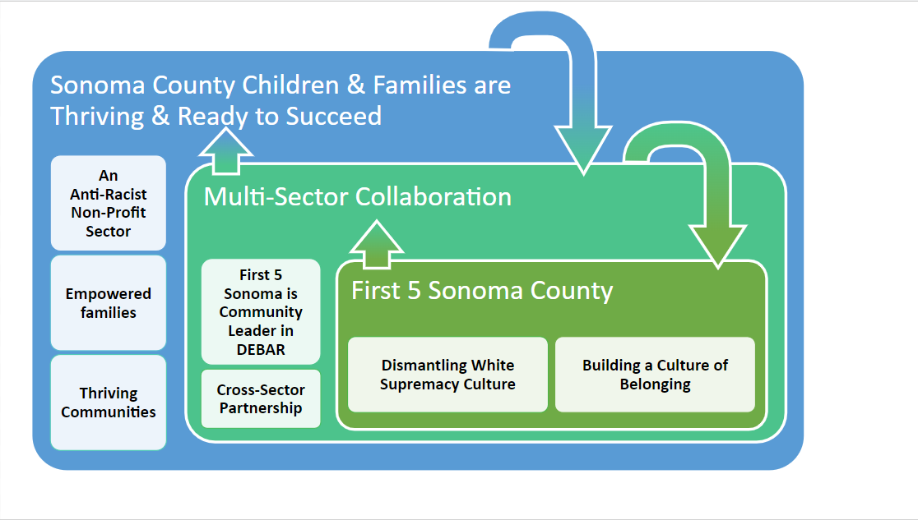
Advancing Diversity, Equity Belonging & Anti-Racism

Slide 37
Role of First 5 Sonoma County
Incubate, evaluate, scale, and sustain effective strategies
Engage stakeholders in understanding the needs of families and young children
Invest in improvement, integration and innovation of child-serving systems
Lead & engage in equity-centered, collaborative efforts
Advocate for policy that supports the well-being of children, caregivers and the field.

Slide 38
First 5 Sonoma’s Role as
Measure I Administrator
              Convene and staff the CAC to support development of recommendations in compliance with Brown Act
              Commission approves strategic plan & funding allocations
              Develop programming & administer funding contracts, pilots, grants, payments
              Evaluate impact of Measure I investments and report to the community
              Prudent financial management of sales tax revenue: robust accounting, ensure compliance with admin cost policy, prevent supplantation,
              Ensure responsive & streamlined business practices support funded partners
              Annual audit & reporting to Board of Supervisors & First 5 California

Slide 39
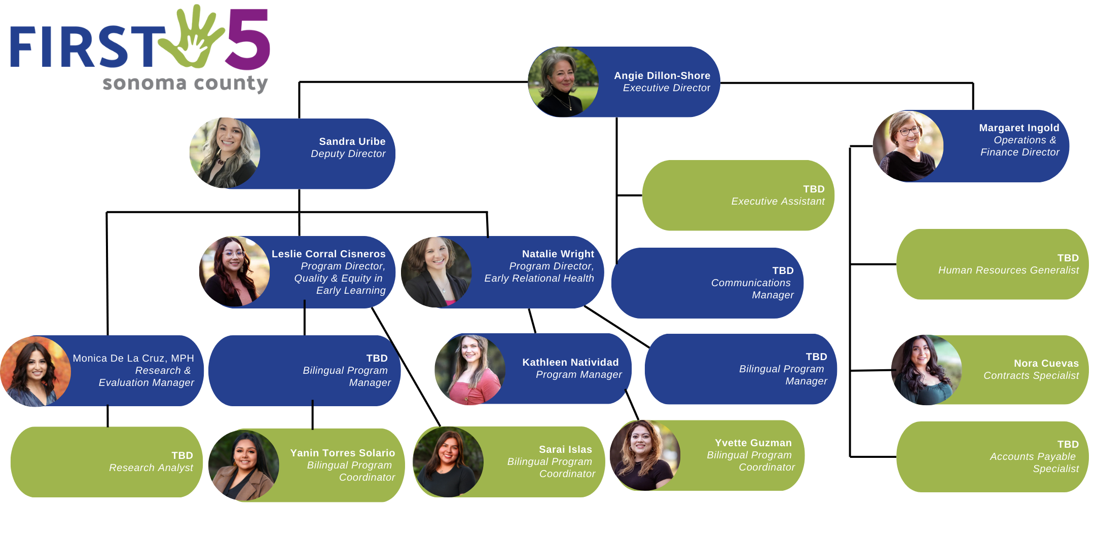

Slide 40
Questions?

Slide 41

Overview of the Strategic Planning Process
April - December 2025

Slide 42
First 5 Sonoma County Strategic Planning
Prop. 10 mandates each County Commission approve a strategic plan
Measure I Plan: “Child Care and Children’s Health Plan and Annual Expenditure Plan”
  Per Measure I - planning must be coordinated to reduce duplication
Plan Term: July 1, 2026 - June 30, 2031 (5 years)
The “Plan” will be approved by the First 5 Commission and then by the Board of Supervisors

Slide 43
Estimated Annual Tax Revenue to be Administered by First 5 Sonoma County
Prop. 10 |  | Measure I
Estimated Total Revenue FY 2025-26 | $2,500,000 | Estimated Total Revenue FY 2025-26 | $30,000,000
Notes:
$162,500,000 total estimated 5 year allocation+administration
~91% of the First 5 Sonoma County will be the investments from Measure I

Slide 44
Planning Inputs & Timeline
 | Apr | May | Jun | Jul | Aug | Sep | Oct | Nov | Dec | Jan
Community Engagement | ✔ | ✔ | ✔ | ✔ Report
F5 Staff Planning | ✔ | ✔ | ✔ | ✔ | ✔ | ✔ | ✔ | ✔
Measure I CAC | ✔ | ✔ | ✔ | ✔ | ✔ |  | ✔
Strategic Planning Committee |  | ✔ | ✔ |  | ✔ | ✔ | ✔
Ad-hoc Committee |  |  |  |  |  | ✔
First 5 Commission |  |  |  |  | ✔ |  |  | ✔ Draft | ✔ Adopt
Board of Supervisors |  |  |  |  |  |  |  |  |  | ✔ Adopt
Notes:
Strategic Planning Committee Members:
Denia Candela (F5 Commission)
Nora Mallonee Brand (F5 Commission & Department of Health Services)
Dr. Daisy Morales (F5 Commission & Santa Rosa City Schools)
Imelda Vera (F5 Commission & Humanidad)
Donna Broadbent (F5 Commission & Human Services Department)
Adriana Arrizon (Health Action Together)
Liz DePrimo (SCOE - CCPC)
Pedro Toledo (Petaluma Health Clinic)

Slide 45
Measure I: CAC Meeting Sequence
Apr
May
Jun
Jul
Aug
Oct
Orientation
Laying the
Foundation
Landscape &
Early Recommendations
Equitable Access to Quality ECE
Draft Recommendations
ECE Workforce Compensation Draft Recommendations
Health
Draft Recommendations
Final Recommendations
ECE means Early Care and Education and is the term used professionally in the field. Others may refer to this as preschool, child care, etc.
Notes:
Ad-hoc in September

Slide 46
Measure I: CAC Meeting Sequence
Apr
Orientation
Brown Act Training
Conflict of Interest Rules
Supplantation Rules
Overview of First 5 Sonoma County and Measure I
Action: Approve Bylaws
Lottery for CAC terms and other business matters

Slide 47
Measure I: CAC Meeting Sequence
May
Laying the
Foundation
ECE and Health Data Landscape
Existing ECE and Health Supports/Initiatives
Action: Elect Chair and Vice Chair
Action: Vote on the recommendation for release of early Measure I investments (August - December 2025)

Slide 48
Measure I: CAC Meeting Sequence
Jun
Equitable Access to Quality ECE
Topic Focus: Equitable Access to Quality ECE
Understanding what “Equitable Access” means in ECE
Indicators of ECE capacity, utilization, and quality
Share Back: What we have heard from Stakeholders
  Recommendations from Early Learning Systems Investment workgroup and others
Action: Draft recommendations related to Equitable Access to High-Quality ECE

Slide 49
Measure I: CAC Meeting Sequence
Jul
ECE Workforce Compensation
Topic Focus: ECE Workforce Compensation
Understanding challenges related to ECE Workforce Compensation
Share Back: What we have heard from Stakeholders
  Recommendations from Early Learning Systems Investment workgroup and others
Action: Draft recommendations related to ECE Workforce Compensation

Slide 50
Measure I CAC Meeting Sequence
Aug
Health
Topic Focus: Perinatal and Postnatal Health; Child Health (under age 6); Inclusive of Mental Health
Understanding challenges related to Health
Share Back: What we have heard from Stakeholders
Action: Draft recommendations related to Health
Notes:
FQHC
Focus Groups
Meetings/Interviews
Learning from pilots and existing
Listing of who has been met with
IPP Grant / UCAN Grant

Slide 51
Measure I: CAC Meeting Sequence
Oct
September: An ad-hoc workgroup comprised of a few CAC members and a few First 5 Strategic Planning Committee members will meet one time to understand progress and provide feedback on draft recommendations.
Feedback to the CAC will be shared and discussed in the October meeting prior to taking the final vote on recommendations.
Final
Recommendations
Action: Final Recommendations for ECE and Health

Slide 52
Measure I CAC Meeting Sequence
Apr
May
Jun
Jul
Aug
Oct
Orientation
Laying the
Foundation
Equitable Access to Quality ECE
ECE Workforce Compensation
Health
Final
Recommendations

Slide 53
Questions?

Slide 54
Stipends & Expense Reimbursements
Participation Stipend
        Eligibility: non-compensated members
        $35/hour of meeting attendance
Expense Reimbursement
  Eligibility: all members
  Child care: up to $75 per meeting
  Transportation: $.70/mile (federal mileage rate)
Submit form for each meeting
  Receipt from child care provider
  Google Maps showing mileage to meeting location and return

Slide 55

Lottery for CAC Terms
Five members will serve
2-year terms
Six members will serve
4-year terms

Slide 56

Next Community Advisory Council Meeting:
May 22, 2025
3:00-5:30 pm

